Slide 1
Corps Reservoirs
Elizabeth Nelsen and Brian Johnson
Hydraulic Engineers
29 Mar, 2012

Slide 2
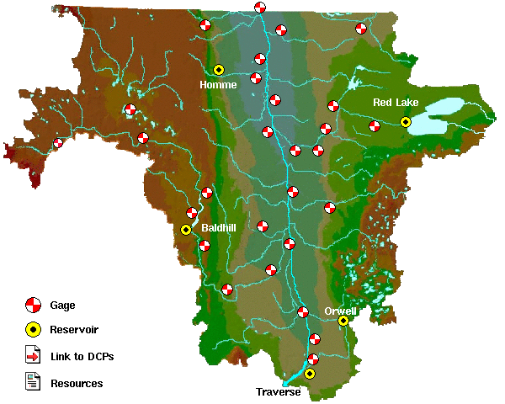
Red River of the North
All reservoirs are at conservation.
Red Lake’s inflow is greater than normal, the rest of the reservoirs are outflow = inflow.
East Grand Forks, MN
 | Current | Min
Site | Outflow | Outflow
Traverse | 150 | 0
Orwell | 630 | 80
Baldhill | 420 | 13
Homme | 25 | 0
Red Lake | 850 | 35
Moorhead, MN
City
Breckenridge, MN
No needed.

Slide 3
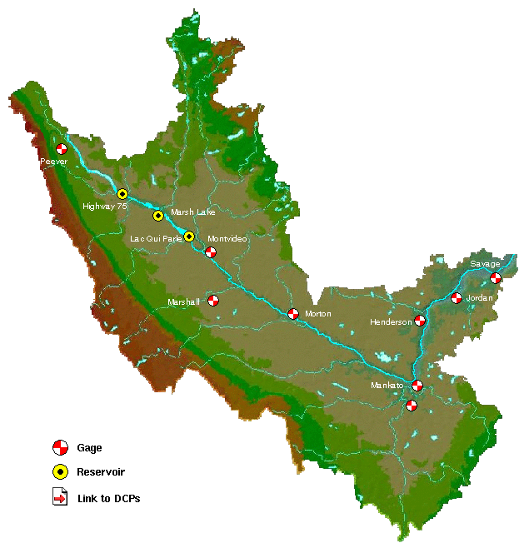
Minnesota River
Highway 75 and Marsh Lake are at conservation.
Lac qui Parle is half a foot above conservation until June 1.
Outflow = Inflow.
 | Current | Min
Site | Outflow | Outflow
Highway 75 | 350 | 2
LQP | 1500 | 20

Slide 4
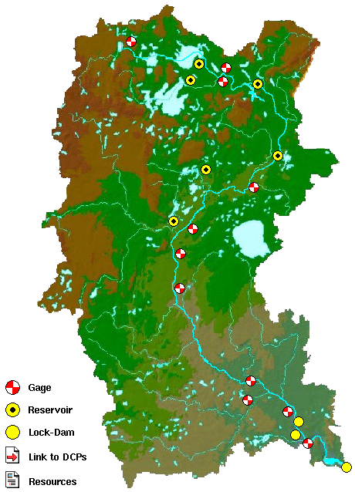
Headwaters of the Mississippi
Bemidji, MN
Winnibigoshish
Leech
Pokegama
 | Current | Reservior | Federal | Running | Min | Lower | Trigger
Site | Outflow | Elevation | Ave Min | Average | Outflow | Outflow | Res Elev
Gull | 42 | 1194.02 | 30 | 66 | 20 | 10 | 1192.75
Cross | 33 | 1228.94 | 90 | 178 | 30 | 15 | 1225.32
Sandy | 21 | 1215.51 | 80 | 66 | 20 | 10 | 1214.31
Pokeg | 440 | 1272.26 | 200 | 658 | 200 | W+L | 1273.17
Leech | 138 | 1294.29 | 70 | 134 | 120 | 60 | 1292.7
Winni | 145 | 1297.51 | 150 | 417 | 100 | 50 | 1294.94
Sandy
Cross/Pine
Aitkin, MN
Gull
Brainerd, MN
City
SAF
Lock 1
No needed.
Lock 2
St. Paul, MN

