Slide 1
Corps Reservoirs
Farley Haase
Hydrologic Technician
02 Aug, 2012

Slide 2
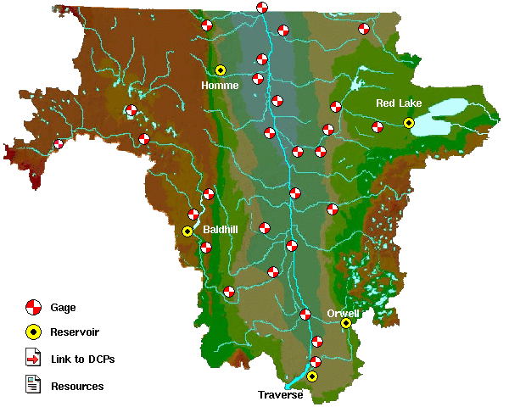
Red River of the North
All reservoirs are at conservation.
Outflow = Inflow.
East Grand Forks, MN
 | Current | Min
Site | Outflow | Outflow
Traverse | 0 | 0
Orwell | 700 | 80
Baldhill | 535 | 13
Homme | 13 | 0
Red Lake | 200 | 35
Moorhead, MN
City
Breckenridge, MN
No needed.

Slide 3
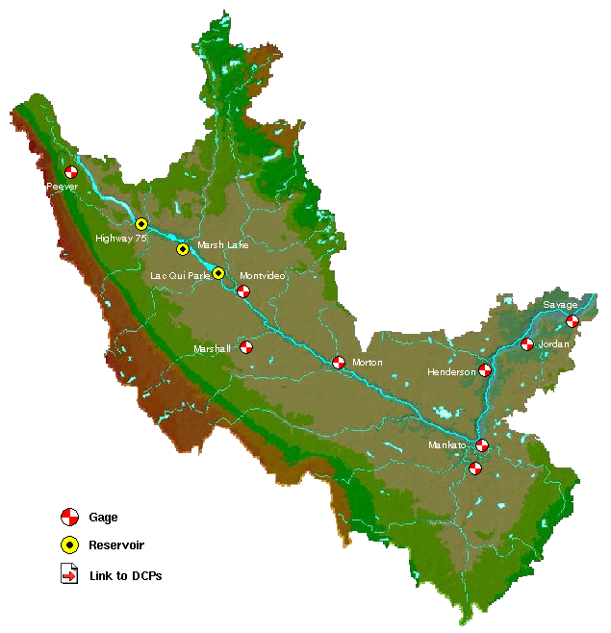
Minnesota River
All reservoirs are at conservation.
Outflow = Inflow.
 | Current | Min
Site | Outflow | Outflow
Highway 75 | 30 | 2
LQP | 200 | 20

