Slide 1
2012 Spring-Summer Weather Outlook Where we are, where might we be going…
National Weather Service
Diane Cooper
Service Hydrologist, NWS Twin Cities, MN
Mark Ewens
Data Acquisition Program Leader, Grand Forks, ND
March 29, 2012
Acknowledgement to Tom Hultquist, Science & Operations Officer

Slide 2
Outline
Local Research for MSP - Any Tele connections (Diane C.)
NWS Climate Prediction Center (CPC)
Models (Diane C.)
Other Considerations (Mark E.)
Official Forecasts (Mark E)
Low Flow Probabilistic Outlook Graphics (Diane C.)

Slide 3
Local Research for MSP Any Tele-Connections Given our Dry and warm Winter/Spring? Diane Cooper

Slide 4
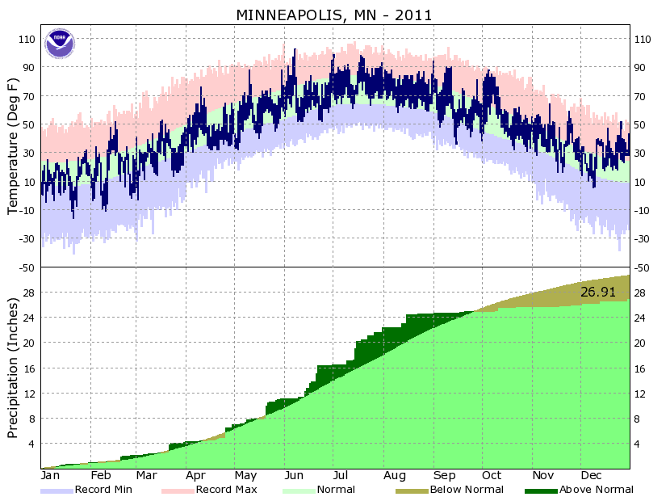
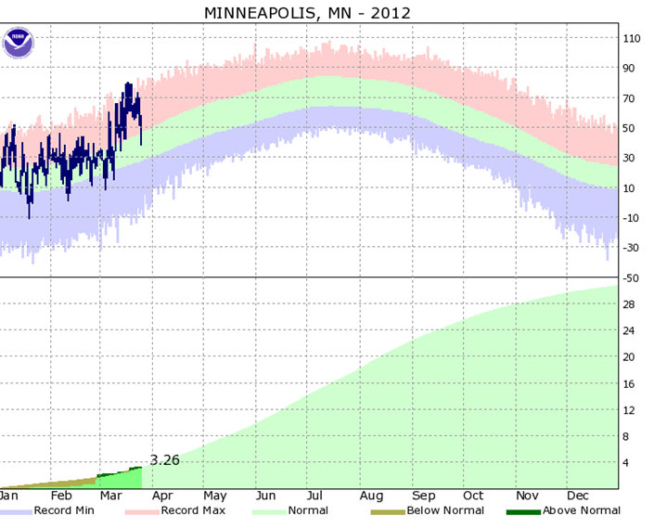
Facts & Figures
Rapidly Transitioned from wet to dry conditions in August 2011, and have remained in that regime.
August 15, 2011 – March 26, 2012 (225 day comparison back to 1850 for Twin Cities)
Warmest on record
11th driest on record. (for the study period we were #2)
Notes:
http://www.crh.noaa.gov/mpx/Climate/MSPClimate.php
Records comparison from xmACIS

Slide 5
Looking Forward
Monthly and seasonal outlooks are based on a variety of information
Past analogs
Dynamical models
Empirical/statistical models
Tele-Connections / Climate Drivers
ENSO, NAO, AO, PDO, PNA, etc.
Focused on March – July 2012
Utilized analogs, dynamical model (CFSv2), ENSO, and NAO information

Slide 6
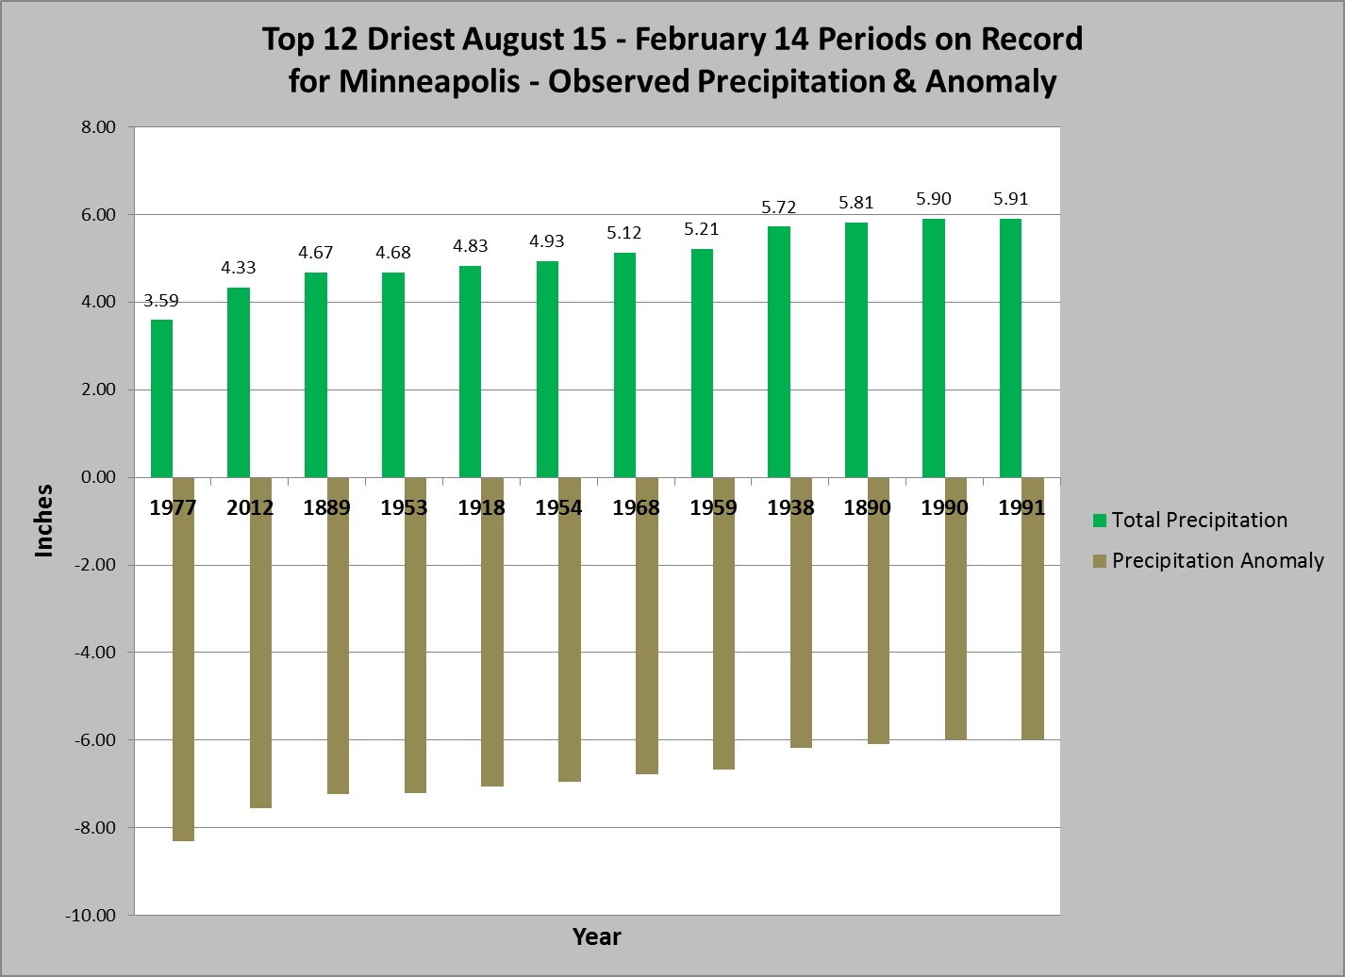
Driest Years (August 15 – February 14)

Slide 7
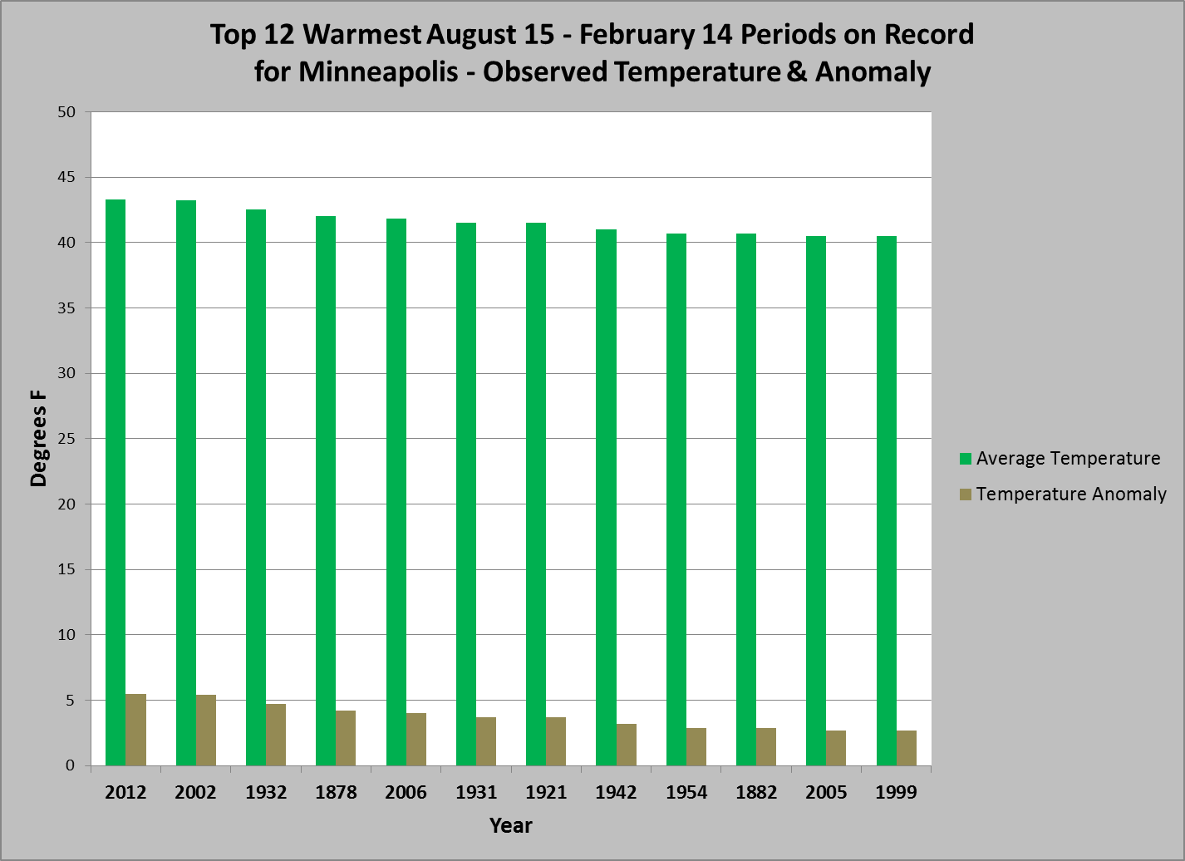
Warmest Years (August 15 – February 14)
Notes:
Atmospheric pattern wise – several times the analogs in the winter have seen similar patterns to 1954 (Very unusual pattern in March did not show consistent analogues.)

Slide 8
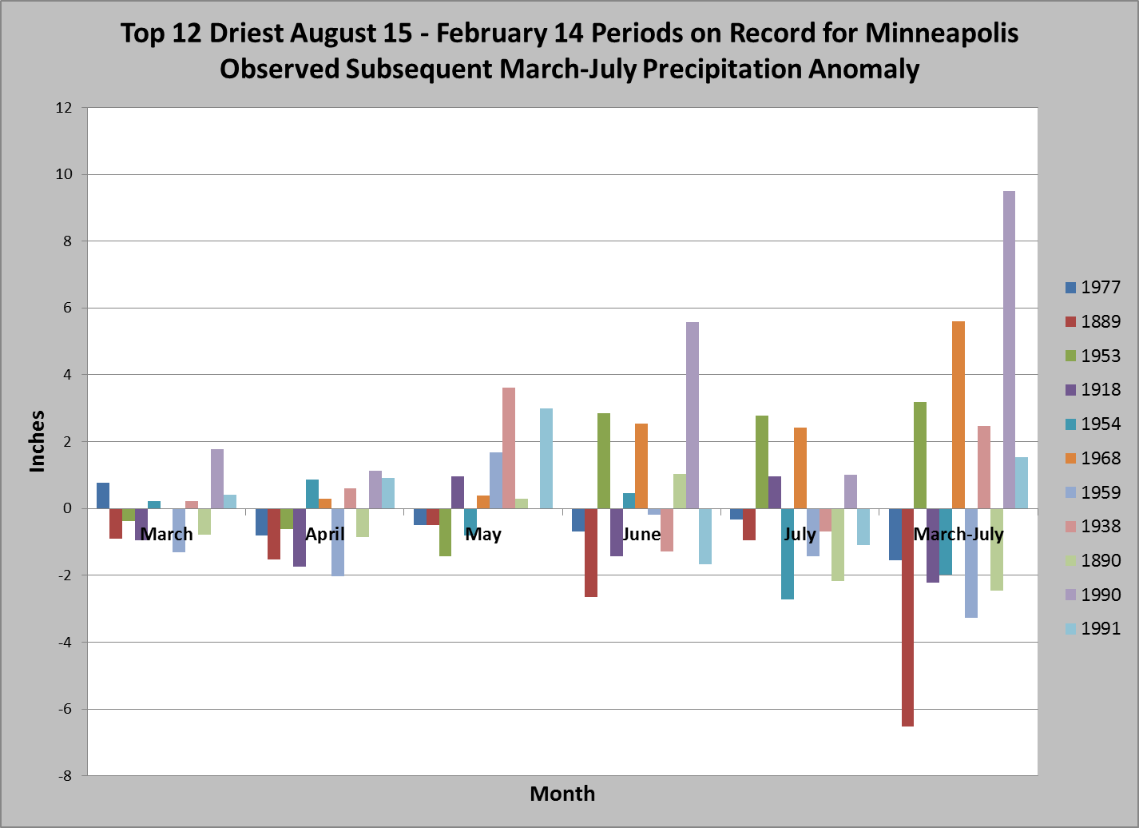
Driest Years – Future (March – July) Precipitation
1990 influenced by a few events in June.
Notes:
Zero is subtracting the normal value. So just as many years excess above normal as excess below normal in the late spring/summer months if they had been dry in the fall/winter.

Slide 9
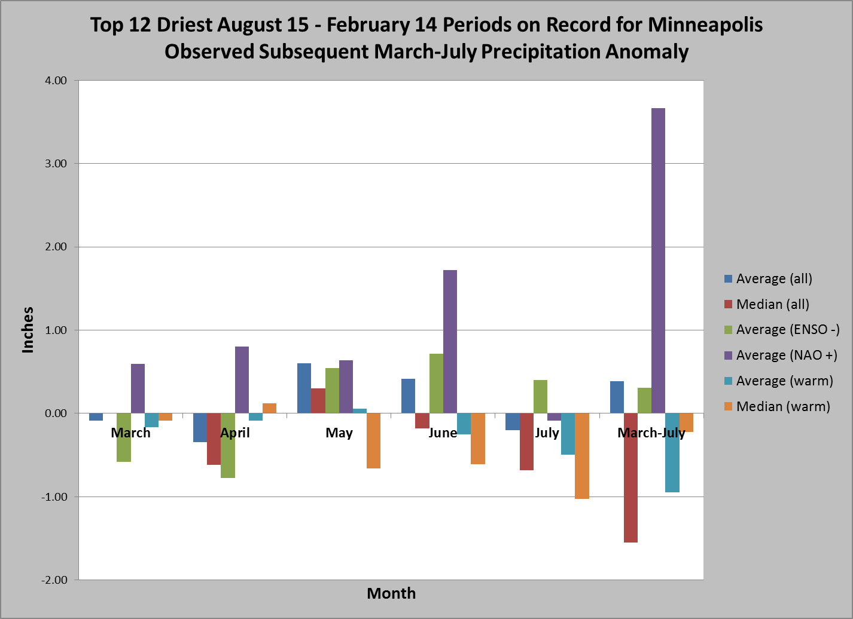
Driest Years – Future Precipitation Averages
Notes:
Looking at if there are any sea surface temp or Atmospheric pattern signals – not really
ENSO – is a La Nina pattern or the Pacific Temperatures are cooler than normal. Typical (but not always) winter weather pattern influences of La Nina’s/El Nino’s http://www.cpc.ncep.noaa.gov/products/analysis_monitoring/ensocycle/nawinter.shtml

Slide 10
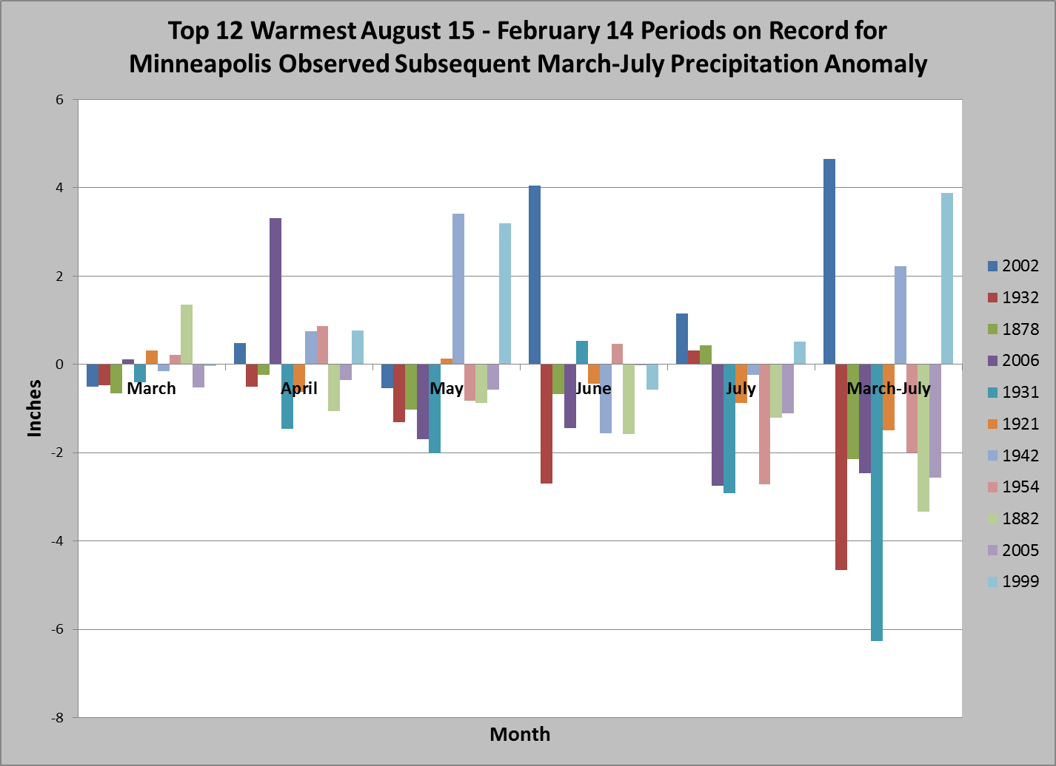
Warmest Years – Future (March – July) Precipitation
4/6/02 - 2.58 in
6/21/02 2.95 in
5/29/42 2.49 in
Notes:
Individual events influenced some of the “wet” months. Not sure of the overall influence on the Hydrologic situation unless they were widespread vs. individual thunderstorms with heavy bursts that happened to hit MSP.

Slide 11
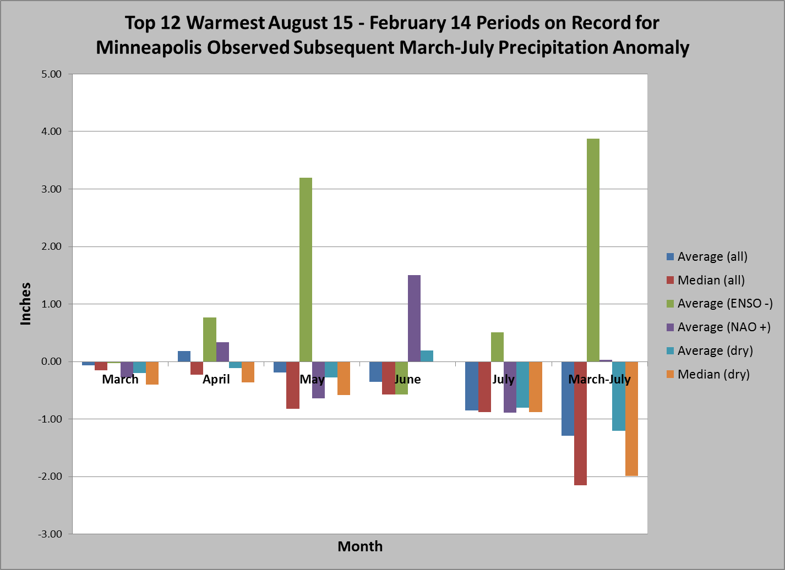
Warmest Years – Future Precipitation Averages

Slide 12
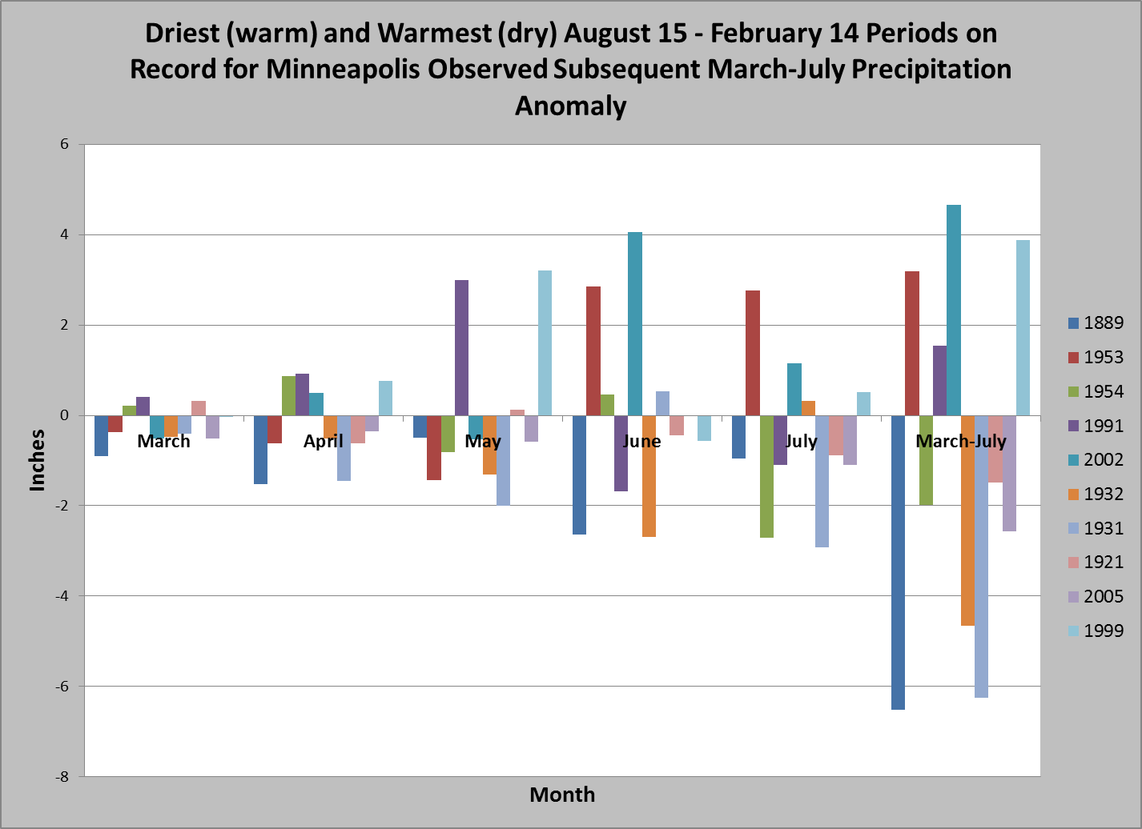
D/W & W/D Years – Future (March- July) Precipitation
While there are some wet years in this cluster, avg. trend is for below normal precip.

Slide 13
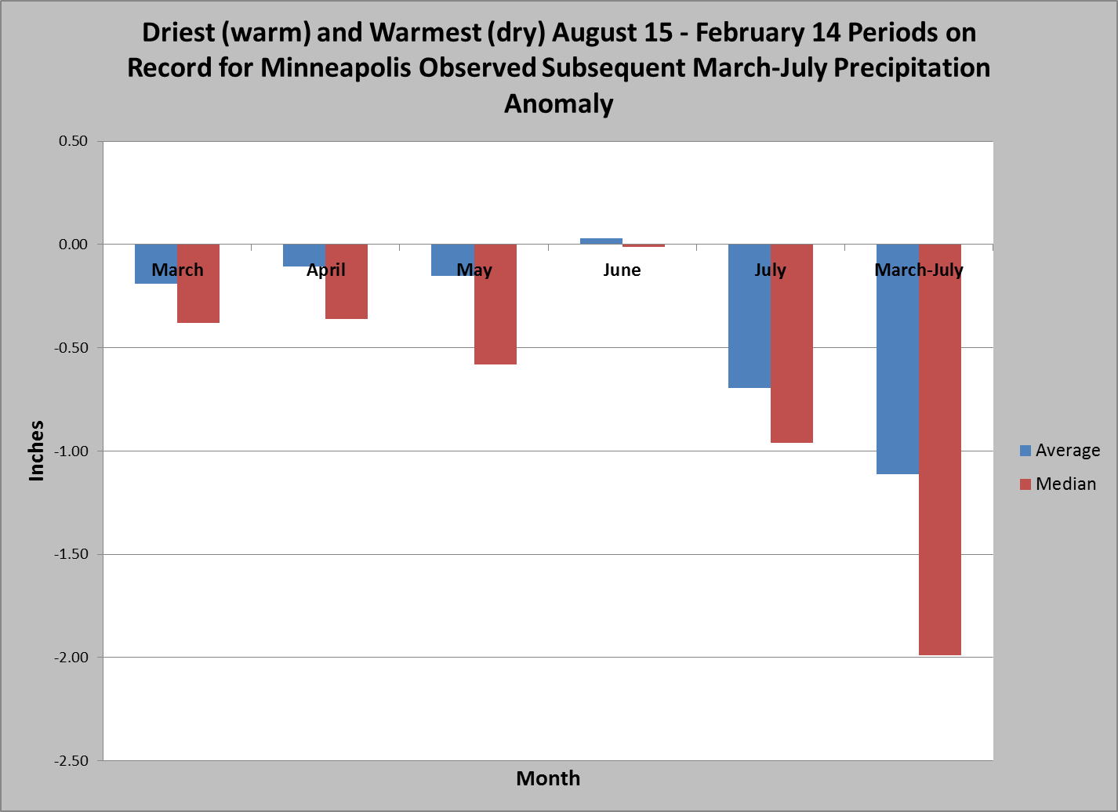
D/W & W/D Years – Future Precipitation Averages

Slide 14
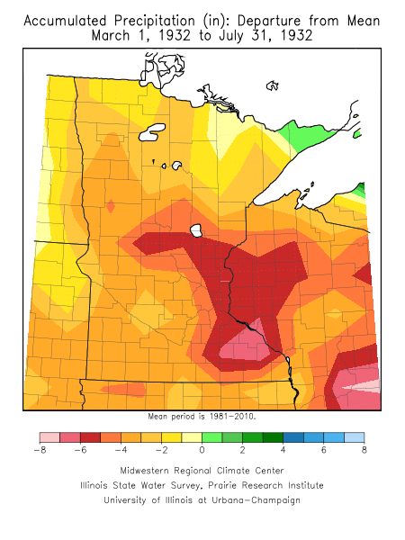
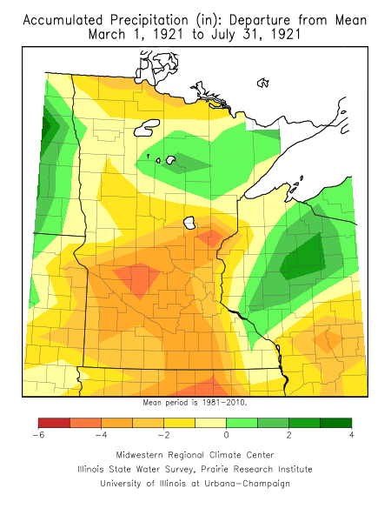
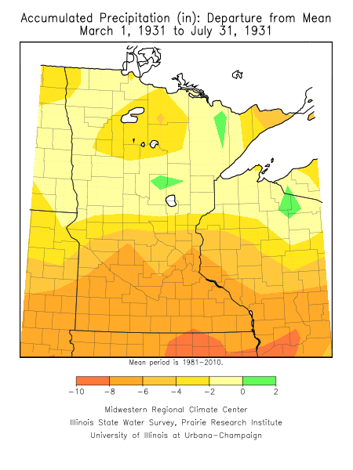
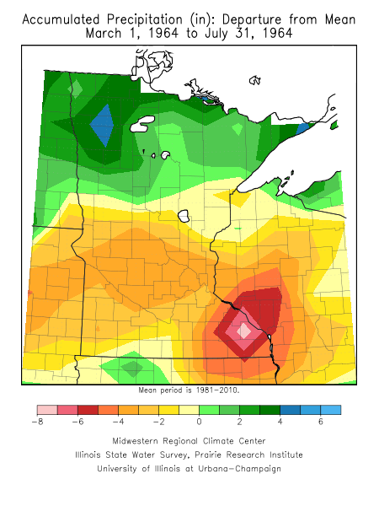
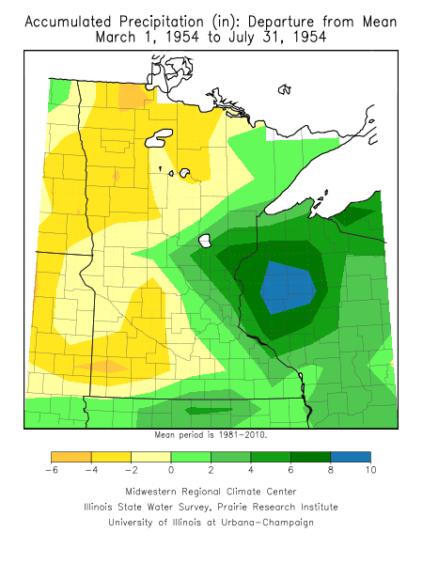
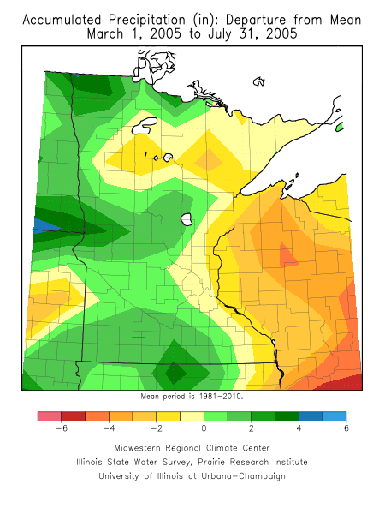
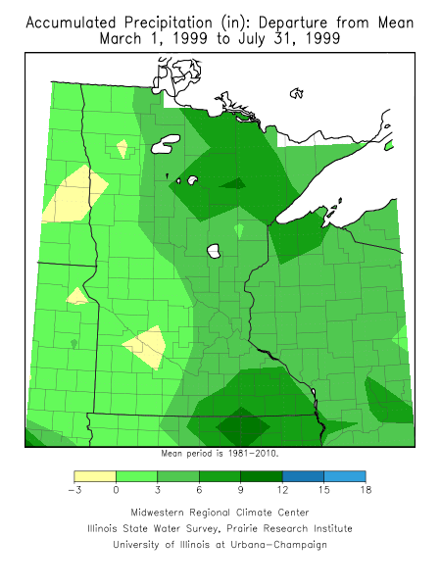
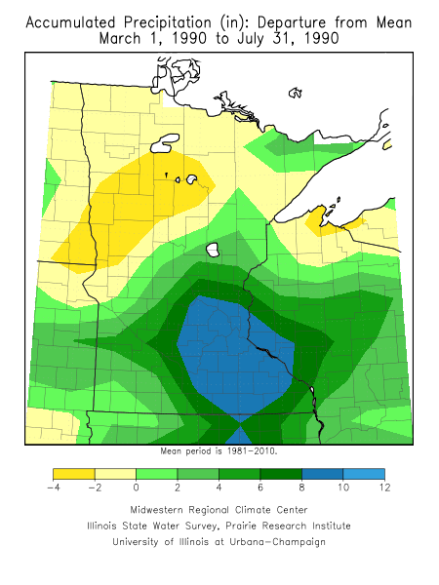
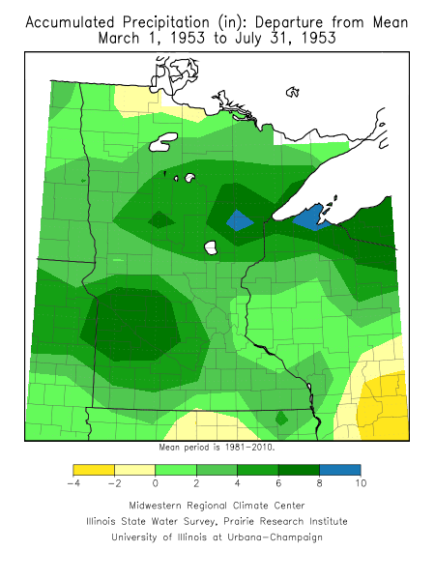
D/W & W/D Years – Future Precipitation Departures What actually occurred.
Dry years on the top; Wet years on the bottom

Slide 15
NWS Climate Prediction Center (CPC) Models Diane Cooper

Slide 16
Climate Forecast System (CFSv2)
Dynamical model
Approximately 80 km resolution
Global
Coupled atmosphere, ocean, land surface
Sixteen runs each day
Four 9-month forecasts
Three 3-month forecasts
Nine 45-day forecasts
Results are blended into various ensemble products
Demonstrates some skill in monthly and seasonal outlooks
Particularly for temperature & ENSO
Precipitation forecasts are more problematic
http://origin.cpc.ncep.noaa.gov/products/people/wwang/cfsv2fcst/

Slide 17
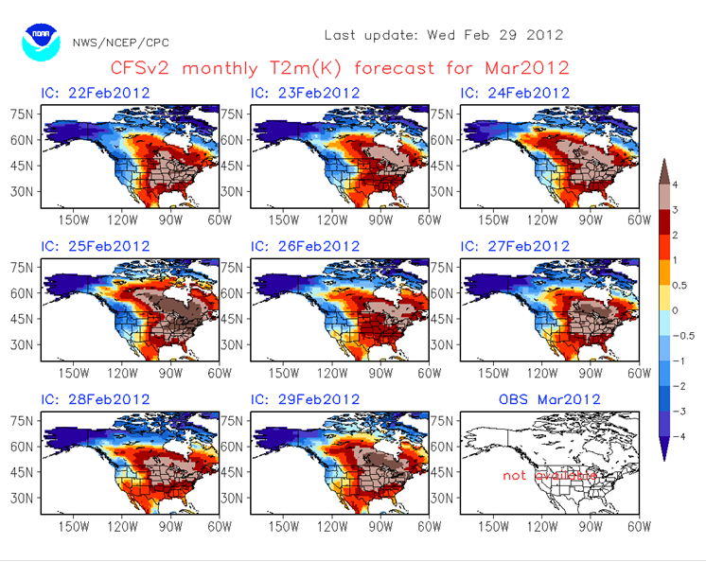
What was CFSv2 forecast for March
Temperatures
Notes:
http://www.cpc.ncep.noaa.gov/products/people/mchen/CFSv2FCST/monthly/images/summaryCFSv2.NaT2m.201203.gif

Slide 18
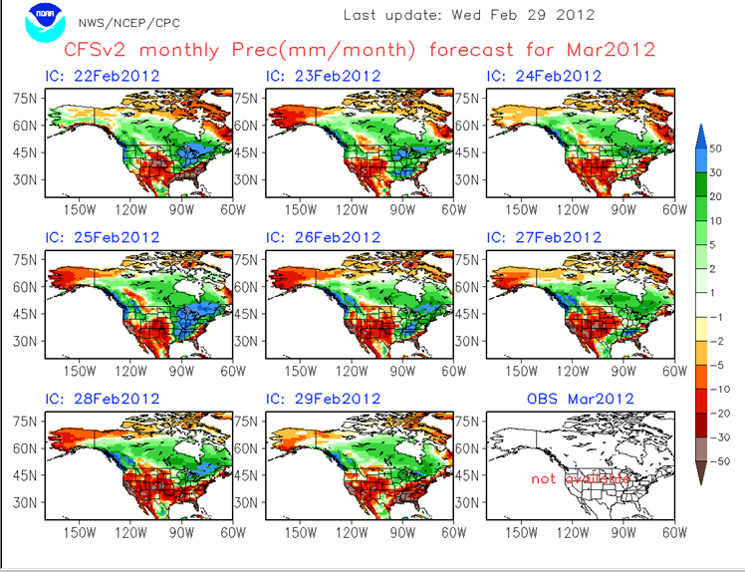
What was CFSv2 forecast for March –
Precipitation
Notes:
More skill in temperatures than precipitation especially as you move into convective/thunderstorm season.

Slide 19
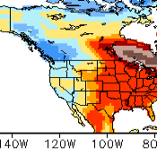
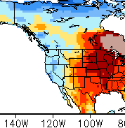
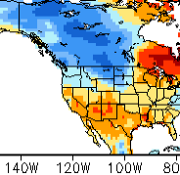
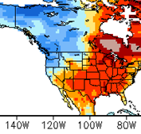
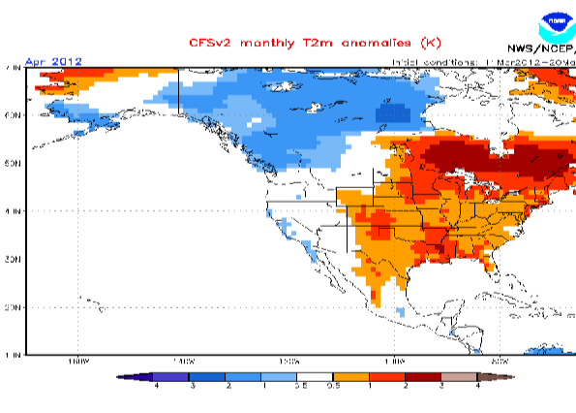
What CFSv2 showing for April
Temperature
Mar 7
Mar 21
Mar 27
Mar 26
Blues - areas of below normal.
Reds – areas of above normal.
Models will flux a bit day by day; so it is good to look at a multi day average to see the overall trend.
March 11 thru 20th - 10 day average for April temperatures
Notes:
Latest 10 average model runs for monthly outlooks - http://origin.cpc.ncep.noaa.gov/products/people/wwang/cfsv2fcst/imagesInd3/usT2mMonInd1.gif
Link to each day’s model runs
http://www.cpc.ncep.noaa.gov/products/people/mchen/CFSv2FCST/monthly/

Slide 20
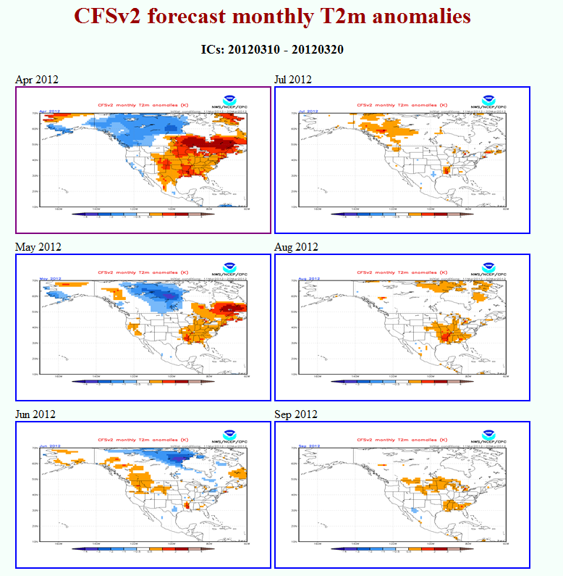
Ensemble Monthly Temperature Forecasts
Average Temperature for the Month.
Blues - areas of below normal.
Reds – areas of above normal.
White – no clear signal either way.
Notes:
http://origin.cpc.ncep.noaa.gov/products/people/wwang/cfsv2fcst/htmls/usT2me3Mon.html

Slide 21
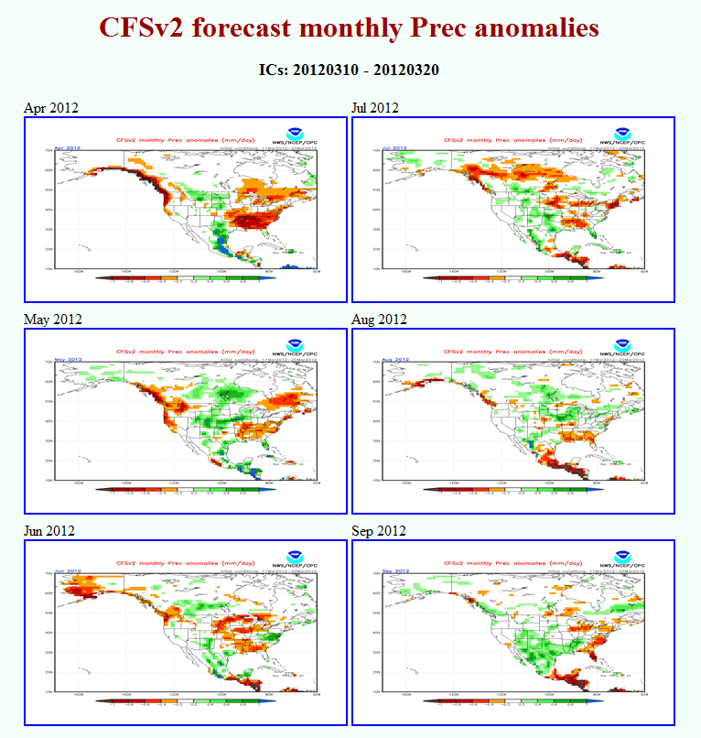
Ensemble Monthly Precipitation Forecasts
Average Precipitation for the Month.
Reds - areas of below normal.
Greens – areas of above normal.
White – no clear signal either way.
Notes:
http://origin.cpc.ncep.noaa.gov/products/people/wwang/cfsv2fcst/htmls/usPrece3Mon.html

Slide 22
Other Considerations for CPC Official Forecasts Mark Ewens

Slide 23
Climate Attribution Fall 2011 through Winter 2012
A borderline moderate La Niña had developed last fall and was expected to bring an enhanced risk of a colder and snowier winter season.
A strongly positive North-Atlantic Oscillation (NAO) developed, essentially trapping the coldest air north over Alaska and the Eastern Hemisphere.
In concert with a predominantly positive Arctic Oscillation (AO), the Polar Jet was displaced to the west and north of the region. The sub tropical jet dominated bringing some drought relief to the southern plains.
Late in the winter the AO turned neutral to weakly negative yet the impacts were minimal. A brief return to a strong positive phase helped with the March “Heat Wave”

Slide 24
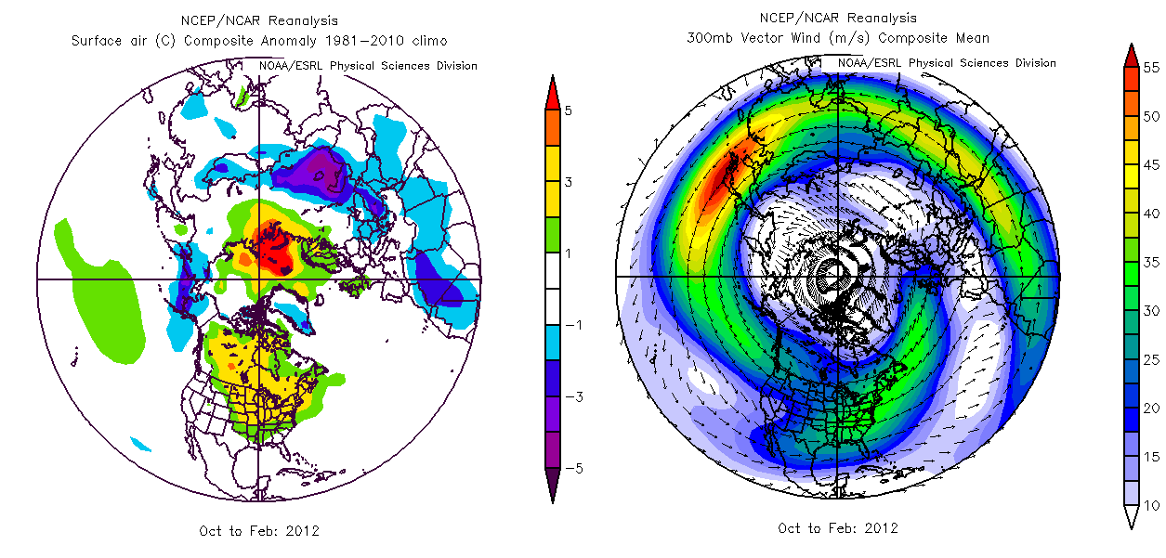
Cold Season Hemispheric Patterns

Slide 25
Near Term Outlooks (April)
Recent changes to the global patterns suggest a wetter period the next few weeks.
This will probably spell some relief to areas suffering drought, but most areas will not get enough precipitation to reverse it.
Research suggests that after periods of prolonged extremes, the atmosphere ‘flips’ in an attempt to rebalance.

Slide 26
Spring Transition to Summer
La Nina forecast to weaken, leaving ENSO neutral conditions in the Pacific.
Classic fading La Nina conditions over Minnesota include a bias toward wetter than average conditions in the north; drier south.
Temperatures tend toward normal climatic variability.

Slide 27
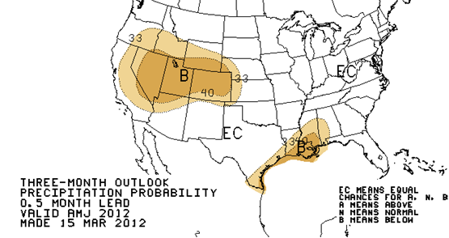
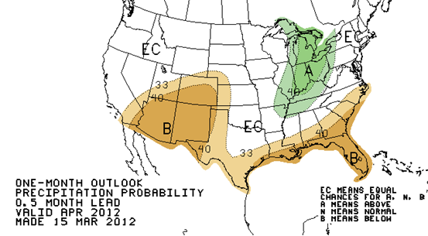
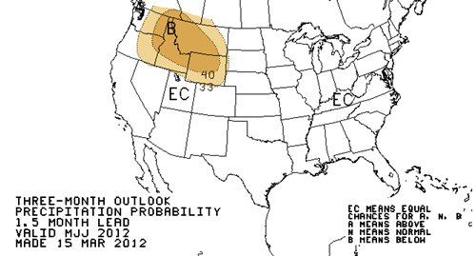
Spring/Early Summer CPC Precipitation Forecast
Apr, May, Jun outlook
April outlook
May, Jun, July outlook
Equal Chances of Above or Below normal for April as well as the 3 month the periods of A,M,J and M,J,J.

Slide 28
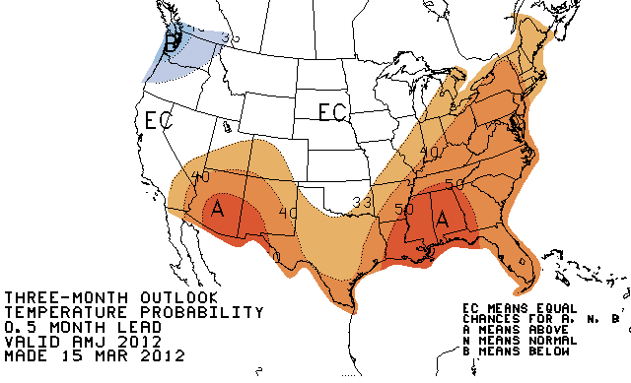
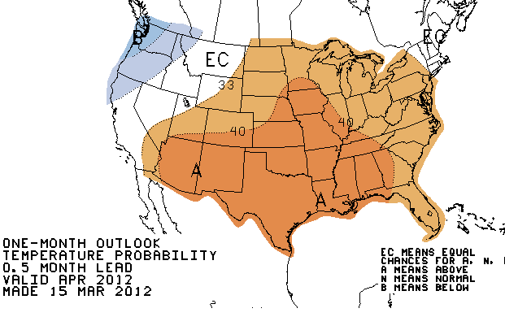
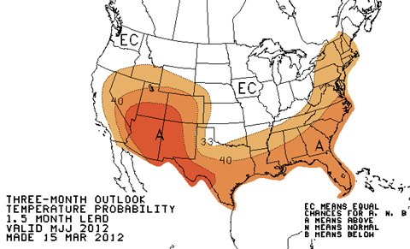
Spring/Early Summer CPC Temperature Forecast
Apr, May, Jun outlook
April outlook
May, Jun, July outlook
Above Normal Temps for April but transition to Equal Chances for Above Normal temps for the periods of A,M,J and M,J,J.
http://www.cpc.ncep.noaa.gov/
Notes:
CPC 90 day products http://www.cpc.ncep.noaa.gov/products/predictions/90day/

Slide 29
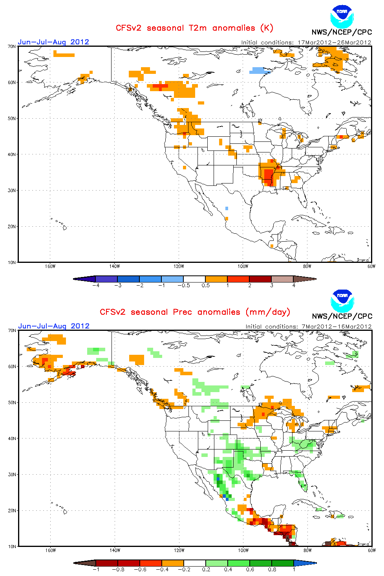
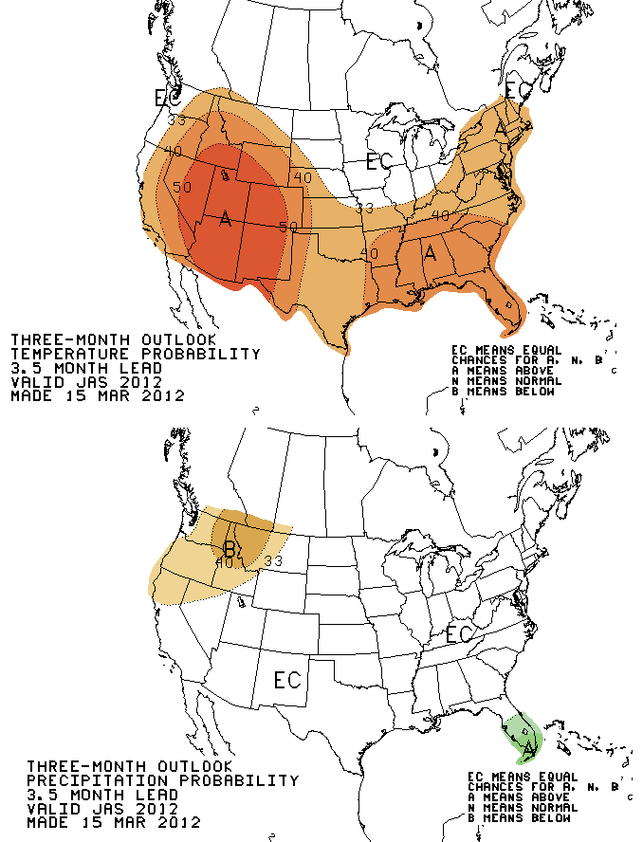
Longer Term Summer 2012 Outlooks (July, Aug, Sept)

Slide 30
Long Term Outlook - Impacts
At this time, it would appear that the expected precipitation patterns the next few weeks will have some beneficial impacts on drought conditions.
Should the computer models verify, the late spring through summer will feature a greater likelihood of warmer and drier conditions returning especially last half summer.
Depending on the magnitude of the warmth and potential precipitation deficencies drought conditions could worsen later in the summer.

Slide 31
Low Flow Probabilistic Outlook Graphics Potential Implications to Rivers Diane Cooper

Slide 32
Low Flow Outlooks.
Where to find on NWS AHPS Pages

Slide 33
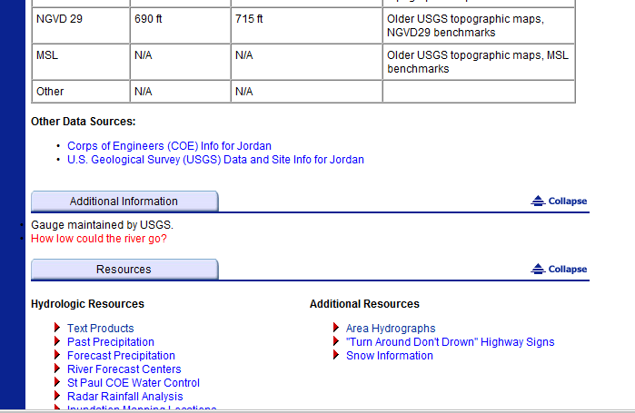
Potential Implications to Rivers.
Location of Low Flow information
Low Flow Information

Slide 34
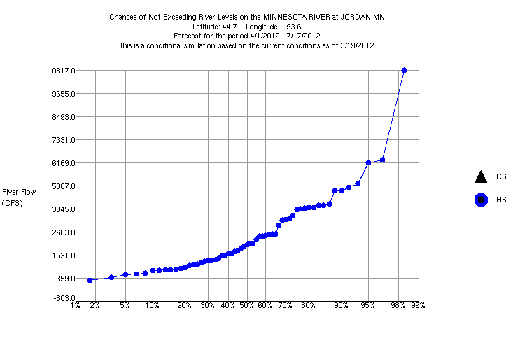
“Normal” Historical Low flows
3 month window
The blue line considered “normal” for flow. So Risk of not exceeding a specific level /Low flow Climatology.
A critical level is ~ 2700 cfs. So the risk of the river of not falling below this level for any given year between April – July is ~ 67%.
A critical level is ~1000cfs, risk of the river falling to this level is ~ 20%
~20 %
~67%
*The Simulated Historical Distribution may not “exactly match” the actual observed historical flows, but the relative risk percentages are still comparable.

Slide 35
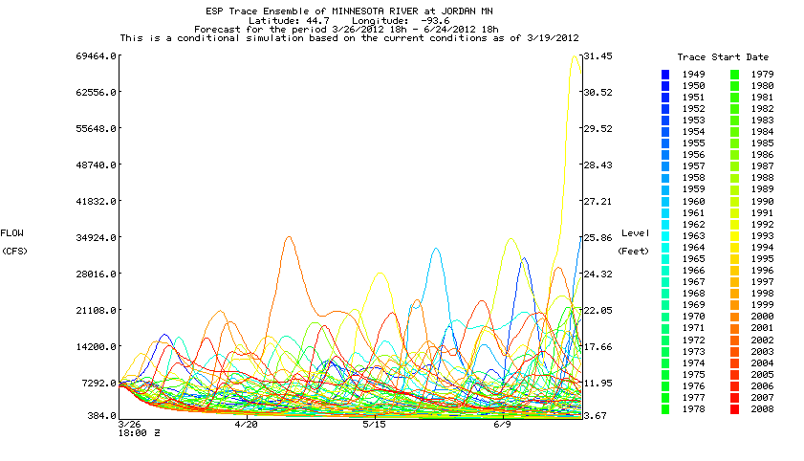
Condition Traces (CS) How are they Created?
Each “triangle point” is obtained from the lowest point in each year’s 3 month window simulation (in this case 3/26 – 6/24).
60 years of Temperature and Precipitation information. (1949 – 2008)
Each line represents the response if the Temperature and Precipitation was the same as XX year for the 3 month period. From this we can glean a range of extremes of how low and high the water could be this year based of our past history. (Temperature is a factor from an Evaporation perspective.)
Unlike spring melt high flow graphics, late Spring/Summer graphics are highly dependent on individual rainfall events.
Notes:
http://www.crh.noaa.gov/Image/ncrfc/data/ahps/JDNM5.traces.gif

Slide 36
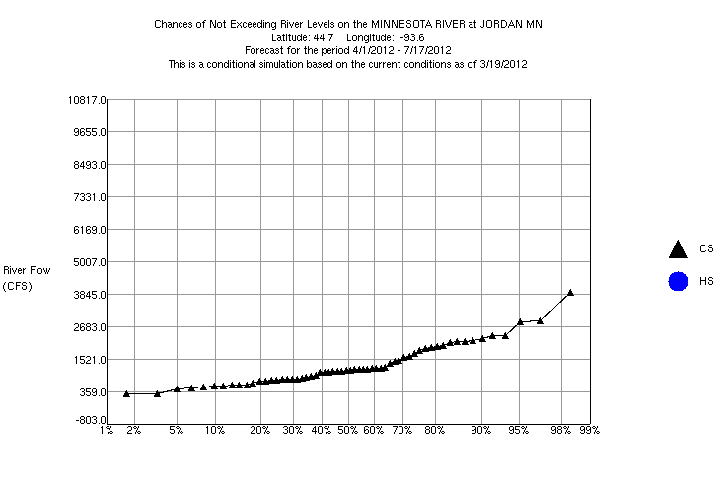
“Conditioned” Low Flow Risk
Based on current soil moisture and past 60 years of temps and precipitation.
Black line - risk for a specific “3 month period” for this year that levels will not exceed a specific level at least once in the period.
A critical level is ~ 2700cfs, likelihood (risk) that the river will fall below that level level between April – July this year is ~ 95%.
A critical level is ~1000cfs, the risk between April – July is ~ 30% that it will reach/fall below 1000 cfs this year.
~30%
~95%

Slide 37
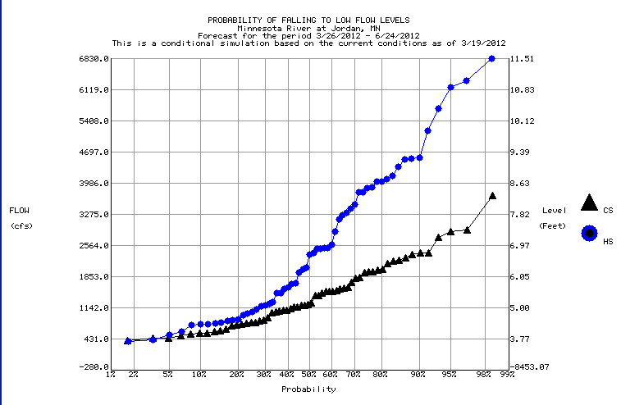
Probability of Low Flows
Combined traces
Combined historical and conditional plots provide a perspective of above below or normal conditions.
Say your critical level is ~ 1800cfs, historically we have a 45% that the river reaches/falls below this level, but this year it is 72% chance of reaching/ dropping below 1800cfs. (i.e. dryer than normal)
Probability
~45%
~72%

Slide 38
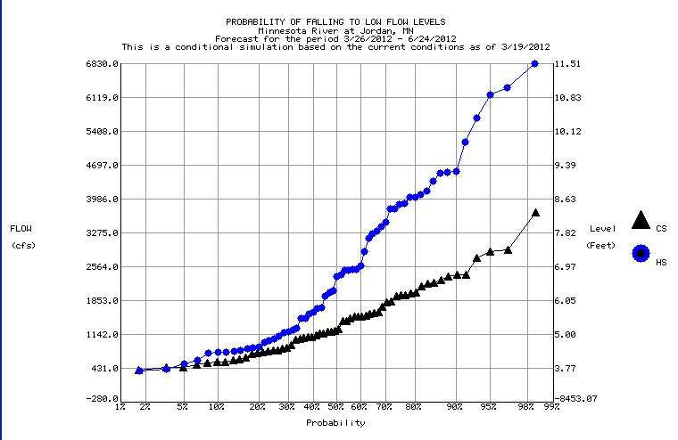
“Low Flow” Risk A general way to look at these graphics
Rule of thumb – when the Black line is to the Right of the Blue, conditions are dryer than normal and higher risk for not exceeding a specific flow level.
Historically the dryer years produce the “lower “ CS probabilities.
Historically the wetter years (which may include only one or two BIG rain events) are driving the “higher” CS probabilities.
Simulations from Wet years
Simulations from Dry years

Slide 39
How/When to use the Low Flow Graphics
Information is “most appropriate” once we get through the “wetter” spring months.
Spring also allows RFC to tweak our model and double check soil moistures (observed and simulated) after coming out of the frozen season.
With the end of May updates, the 3 month graphics will be more applicable (June, July, Aug)
If partners have special needs, we extended model runs through Sept.
**Probabilistic Graphics Update Schedule- April 27th, May 25, June 29, July 27th, Aug 24th

Slide 40
Contact Information
Diane Cooper
Service Hydrologist – NWS Twin Cities, MN
Diane.Cooper@noaa.gov
952-368-2542
Mark Ewens
DAPM – Grand Forks, ND
Mark.Ewens@noaa.gov
701-772-0720X327
All NWS Offices have Facebook Pages.
Search for “US National Weather Service (Twin Cities, Grand Forks, Duluth, La Crosse, Sioux Falls, or Aberdeen)”

