Slide 1
National weather service – Grand Forks drought summary for northwest minnesota MN drought task force conference call – August 2, 2012
Brad Bramer – Science and Operations Officer

Slide 2
Red River Valley July 2012 Weather Summary
Fargo had the 2nd warmest July on record with an average temperature of 76.6 degrees F. This was 5.6 degrees above the 1981-2010 normal period. July precipitation in Fargo was slightly above average with 2.88 inches (departure of +0.09”).
The Grand Forks airport (records since 1941) had the warmest July on record with an average temperature of 74.8 degrees F. This was 6.2 degrees above the 1981-2010 normal period. July precipitation in Grand Forks was slightly above average with 3.35 inches (departure of +0.20”).

Slide 3
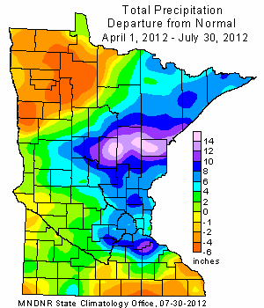
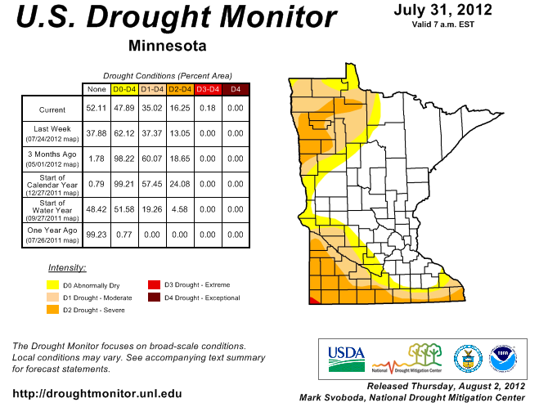
Growing Season Precip. Summary
Growing Season Precipitation Departure (MN DNR)
MN Drought Monitor – July 31 (NDMC)

Slide 4
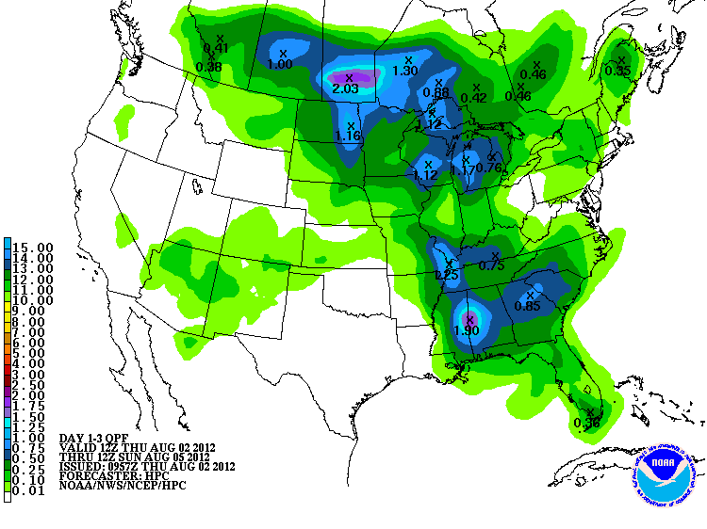
Short-term precipitation forecast (some relief by the weekend?)

Slide 5
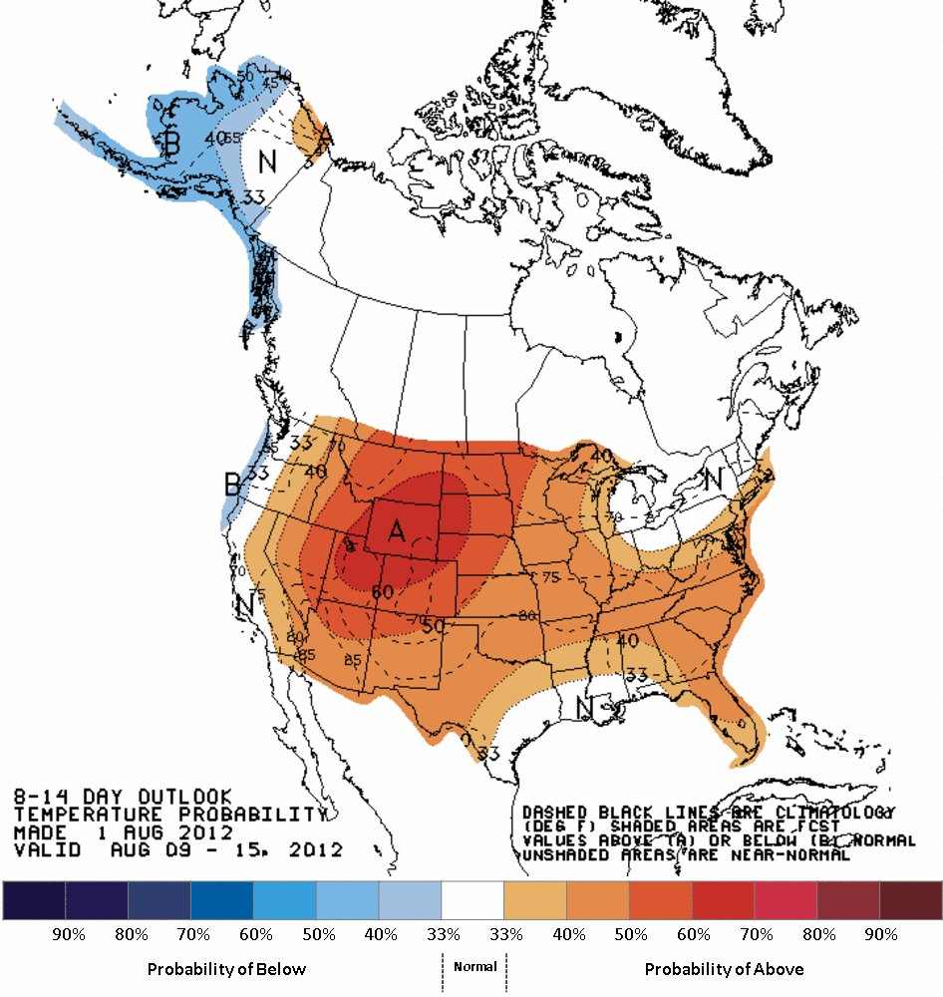
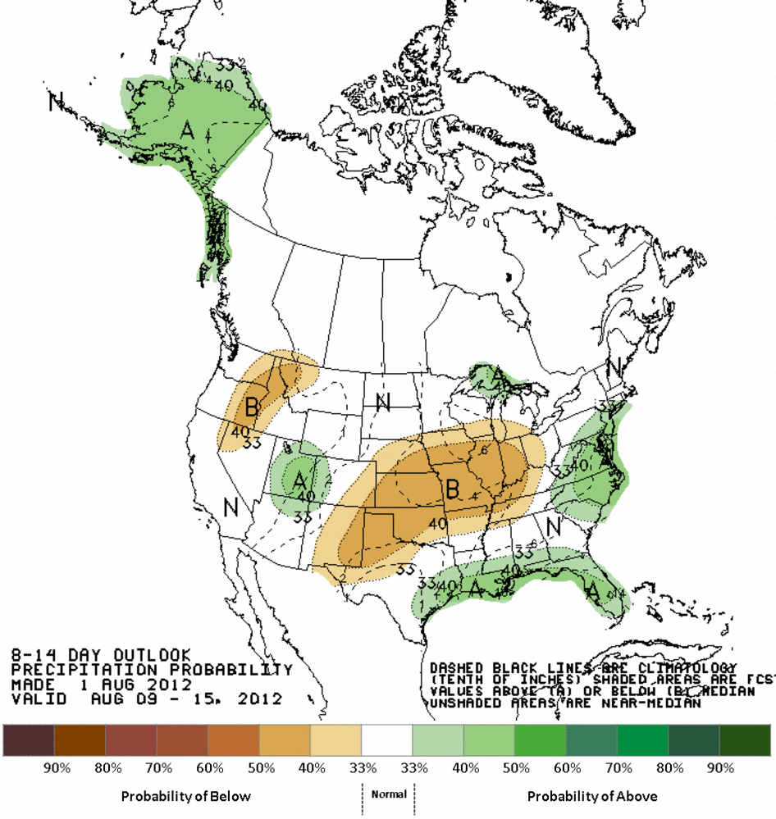
8-14 day outlooks
Temperature
Precipitation

Slide 6
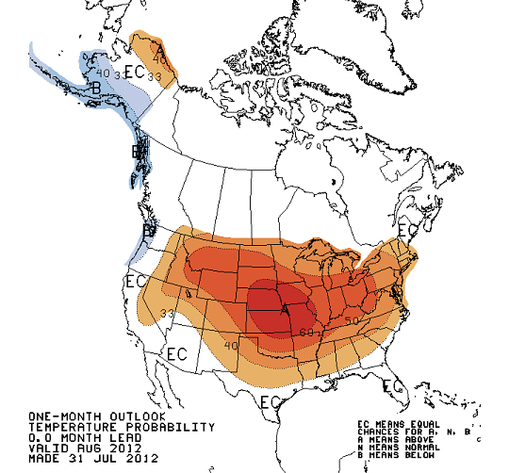
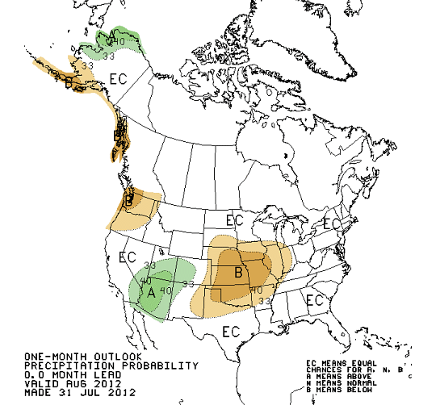
Monthly Outlooks – August 2012
Temperature
Precipitation

Slide 7
THE END
Questions?

