Slide 1
Climate Stations in Southwestern and south-central MN
Precipitation for Aug 1, 2011 through Mar 31, 2012
Location Total Precip Departure From Historical
(inches) Normal (inches) Rank
Lamberton 5.35 -8.50 1st
Pipestone 6.31 -7.58 7th
Marshall 4.66 -10.10 2nd
Lakefield 6.58 -7.34 2nd
Windom 6.54 -8.72 5th
Worthington 7.74 -6.42 12th
St James 5.07 -9.72 3rd
Fairmont 7.80 -8.46 3rd
Benson 6.47 -8.23 2nd
Melrose 6.35 -8.37 2nd
Jordan 8.31 -8.33 5th
Morris 6.59 -6.89 8th
Milan 5.24 -8.09 1st
Waseca 8.65 -10.87 2nd
Winnebago 7.97 -8.53 1st
Austin 8.97 -8.11 9th
Zumbrota 8.86 -9.13 7th

Slide 2
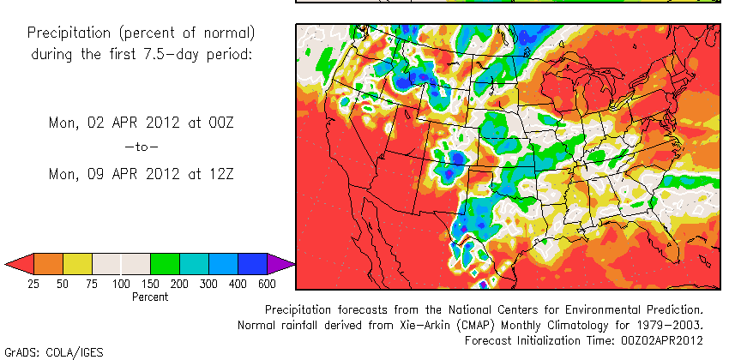
Ten Day Precipitation Anomaly (thru Apr 9th)

Slide 3
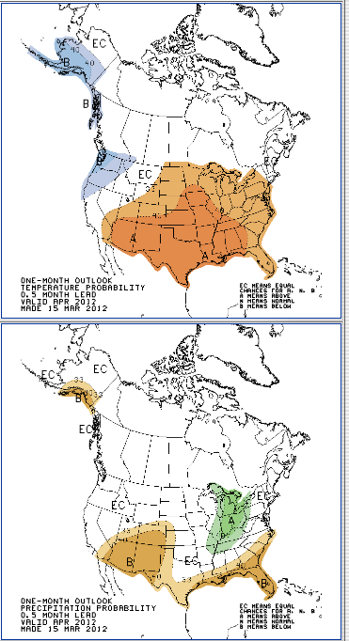
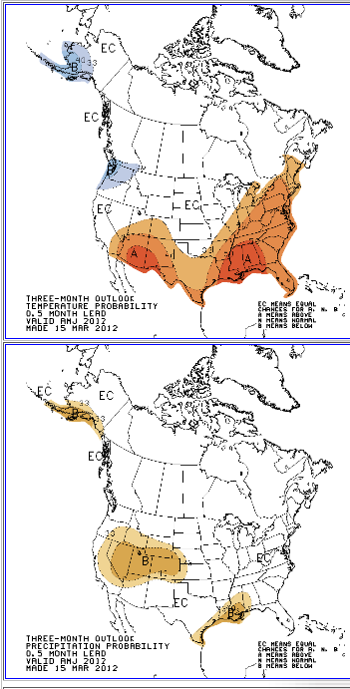
Apr Climate Outlook
Apr-June Climate Outlook

Slide 4
Summary
The drought threat posed by inadequate stored soil moisture across southern and western Minnesota is the most serious in over a decade, perhaps for some counties since 1987.
Many areas are so deficient in stored soil moisture they will need 125 to 175 percent of normal rainfall (7.50 to 10.5 inches) during April and May to make up the difference. February’s wetness was a good start, and March brought some highly variable amounts.
Historical climate patterns show about a 1 in 4 (SC) to a 1 in 6 (WC) probability that April-May precipitation would exceed 7.5 inches in southern and western counties.
Analogous years where a somewhat similar situation worsened included 1974, 1976, and 1988. Conversely analogous years when a somewhat similar situation was alleviated by either a wet spring and/or a wet summer included 1964, 1968, 1977, and 1984.
Contingency planning for dealing with drought during 2012 is an exercise in judgment, but probably wise to do this year. Crop insurance options should be seriously considered where soil moisture deficiencies are still great. Unfortunately minimal tillage may not be an option where large soil aggregates were left in the fall.

Slide 5
TREND IN WET APRIL-MAY PERIODS FOR SOUTHWESTERN MN
Top 20 wettest Apr-May periods in southwestern, MN since 1895 based on pooled mean coop observers (in.)
1979 7.49 1937 7.64 2005 7.69 1984 7.79
1999 7.87 2004 7.89 1959 7.91 1991 7.97
1960 8.44 2000 8.49 2011 8.57 1985 8.61 1995 8.71 1972 8.75 1938 9.03 1986 9.17 1953 9.30 1993 9.33 1965 10.49 2001 11.06
11 of top 20 come from past 3 decades
Notes:
Brown font shows recent years where the Jan-Mar period falls among the warmest 20 since 1895 at International Falls, MN. Twelve of these periods have occurred since 1981.

Slide 6
A Good Start, But Much More Rain Needed
Climate Stations in Southwestern and south-central MN
Precipitation for Feb 1, 2012 through Feb 29, 2012
Location Total Precip Departure From Historical
(inches) Normal (inches) Rank
Lamberton 1.73 +1.22 2nd
Pipestone 1.77 +1.17 5th
Marshall 1.91 +1.17 6th
Lakefield 2.19 +1.67 1st
Windom 2.08 +1.33 4th
Worthington* 2.23 +1.58 1st
St Peter 2.01 +1.36 2nd
Fairmont 2.54 +1.74 5th
Waseca 2.09 +1.09 10th
Sioux Falls, SD 2.43 +1.80 3rd
Winnebago 2.34 +1.57 5th
Faribault* 2.55 +1.78 1st

