Slide 1
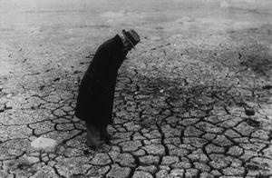
Minnesota Drought 2012
.. abnormally dry and/or unusually warm weather sufficiently prolonged for the corresponding deficiency of water to cause a "serious hydrologic imbalance"
Greg Spoden
State Climatology Office
Minnesota DNR
Division of Ecological and Water Resources
April 2, 2012

Slide 2
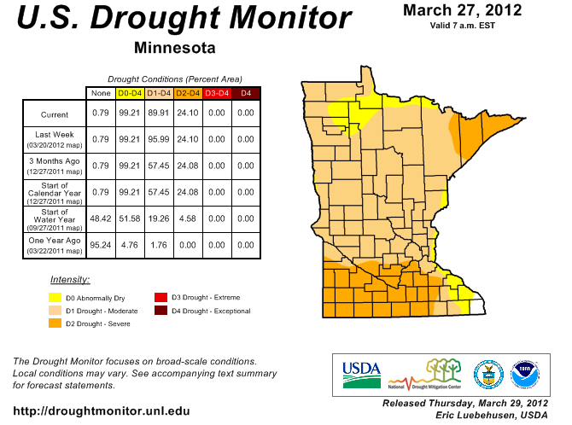

Slide 3
Drought Severity Classification
Five Key Indicators
Palmer Drought Index
CPC Soil Moisture Model
USGS Weekly Streamflow
Standardized Precipitation Index
Short (1 - 3 month) and Long-term (6 – 60 month) Drought Indicator Blends
Supplementary Indicators
USDA/NASS Topsoil Moisture
Keetch-Byram Drought Index (KBDI)
NOAA/NESDIS satellite Vegetation Health Indices
Reality Check
Maps are tweaked to reflect real-world conditions reported by contributors

Slide 4
U.S. Drought Monitor Impacts by Category
D0 – Abnormally Dry
Going into drought: short-term dryness slowing planting, growth of crops or pastures. Coming out of drought: some lingering water deficits; pastures or crops not fully recovered
D1 – Moderate Drought (90% of Minnesota at D1 or D2)
Some damage to crops, pastures; streams, reservoirs, or wells low, some water shortages developing or imminent; voluntary water-use restrictions requested
D2 – Severe Drought
Some damage to crops, pastures; streams, reservoirs, or wells low, some water shortages developing or imminent; voluntary water-use restrictions requested
D3 – Extreme Drought
Major crop/pasture losses; widespread water shortages or restrictions
D4 – Exceptional Drought
Exceptional and widespread crop/pasture losses; shortages of water in reservoirs, streams, and wells creating water emergencies

Slide 6
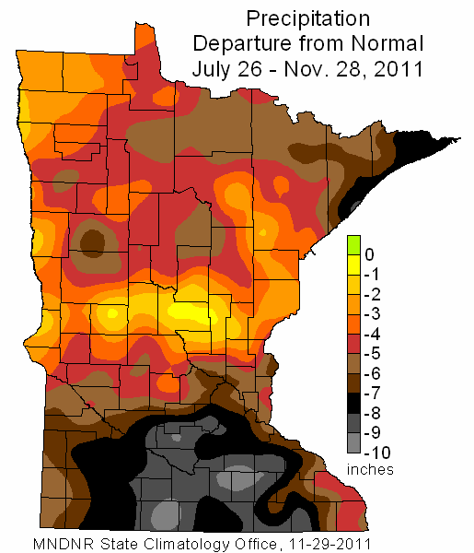

Slide 7
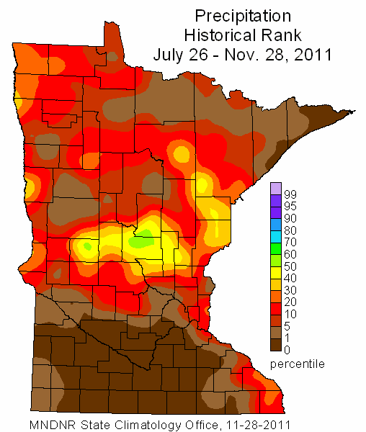

Slide 8
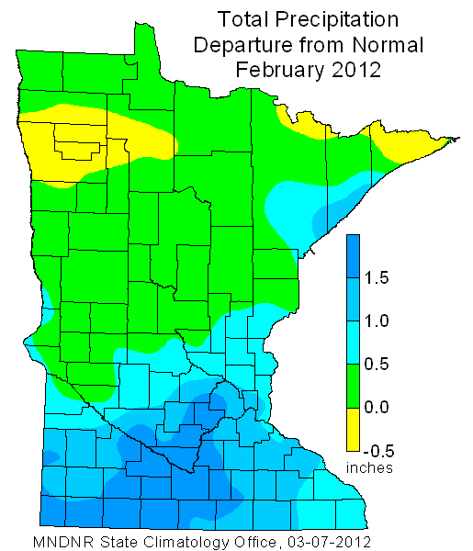

Slide 9
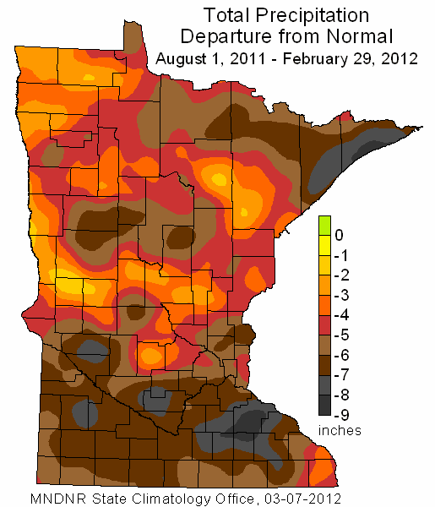

Slide 10
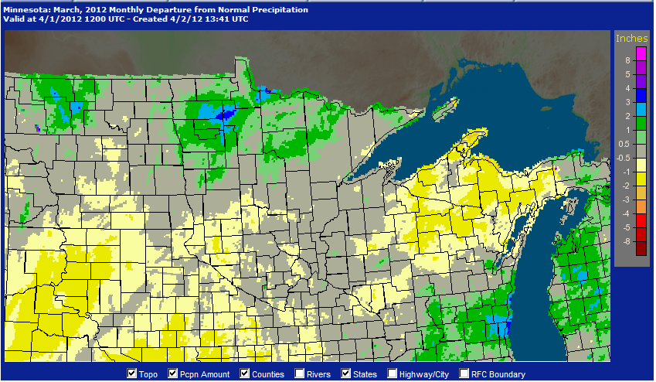

Slide 11
Without ample, widespread precipitation during the spring, Minnesota will face a number of drought-related issues during the 2012 growing season. The drought situation will become rapidly apparent in the spring in the form of:
wildfire potential
deficient soil moisture supplies (agriculture, horticulture)
low water levels in wetlands, lakes, and rivers
(recreation, agriculture, some water supplies, pollution dispersal)
Greg Spoden, 651-296-4214, gregory.spoden@state.mn.us

