Slide 1

Hydrologic Conditions:
Surface and Ground Water Resources
July 2012
Notes:
The DNR summarizes the climatic, surface and groundwater resources on a monthly basis using information from a variety of sources.

Slide 2
Notes:
Current conditions across the state are based on indicator wells in various ground water resources. Shape of the markers indicate the aquifer type and colors from darker to lighter colors show the current conditions compared to historical data for this time of year. Generally, based on the state indicator wells, conditions show a slight tendency towards lower levels compared to the March – April meeting.

Slide 3
Notes:
Most of the wells measured in the shallower aquifers within the 11 County Metro Area are within the normal range. Some of the locations considered bedrock aquifers wells continue to show water levels in decline. Many of these deeper bedrock wells reflect the deeper regional system that’s continued to decline over recent years.

Slide 4
Notes:
The two dozen indicator lakes across the state show generally lower than normal for the northwest reflecting the current drought index, normal or above in north central and northeast areas that received the heavy rains in June and mixed levels across the southern part of the state.

Slide 5
Notes:
Stream flow conditions are based on USGS and DNR watershed indicator gages across the state. Comparing current conditions to historical July data, flows are higher than normal flows in the north central and eastern part of the state, below normal in the Northwest and Southeast as indicated by the Drought Index and generally normal in the rest of the state . The USGS will provide further details on this in their presentation.

Slide 6
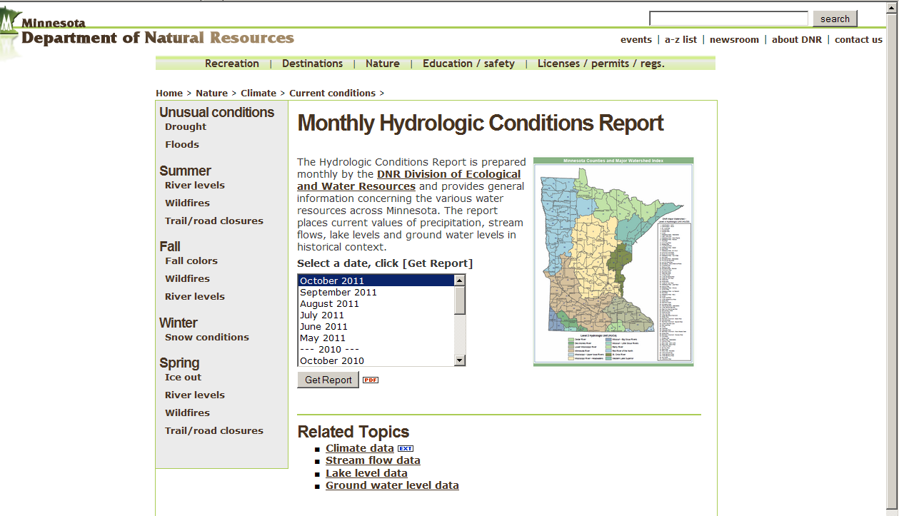
Monthly Hydrologic Conditions Report: http://www.dnr.state.mn.us/current_conditions/hydro_conditions.html
Notes:
Generally groundwater levels are variable throughout the state, many reflect normal conditions however some are showing signs of stress higher use areas.
Lakes across the state for the most part did not receive the normal spring run off, but many did receive significant amount s of water from June storms.
Stream flow conditions closely follow the climatic pattern as described in the drought monitor map with low flows in the northwest and southern part of the state and normal to higher than normal flows in the central and northeast.
DNR will be providing a Monthly Hydrologic Conditions Report that summarize the past months water resources throughout the open water season and will be available usually within the first week after the past month at the above link or also from the drought informational web page.

