Slide 1
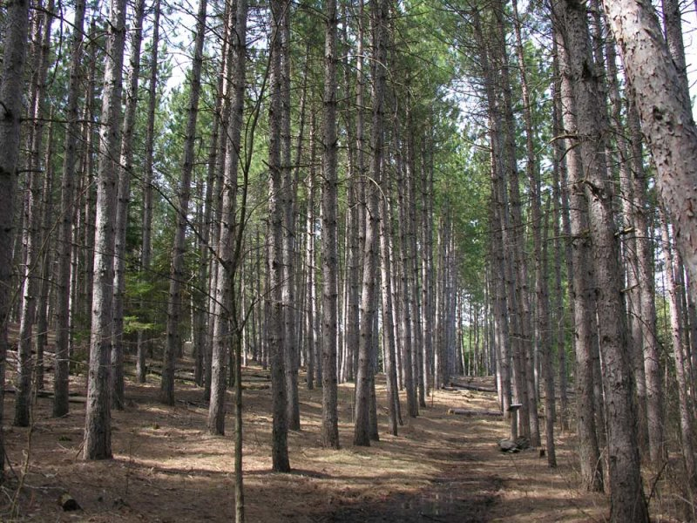
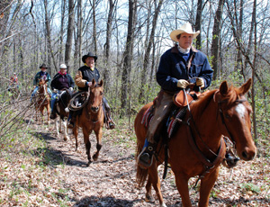
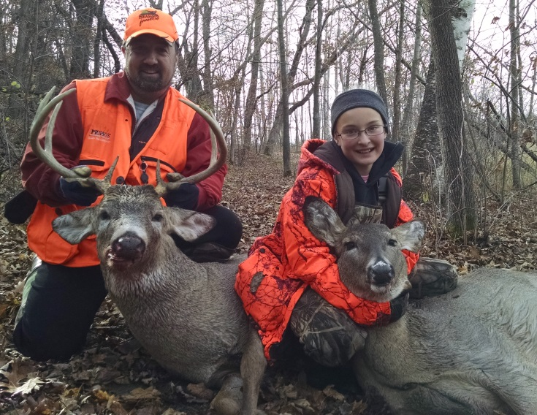
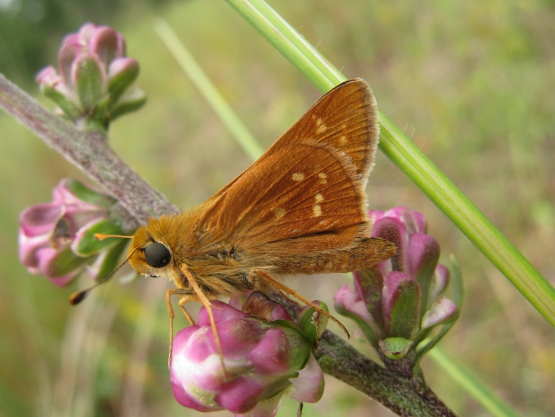
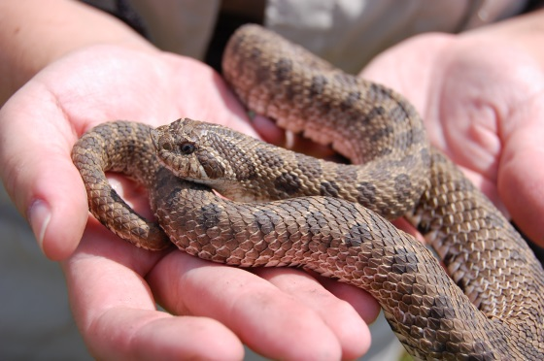
Sand Dunes State Forest
Managing for multiple values
Notes:
Minnesota owns a variety of lands and they often have specific focuses for management. State Parks for example generally focus on recreation and education. They typically have campgrounds and lots of recreational trails – hiking, horseback, snowmobile, xc skiing. Hunting is generally not allowed and where it is, it’s very tightly controlled. There may be interpretive centers or other education facilities. Wildlife Management Areas (WMAs) focus on providing hunting and trapping opportunities. Camping is generally not allowed on WMAs, and recreational trails are very limited. Forests on WMAs are managed to provide habitat for game species. State Forests are sort of like the Swiss Army knife of State lands, they are directed by statute to provide a variety of uses for the public – referred to as multiple use. Forest management to provide raw materials for lumber and paper is a major focus, but so are recreational opportunities. Some state forests have campgrounds, and those that don’t allow minimal impact camping about anywhere. Most state forests have recreational trails – hiking, horseback, snowmobile, ATV.

Slide 2
Minnesota State Forest Management Principles:
Produce timber and other forest products
Provide outdoor recreation
Protect watersheds
q Perpetuate rare and distinctive species of native flora and fauna.
Notes:
But state forests are about more than just the trees.
They’re managed for multiple values, including the perpetuation of rare species.
That part of the mission is especially important in relation to SDSF., because it includes a variety of unique features and rare species that make it a special place.

Slide 3
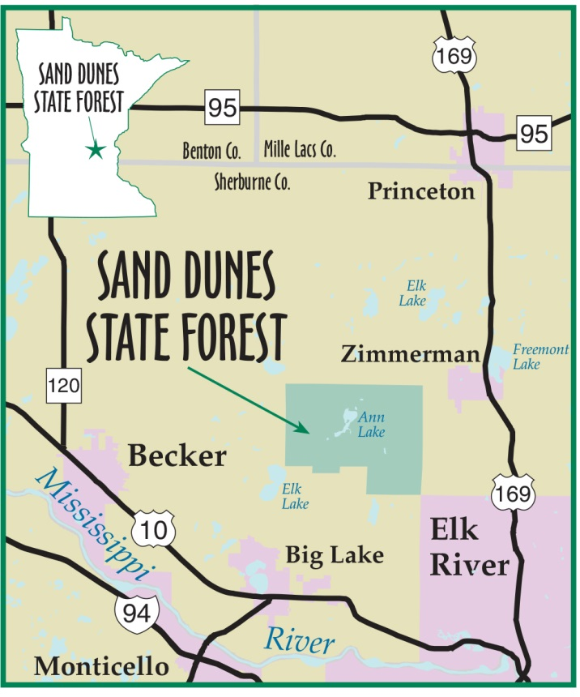
Overview
11,040 acres (statutory)
About 6,000 acres owned by state
Area had a mix of oak woodlands, savanna, prairie prior to 1850s/settlement
Much of the land subsequently cultivated: small grains, corn, potatoes, hay
1930s: Great Depression, Drought, Dust Bowl
Trees planted to stabilize blowing soil
State forest established 1945, expanded in1951
Notes:
The statutory boundary of the Sand Dunes State Forest encompasses about 11,000 acres, of which the state owns about 6000 acres. Private lands within the statutory boundary exist; there are no special regulations for private lands within the state forest. Prior to European settlement the area likely had a mix of oak woodlands, savanna, and prairie. As settlers arrived, they attempted to farm the land. In the 1930s the drought and dust bowl conditions caused crops to fail and allowed the sandy soil to blow in the wind. Folks started planting trees to stabilize and conserve the blowing soil.

Slide 4
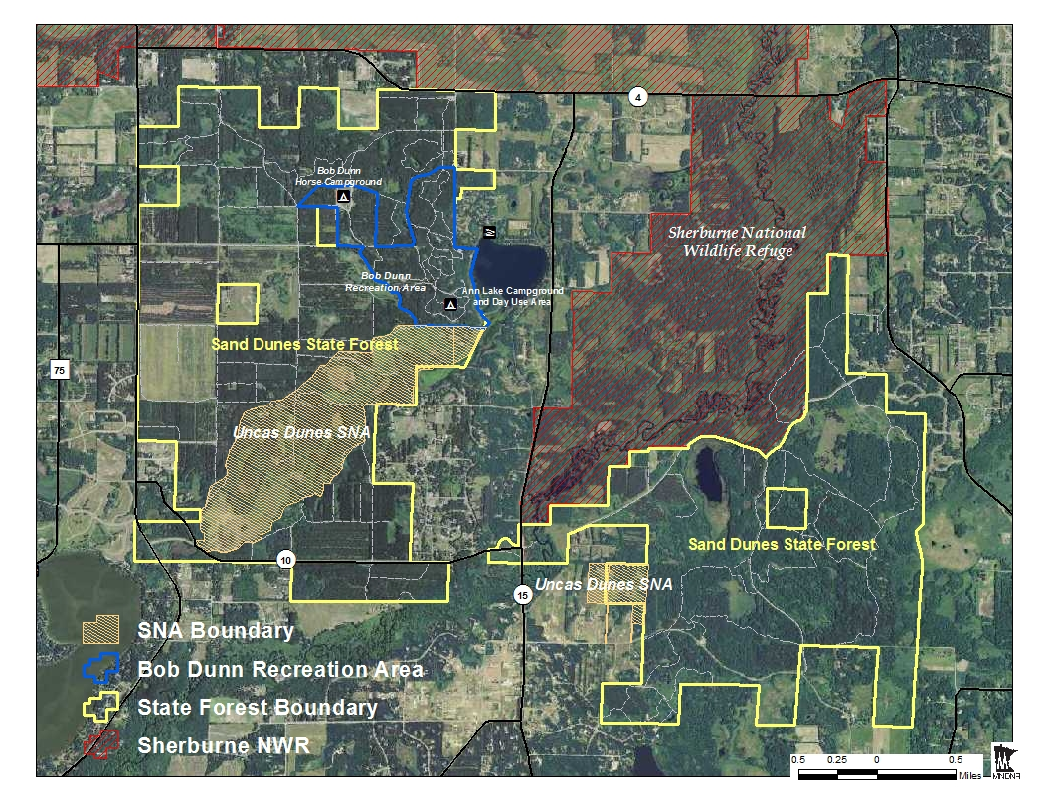
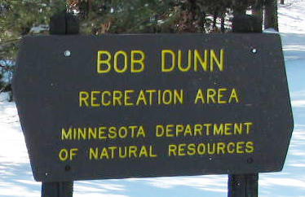
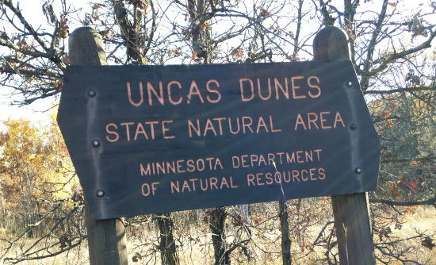
Specially designated areas
Sherburne
National Wildlife
Refuge
Bob Dunn Recreation Area
Uncas Dunes SNA
Notes:
Bob Dunn Rec Area: Ann Lake Campground with 36 individual campsites, 4 group camps, day use area and swimming beach, horse campgrounds, 29 miles horseback riding trails; 23 miles snowmobile trails.
Come autumn, SDSF is popular with hunters, both small game and deer.
Uncas Dunes SNA: 676 acres; relic dunefield associated with Glacial Lake Grantsburg; oak savanna, oak forest, and wetland; one of only two sites in the state where Uncas Skipper butterfly is found.
SNAs preserve natural features and rare resources of exceptional scientific and educational value.
SNAs are open for nature observation and education, but are not meant for intensive recreational activities
Sherburne NWR: 31,000 acres; wetlands, prairie, oak savanna.; part within SDSF. Managed by USFWS, a federal agency: State has no say.

Slide 5
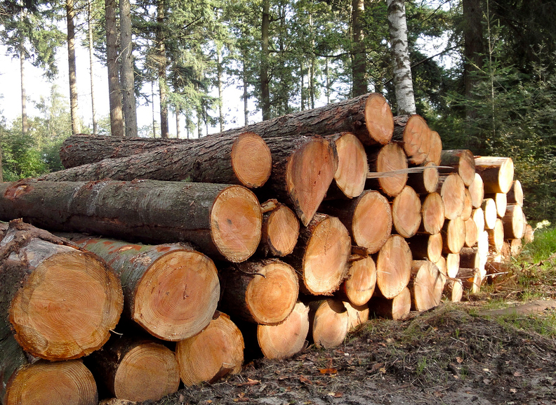
Forestry Facts
2,190 acres planted red pine
650 acres planted white pine
1250 acres oak
1,160 acres School Trust Fund land
Notes:
Some of the current tree covertypes in the Sand Dunes State Forest.

Slide 6
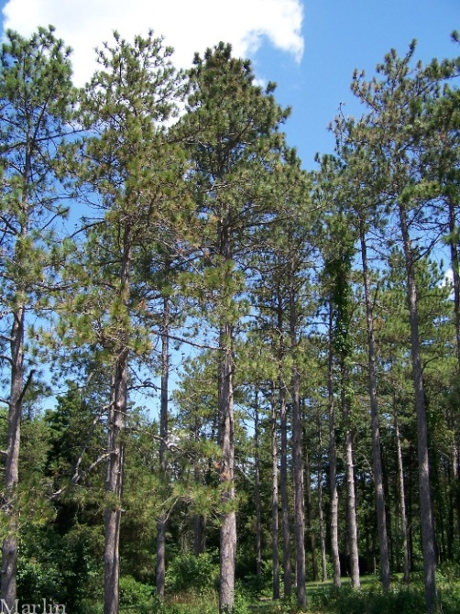
Forestry Facts
Soil Type: Zimmerman Fine Sand
High Site Index for red pine and white pine
Can produce 40 cords/acre +
Notes:
Most of the upland soil in the SDSF is Zimmerman Fine Sand. This sandy soil is only rated for around 60 bushels/acre of corn but has a high site index (high productivity) for red and white pine (SI 70+).

Slide 7
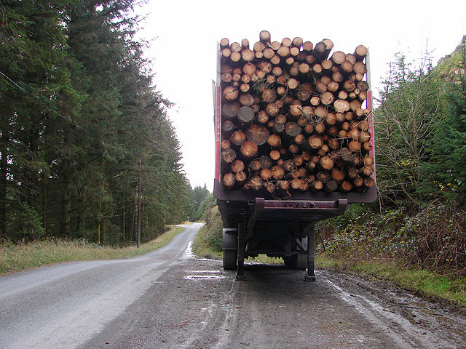
Recent changes
Shift in emphasis to
manage part of the forest for rare features and habitats
Legislative directive to enhance income to School Trust Fund
Accelerated rotation for planted pines
Notes:
Most recent changes on top.

Slide 8
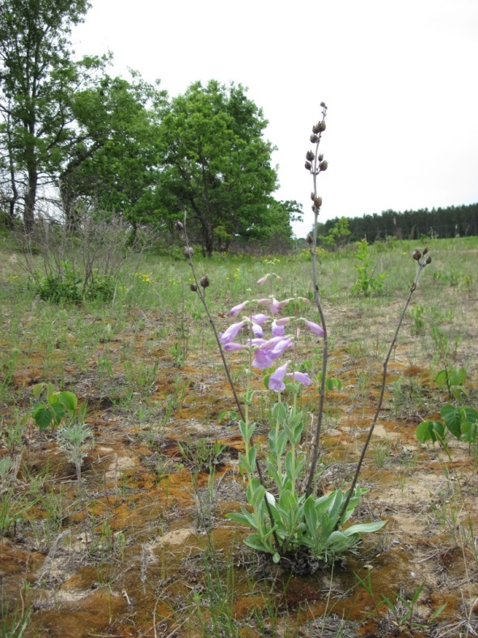
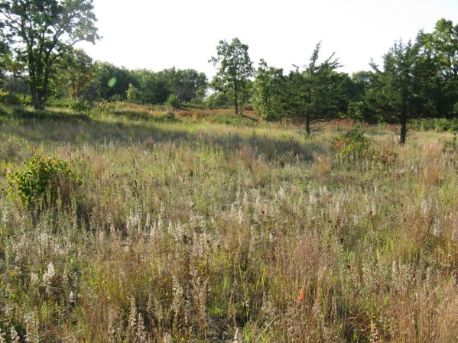
Special features of Sand Dunes State Forest
Rare sand dune ecosystem
Dry barrens oak savanna: most imperiled upland native plant community in midwest: only 0.02% of pre-settlement acreage remains
Global significance
Variety of rare species:
9 plants
16 animals
Notes:
Sand Dunes State Forest is a special place with many rare features.

Slide 9
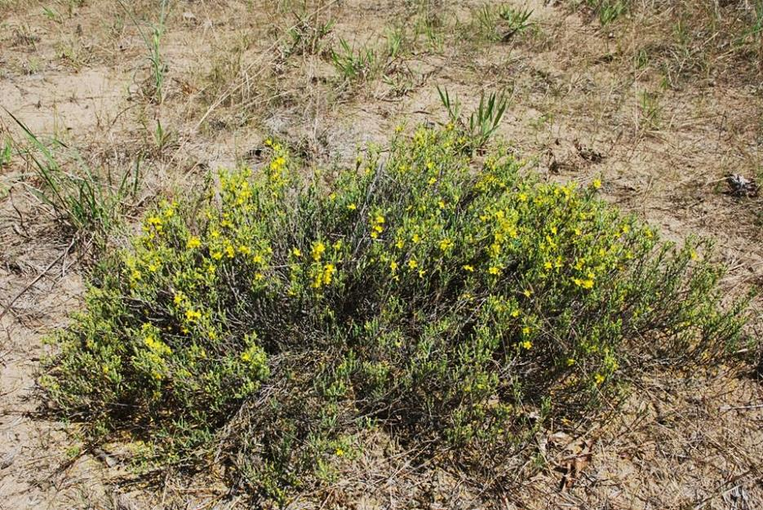
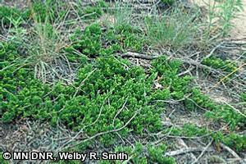
Special features of Sand Dunes State Forest
Beach heather
Creeping Juniper
Notes:
Two examples of rare plants found in the Sand Dunes State Forest.

Slide 10
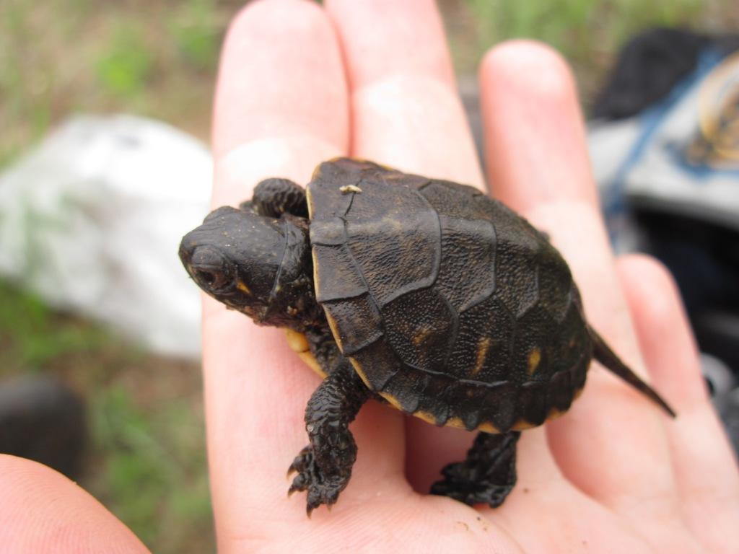
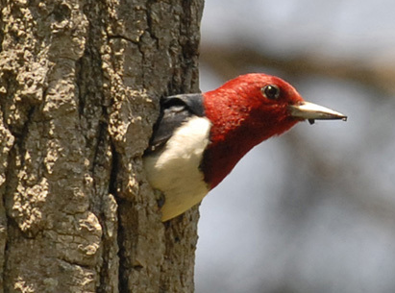
Special features of Sand Dunes State Forest
Red-headed Woodpecker
Blanding’s Turtle
Leonard’s Skipper
Notes:
Plains pocket mouse: state listed special concern.
Sole representative of its family found within MN; related to kangaroo mice of the great plains.
It uses its fur lined cheek pouches to transport large amounts of the prairie seeds that it feeds on almost exclusively.
Pocket mice set up very small home ranges (less than .05 of an acre) in which they build small burrows with chambers for storing food, sleeping, etc.
They hibernate in the winter but must awaken periodically to eat stored food.
Plains pocket mice and pocket gophers (their next nearest mammal relative) are some of the only small mammal species to exploit sandy, well drained soils with minimal vegetation.
In the absence of fire and introduction of more trees and grasses pocket mice are quickly out competed by other more generalist mammal species.
Also, they are adorable, smaller than a golf ball and tan – peach colored.

Slide 11
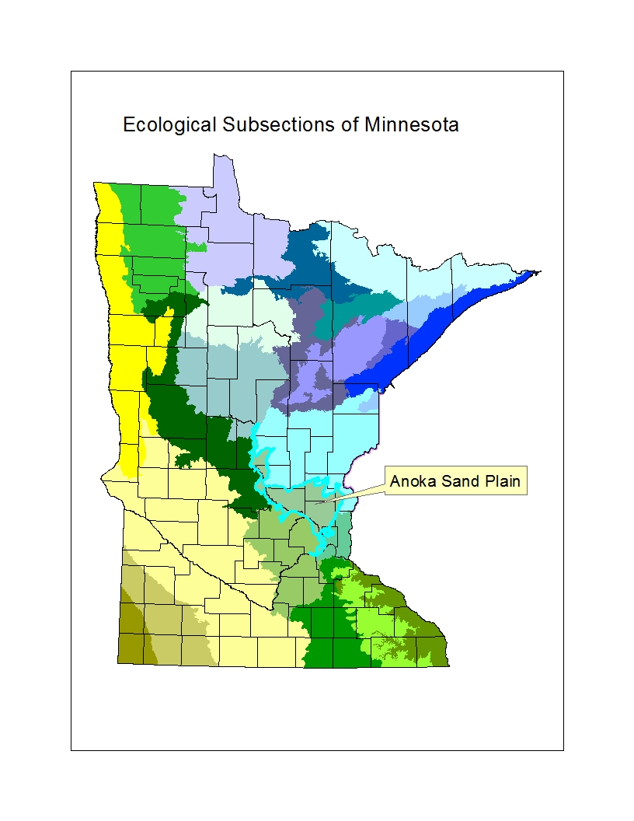
Sand Dunes State Forest Operational Plan
Anoka Sand Plains Subsection Plan
Guide vegetation management as part of broader ASP
Provide direction to local managers
Notes:
The Sand Dunes State Forest Operational Plan is a subset of the larger landscape plan know as the Anoka Sand Plains Subsection Plan. The larger subsection plan provides general direction for forest management over the entire subsection, including the Sand Dunes State Forest. The Operational Plan for the Sand Dunes provides some additional guidance to managers about where to focus on management of rare features and where to focus management on more traditional state forest uses. The Operational Plan does not address recreational use or general forest management.

Slide 12
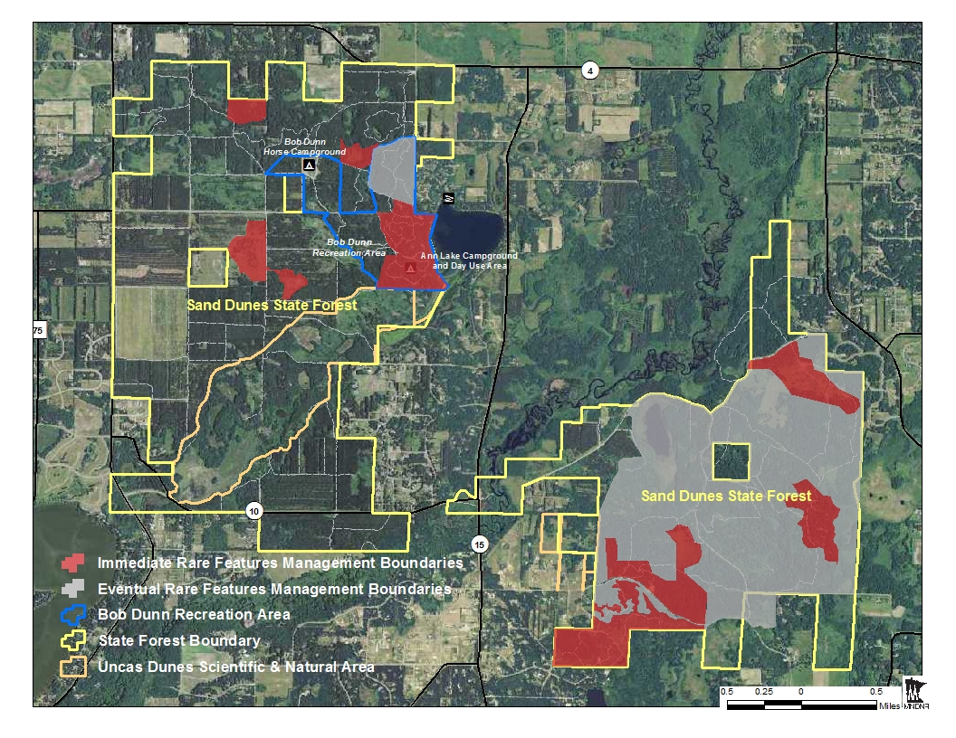
Sand Dunes State Forest Operational Plan
Notes:
Because of its rare plants, animals and geological features, DNR’s division of Forestry in 2010 entered into discussions with the division of Ecological and Water Resources and the section of Wildlife to develop a management approach that better balances the multiple values of the state forest.
In February 2013, the three DNR units signed off on an operational plan that divides the forest into management zones:
About half the forest will continue to be managed based on standard forestry protocols: 2,862 acres
About half will be managed to sustain and enhance habitat conditions that support the rare and threatened plant and animal communities of the Sand Dunes SF: 2,517 acres.
Some changes will occur in the near future, over the next 5-10 years; invasive species removal; pines harvested: IMMEDIATE RARE FEATURES MANAGEMENT AREA: 513 acres
Some changes will take place over the next 60 years, as pines reach harvest age: 1,328 acres: EVENTUAL RARE FEATURES MGMT. AREA
The Bob Dunn Rec Area will be managed for recreation, forestry and ecological values: 353 acres

Slide 13
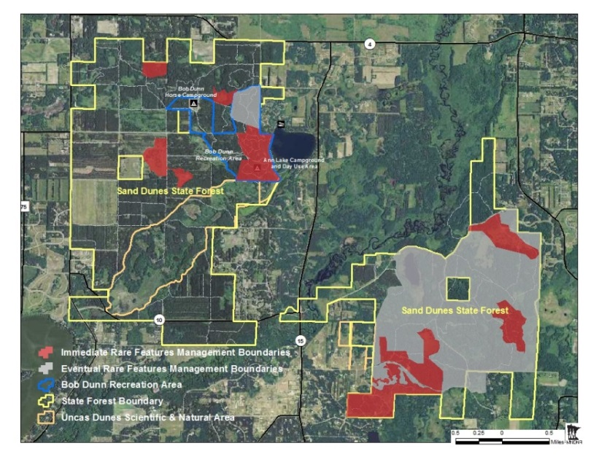
Sand Dunes State Forest Operational Plan
About half of the Sand Dunes State Forest will be managed similarly as it has in the past.
About half of Sand Dunes State Forest will be managed to better support rare species.
Continue to emphasize Recreation in Bob Dunn unit.
A diverse mosaic of habitats: pine forests, hardwood forests, oak savannah, swamp, marsh, meadow, prairie.
Restoration phased over
next 5 – 50 years.
Notes:
Highlights in the Operational Plan.

Slide 14
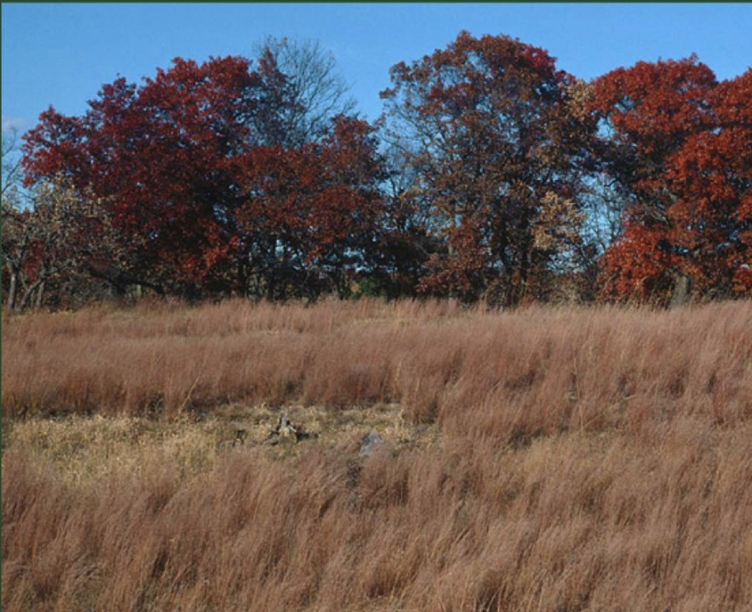
Communications & Outreach
Anoka Sand Plains SFRMP – February 2012
Letter to adjacent landowners – September 2014; October 2015
Interpretive field trip – October 2015
Email newsletter launched
Sherburne County Board Meeting – August 2015
Meetings with Orrock Twp. Board re: roads, etc.
Meetings with local legislators
Meetings with local citizens
Stakeholders Advisory Group
– June 2016
Notes:
DNR strives to be a good neighbor, and to keep adjacent landowners informed as to what’s going on.
We have made some efforts to inform community about what we’re doing and why.
The Sand Dunes State Forest Stakeholders Advisory Group was established to develop a long-term communication connection between the DNR, neighboring landowners, and forest users.

Slide 15
Notes:
Break for transitioning into upcoming management activities segment.

Slide 16
Sand Dunes State Forest
Managing for multiple values

Slide 17
Notes:
Summary of the DNR’s planned management activities over the next few months.

