Slide 1
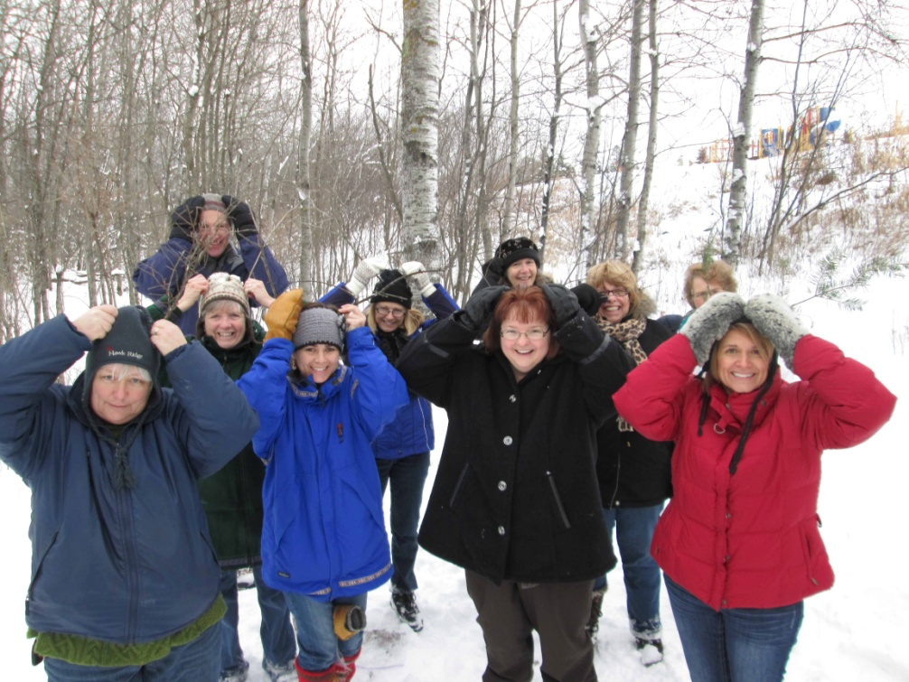
School Forest Committee Basics
February 2013
Notes:
Photo from Lakewood School Forest, Duluth

Slide 2
Why Have A School Forest Committee?
School Forests are accountable to the
DNR for:
Educational activities
Annual report
Committee and Site Coordinator
Funding
Stewardship Plan
Land ownership
Notes:
The School Forest program is set up as a partnership. DNR has certain deliverables; so do schools
One of the criteria for school’s is having a site coordinator and committee. The committee should help accomplish goals and also provide resources for some of the other criteria that school’s are responsible for such s funding.
Educational activities = the school must conduct at least 5 educational activities each year in their school forest
Annual report = the site coordinator must submit an annual report to the DNR before June 30 of each year
Committee and Site Coordinator = every school forest must have a committee and site coordinator
Funding = the school is responsible for providing adequate funding to support teachers to use their school forest
Stewardship plan = each school forest should work with a DNR forester to create a stewardship plan for their site
Land ownership = any site not owned by the school must have a written agreement between the school and the landowner indicating the conditions of use and designating the site as a school forest

Slide 3
Why Have A School Forest Committee?
One person can’t do it all.
Notes:
Don’t get burned out. You can’t and shouldn’t be doing everything for the School Forest. Having a committee helps delegate duties to others and also gives you a larger network of individuals to help with goals and tasks in the forest.

Slide 4
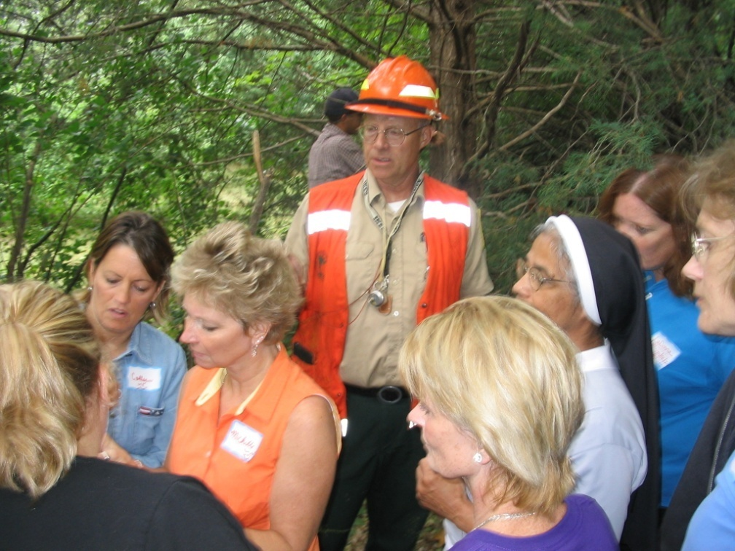
Why Have A School Forest Committee?
Buy-in
When everyone feels they had a say in forming an idea, the idea is more likely to be supported.
Notes:
Everyone has a different motivation to participate on a committee.
Photo from St Therese SF

Slide 5
Who’s in charge?
Usually (but not always) the site coordinator.
Remember:
You DON’T have to do it all!
Notes:
Realize that other committee members may have different ideas about goal priorities.
A committee would need to majority agree on which goals are most important, should be tackled first, etc.
Site coordinator doesn’t have to do the projects. If you want to do a project, it’s ok to pass the leadership torch to another SF committee member. (Shawn Linder example)
Photo from Rockford SF

Slide 6
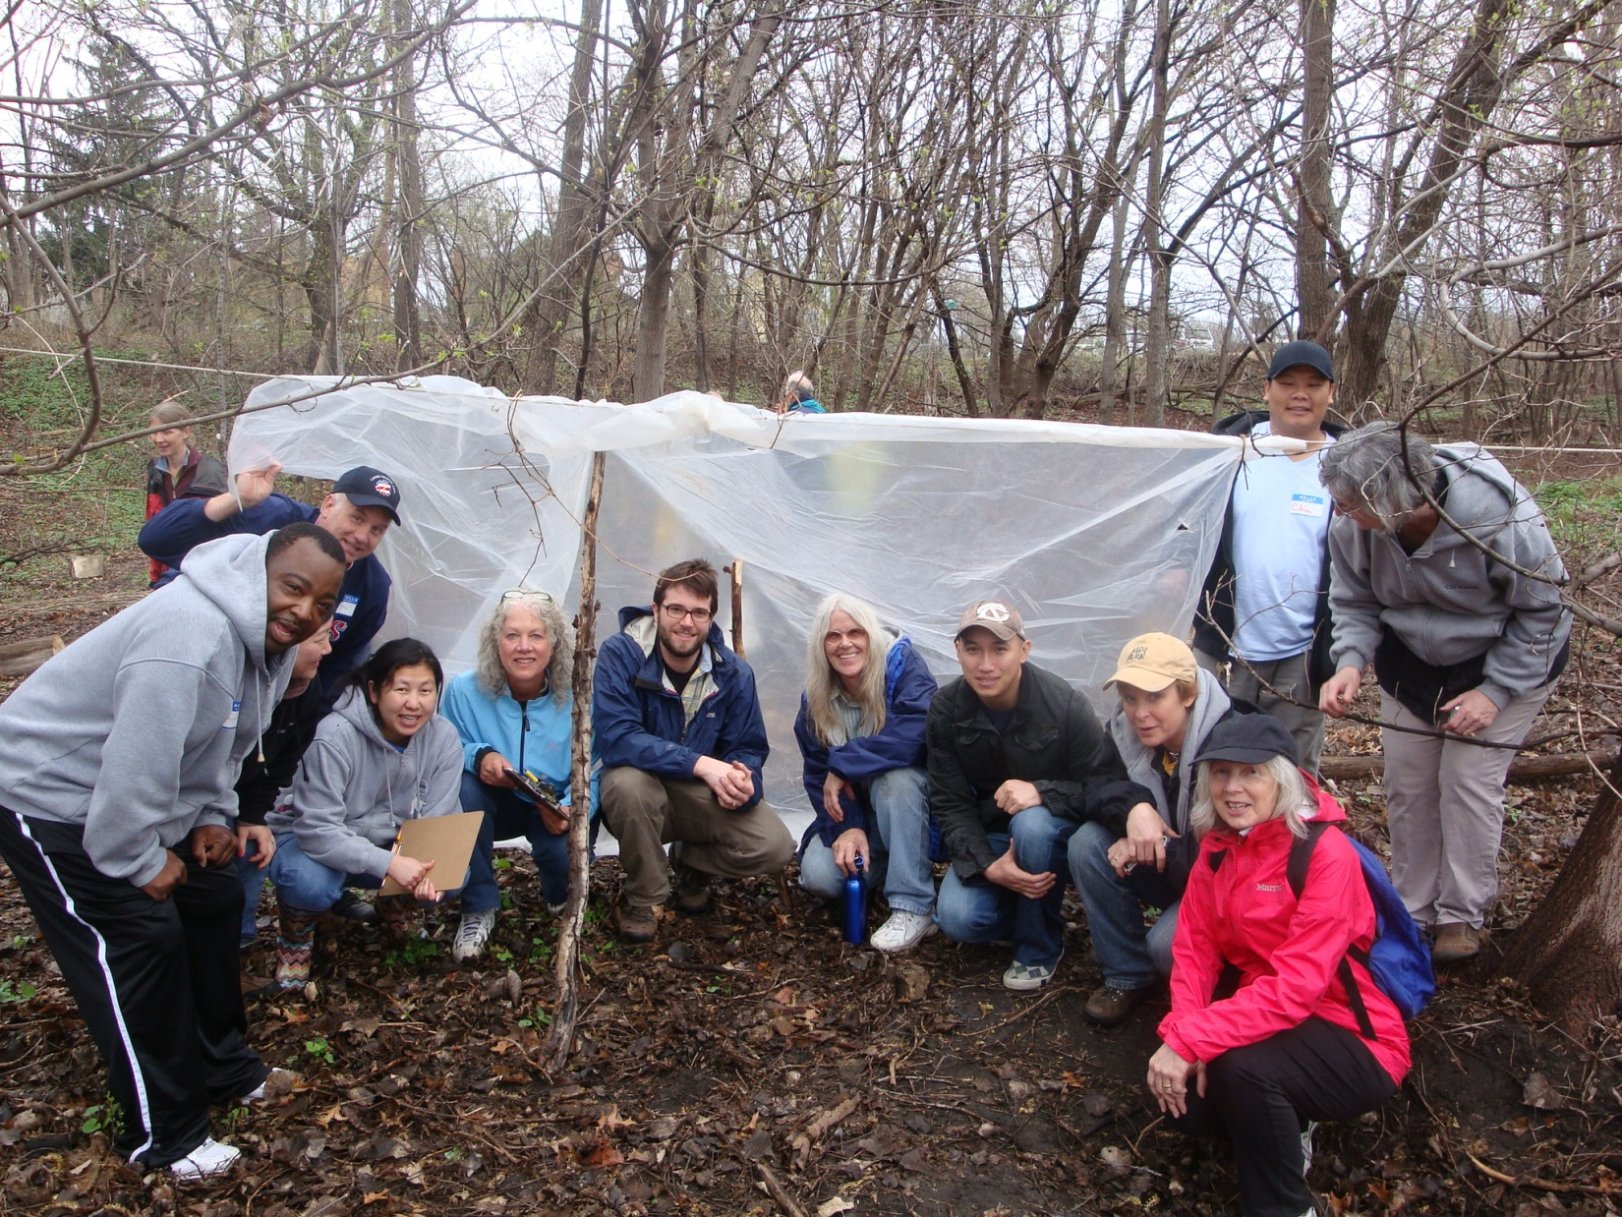
Who should be on your committee?
Notes:
Teachers
Principal
Administrator
Groundskeeper
Parent
SF neighbor
SF landowner
DNR forester
Local business
Back-ups
Photo is of City Academy Teachers, Big Urban Woods School Forest, St. Paul

Slide 7
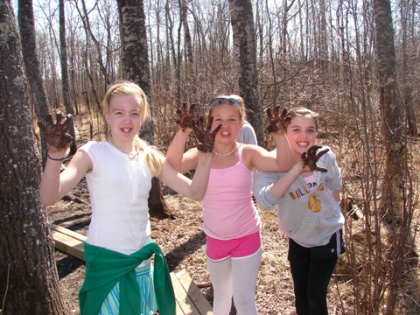
Motivations everyone can agree with:
Restoring forest health
Helping kids
Notes:
When everyone feels they had a say in forming an idea, the idea will be supported.
Everyone has a different motivation to participate on a committee.
Find the common motivations that unite the committee
Typical common goals everyone can agree with:
1. Restoring forest health
2. Helping our children

Slide 8
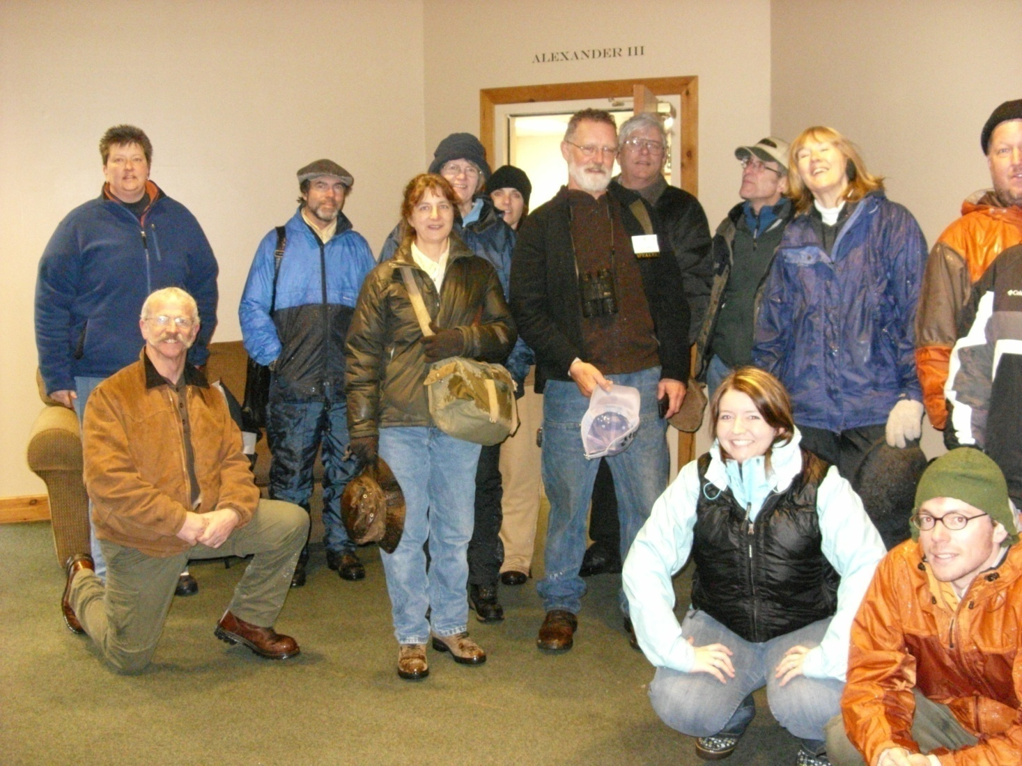
Have diversity!
Diversity = Strength
Notes:
Diversity = strength. Get perspectives from male, female, students, teachers, administrators, business members, old, young, idealists, pragmatists, Democrats, Republicans, etc
Everyone knows someone else whom YOU don’t know! This gives your School Forest a great network of individuals to work with.
Photo from St Therese SF

Slide 9
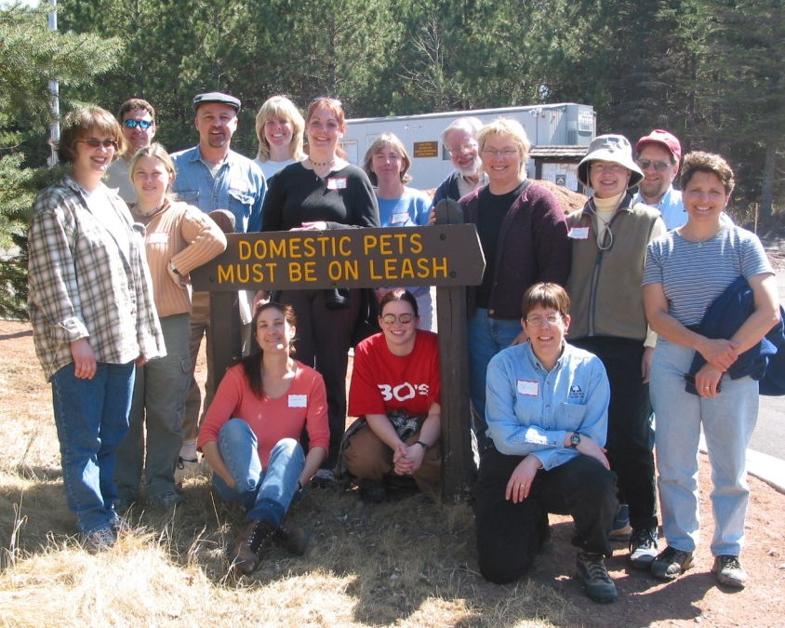
Example Committee Members
Teachers
Administrators
Grounds person
Parents
Students
DNR forester
Local business
Local volunteers
Property neighbors
?
Notes:
to jot down names of committee members, either current or desired.

Slide 10
4 overarching duties common to all committees:
Site Management
Funding
Empowering other teachers
Make decisions/recommendations

Slide 11
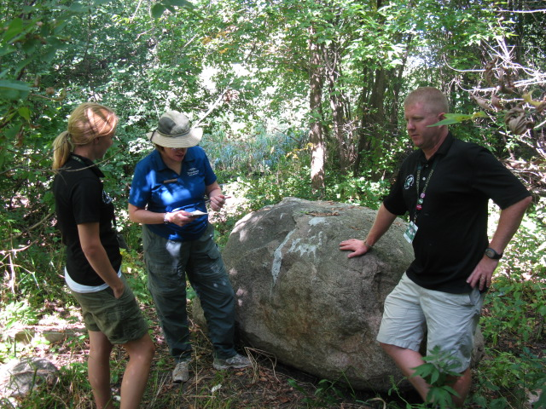
1. Guide site development
Trails
Signs
Invasive species management
Reduce vandalism
Wildlife blinds
Gardens
Outdoor seating area
Plant /harvest/tap trees
Notes:
Photo from Rockford School Forest

Slide 12
2. Ensure appropriate funding is available
For things like:
Construction
Maintenance
Bussing
Think about designating:
A grant writer
Someone to keep track of accomplishments and to write thank you notes.

Slide 13
3. Empowering other teachers
Staff training
Showcase student projects
Grab-and-go activities
Map – post on Google Earth
Student-created trail/field guide
Communication/positive reinforcement
Notes:
What are YOUR School Forest goals?
Other committee members may have different goals.

Slide 14
4. Make decisions/recommendations
Typical Example
Years 1-5
Establish committee
Reduce invasive species
Set up bussing system
Staff training
Years 6-10
Increase school visits
Plant vegetation
Signs
Add SF web page to school site
Years 11-15
Funding for outdoor seating/trails

Slide 15
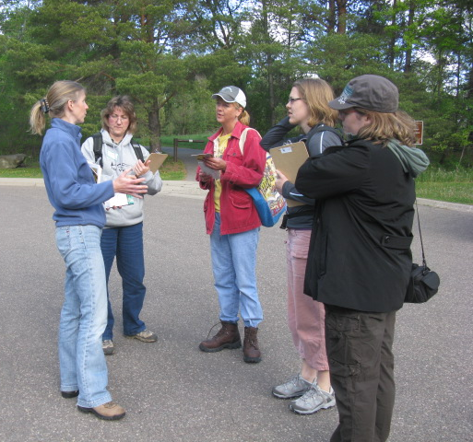
Example Goals: Bailey School Forest
Years 1-5
Establish committee
Reduce invasive species
Set up bussing system
Staff training
Years 6-10
Increase school visits
Plant vegetation
Signs
Add SF web page to school site
Years 11-15
Funding for outdoor seating/trails
Team meets quarterly.
Notes:
Committee meets monthly or b-monthly during the school year, depending on the projects. They let the committee leader position roate between site coordinator (school), landowner, or other project manager
Photo from Newport Bailey School Forest

Slide 16
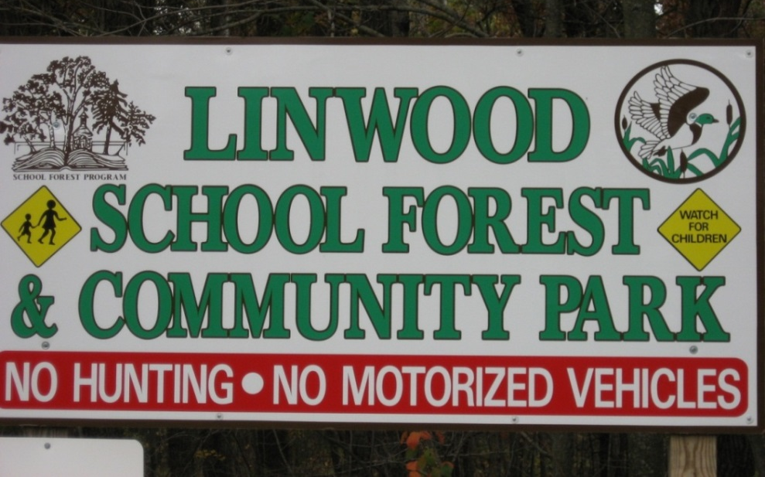
Example: Linwood School Forest
Committee: principal, 1-2 parents, 2 teachers, 2 local community members; 1-2 city staff
Goals:
Add 40 acres,
Obtaining snowshoes
Provide a naturalists-teacher program
Add a butterfly garden
Create a trail & field guide
Add a web site
Notes:
Need notes

Slide 17
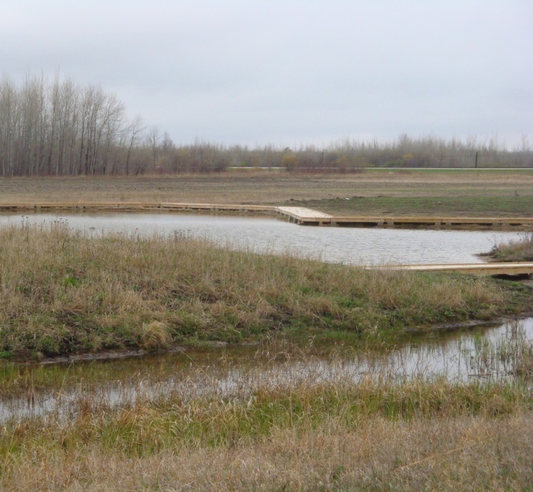
Example: Lake of the Woods School Forest
Committee meets monthly
Members: site coordinator, SWCD, grounds supervisor, parents, DNR forester, teachers (including a high school rep),
Projects:
brush-hogging trails
constructing wetland and boardwalk
creating outdoor seating area
Notes:
Committee meets regularly
Isolated community- good example of DIY’ers
Photo from Lake of the Woods SF

