Slide 1
Firewise in Your Community
Firstname Lastname | Job Title

Slide 2
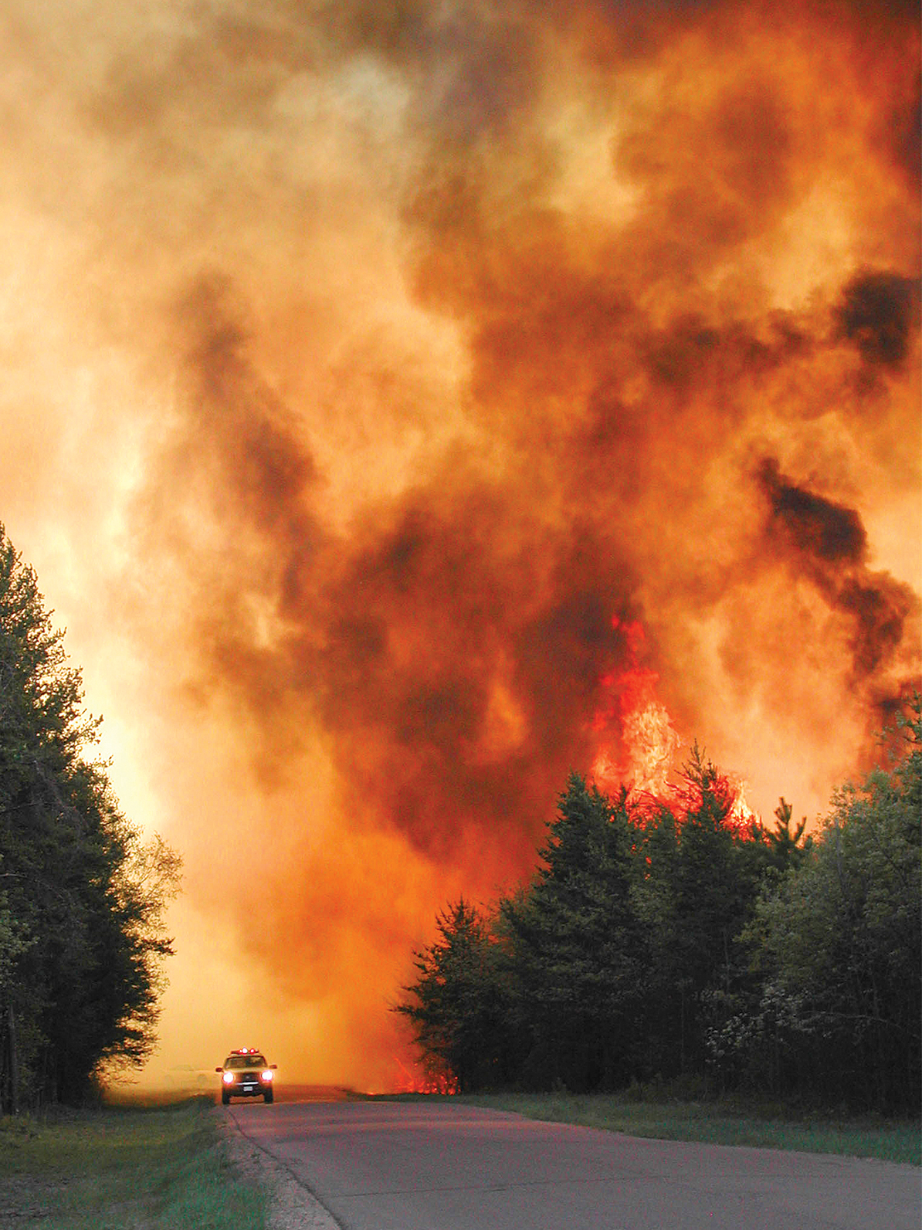
Agenda
Understanding Wildfire
How Homes Ignite
What is Firewise
Hazard Assessment
Firewise Practices
Firewise USA Communities

Slide 3
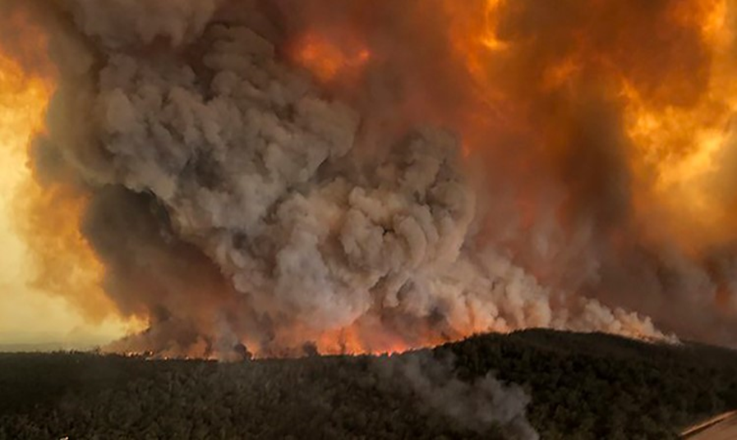
Wildland Fire Is…
An unexplained and uncontrolled fire spreading through vegetative fuels, at times involving structures. (source: Firewise glossary)
Notes:
What’s realistic?
30 Firefighters on a structure fire department, 5-6 large trucks, water tenders, SCBA, ususally only ONE structure (target). CONTAINED
Wildland fire-- NOT CONTAINED. Potentially Limitless fuel, weather and terrain driven, CAN and often does include structures… homes, cabins, deer stands, outhouses, propane tanks, campers, couches, appliances… anything really.
Extreme events stress resources regionally and nationwide.

Slide 4
Fire Plays an Essential Role in the Ecosystem
It’s a natural process that
Replenishes soil nutrients
Removes dead and dying vegetation
Creates conditions for healthy re-growth
Notes:
The truth is: Wildfire is an element of nature. Although fire can be destructive, particularly where property and life are concerned, it is important to recognize that fire performs a vital role in the ecosystem. It is important to understand this because it is the context in which land management agencies make their decisions about fire management. We could spend this entire discussion just talking about fire’s role in the ecosystem, but since we have other topics to cover let’s focus on three key thoughts: Fire can replenish soil nutrients, remove dead and dying vegetation, and create the conditions for healthy re-growth.
FOR MORE DETAIL:
Fire has helped shape our wildlands for thousands of years and is important for the survival of many plants and animals.
Fire reduces accumulation of vegetation that can inhibit plant growth.
Some plants and animals depend on fire for survival. Periodic fire stimulates growth, reproduction of plants, and provides wildlife habitat. USE REGIONAL EXAMPLES For example, lodgepole pine need fire to warm their cones, allowing them to open and drop seed.
Fire behaves differently throughout the country.
In addition to fuels (vegetation), fire behavior is affected by weather and terrain.
Virtually all vegetation types in the United States can experience wildland fire. USE REGIONAL EXAMPLES
Here in our area, we can expect to experience fire every XX years.
This year, our area is at risk because (INSERT DETAILS, E.G. DROUGHT; DRY SEASON; FUELS; BUILD-UP. Be specific about types of fuels in the area. See “Hazard Assessment” section of “Communities Compatible with Nature” handout for examples.

Slide 5
Impact from Climate Change
Climate change is affecting wildland fire – risk factors and fire behavior.
Wildland Fire Risk Factors | Fire Behavior
Increasing temperatures | More fires
Longer snow-free seasons | Longer fire seasons
Changes in vegetation types/growth rates | More intense fires
Larger swings between wet and dry periods | Less predictable fire behavior
More intense wind, lightening, and storm events | Faster growing and dying vegetation
Faster drying periods
Increasing opportunities for insects and disease

Slide 6
Fire Triangles
Fire Triangle
Fire Behavior Triangle
Notes:
Common feature is also the only one we can control ahead of time. == FUEL.
Other things to consider are Topography and Weather--- which directions do they affect you most?

Slide 7
Fire Spreads from the bottom up
Notes:
This is how fire spreads in fuels… bottom up.
If it’s extreme, its already up. Watch for Fire brands.
Remove the connection and you dismantle the ladder.

Slide 8
Research on Wildfire Ignitions
Experiments, models, and post-fire studies have shown homes ignite due to the condition of the home, and everything around it, up to 200’ from the foundation
The top 3 potential ignition sources
Ember attacks (AKA Firebrands)
Surface Fires
Crown Fires
Notes:
Decades of research have shown that both the house and adjacent landscape play a role in the structure surviving a wildfire. A wildfire can transfer from ignited vegetation or an ignited home through radiation, convection, embers/firebrands. A home’s building materials, design, and landscape have a significant role in the level of exposure that can be endured before ignition occurs from any of these sources.
Embers: Burning pieces of airborne wood or vegetation that can be carried more than a mile through wind can cause spot fires and ignite homes, debris and other objects. They can also penetrate and smolder in woodpiles, patio/deck items, vents, debris filled gutters, and roofs. Most home losses in a wildfire are from embers, not direct contact with flames.
Surface Fire: Typically, small flames burning through grass and ground litter. They can reach houses or attachments if there’s no interruption in the types of fuel sources. Flames touching a house, fence, or deck can cause them to ignite.
Crown Fire: Large flames burning in the tops or canopies of trees. These large flames radiate heat that can ignite wood walls from up to 100’ away. Other types of large flames can come from detached buildings, burning wood piles and ignited vehicles.

Slide 9
Wildfire Risk
Notes:
While wildfire is essential in many ways it can also involve everyone and everything on the landscape. Because of this, we try often to try to control or suppress it when necessary. It’s important to look at wildfire risk in order to make important decisions surrounding suppression.

Slide 10
DNR Reported Wildfires
Between 1985-2023
55,000+ wildfires
Average 1,400 wildfires/year.

Slide 11
How it starts
Notes:
Debris Burning is #1 cause… and collectively over 90% are caused by human.
It’s a problem because our homes are in the way.

Slide 12
What is Firewise?
A national program that uses research and best-practices to teach homeowners and communities how to reduce the risk of wildland fire and supports community mitigation and education activities through grant funds.
Notes:
You don’t have to live in a moonscape. While all clear is great, research on homes has helped us understand what makes a difference in wildfire risk reduction so Minnesotans can choose what makes sense for their property, budget, and peace of mind.

Slide 13
Understand your Home Ignition Zones
Lean, Clean, and Green
0-5 ft
5-30 ft
30-100 ft
100+ ft

Slide 14
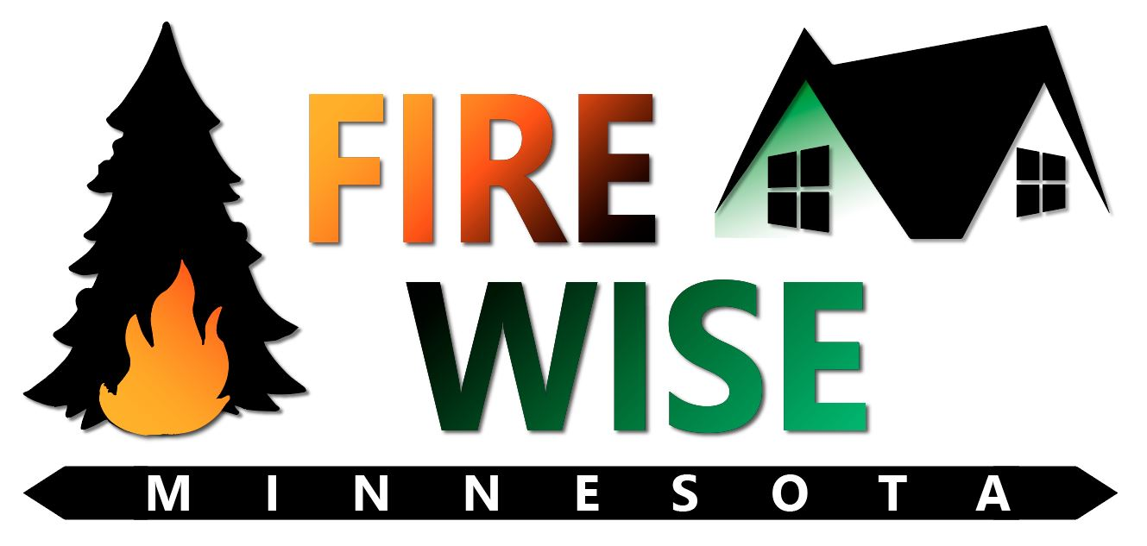
Steps to becoming Firewise
Understand your risk
Practice mitigation
Involve your community

Slide 15
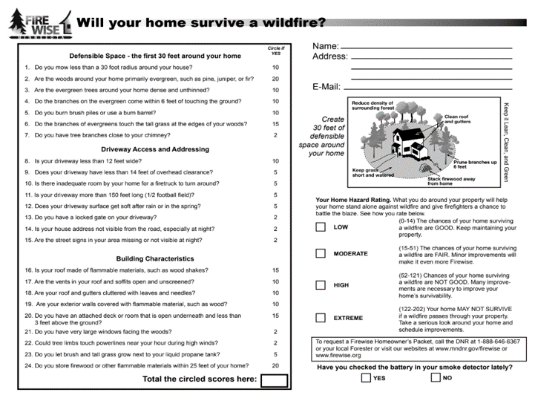
1. Home assessment
Order a Firewise Homeowner Kit
Complete a home assessment yourself
Have a professional do a level 1 or level 2 assessment
Notes:
Fantastic place to start. Assess your risk.
Plug Firewise in the Classroom and Fire Department Evaluations.
Notice #5--- COMPOST, don’t burn brush….. or Fall cleanup, winter burn
ACCESS– work with your neighbors/ FDs -- Not just for Firewise, but for all EMS.

Slide 16
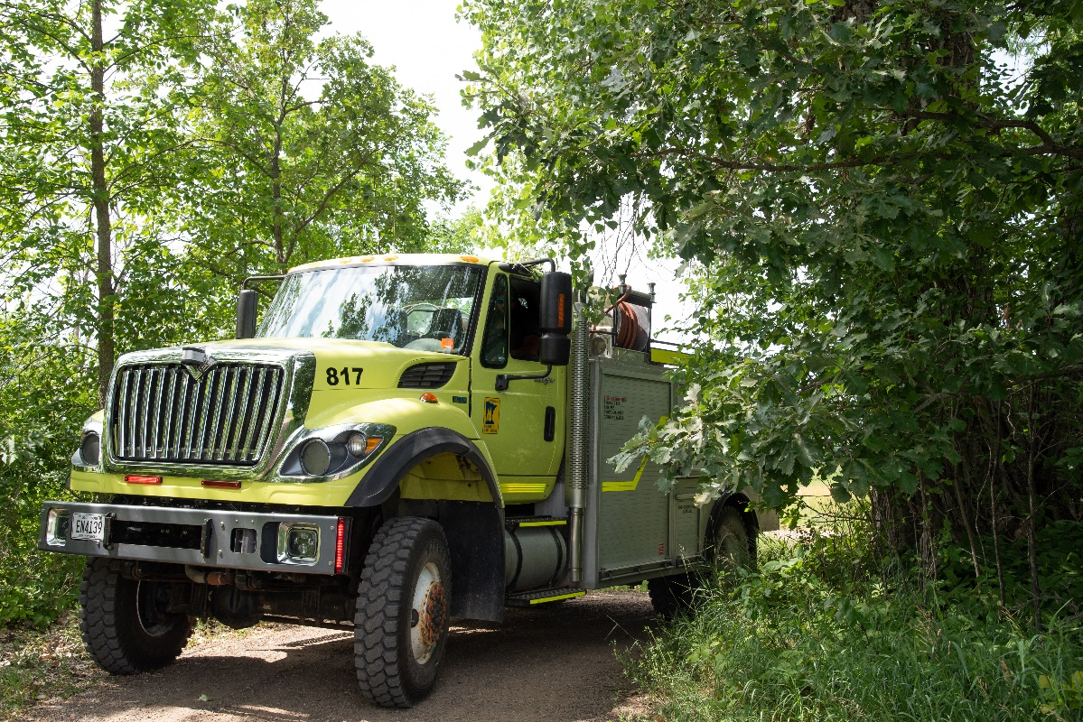
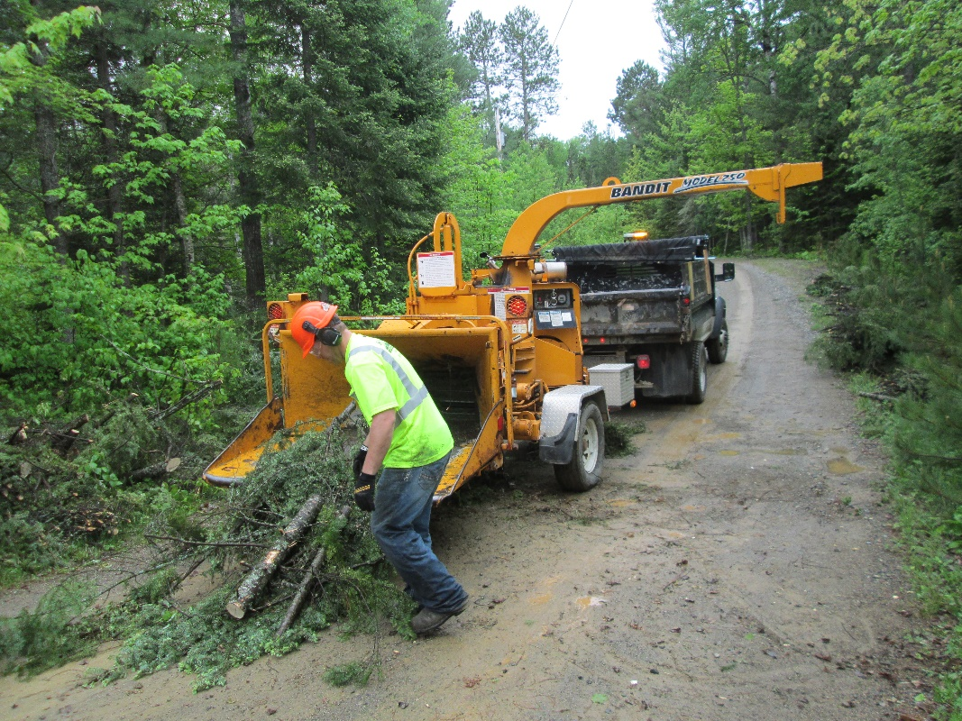
2. Practice Mitigation
Hazardous fuel reduction practices: tree removal, stand thinning, ladder fuel reduction, pruning, slash burning, brush disposal, fuel break construction, etc.
Risk mitigation activities: relocate flammable materials, improve access, increase visibility (signs), etc.
Notes:
Mitigation falls into two categories: Hazardous fuel reduction and risk mitigation

Slide 17
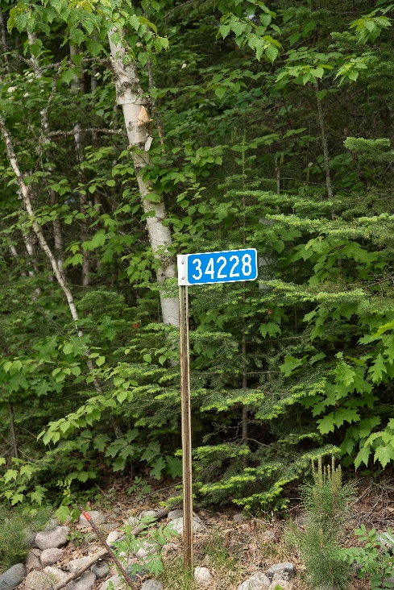
Decide what you can do
Yard waste clean up: decks, roofs, gutters
Home hardening: metal mesh screening for eaves, soffits, under decks/patios, etc.
Plant wildfire-resistant plants and trees
Prune trees, remove ladder fuels, create clearance between tree crowns
Add visible house numbers at the entrance to the driveway and on the house.
Notes:
Some of the least expensive practices can have the biggest effect: Clearing up debris from Decks, Gutters and Roofs.
Perhaps you may not be able to make immediate changes to your home’s exterior construction materials, but you CAN do simple things to minimize home ignition through proper landscape treatments and maintenance.
Landscaping is among the first elements of a home that others notice. If managed effectively, landscaping can also serve as a fuel break, protecting a home in the event of a wildfire. The primary goal for Firewise landscaping is fuel reduction — limiting the level of flammable vegetation and materials surrounding the home and increasing the moisture content of remaining vegetation. Firewise landscaping also allows plants and gardens to reveal their natural beauty by leaving space between individual and groups of plants and trees.
Least Cost with Greatest Effect

Slide 18
3. Community Involvement
Neighbors, fire departments, emergency managers, planners, etc.
Complete a Community Wildfire Protection Plan (CWPPP)
Become a Firewise USA Community
Notes:
Involve the community. The more Firewise your community is, the better protected it is.
Often mitigation activities are more cost effective in larger numbers: chipper day for example.
Grants are available for communities to create a CWPP and for planning, assessment, mitigation and education around Firewise.
Firewise USA communities get financial support.
DNR Regional Firewise Specialists are here to help. Reach out for questions on how to get started.

Slide 19
Thank You!
Firstname Lastname
firstname.lastname@state.mn.us
555-555-5555

