Slide 1
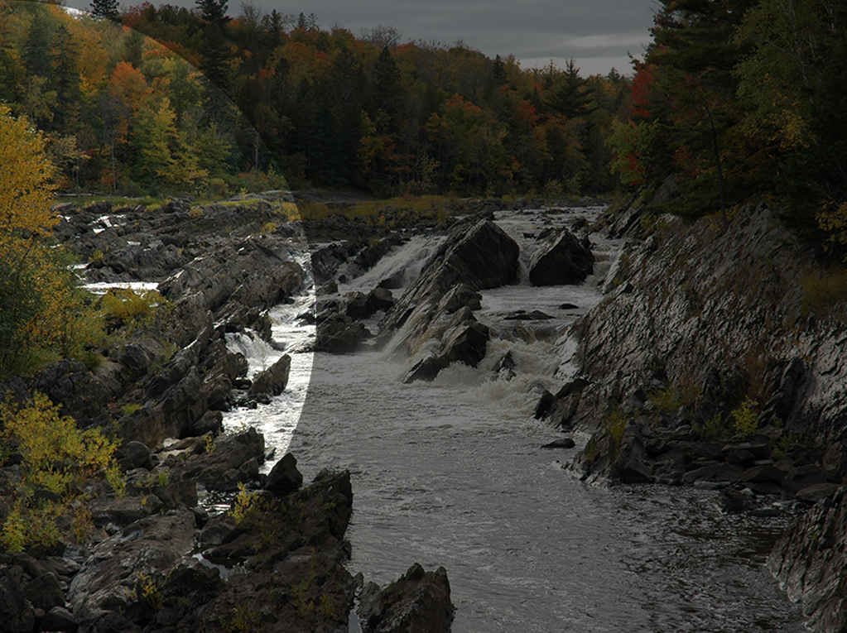
DNR Supplemental Budget 2016

Slide 2

DNR Budget Priorities
Address Budget Shortfall in Parks and Trails
Respond to Emerging Issues
NorthMet Legal Support Costs
Pineland Sands Land and Water Study
Mille Lacs Operations
Advance policy changes that promote best practices
Aviation Supplemental Budget
Wild Rice License Exemption for Tribal Authorities
Cost Recovery for Administration of Local and Regional Grants

Slide 3
Budget Request by Fund

Slide 4
NorthMet Legal Costs
$4 million in FY 2016-17 (general fund)
Legal defense of environmental review and permitting decisions related to NorthMet mining project
Assumes legal challenges on all decisions in all venues
Funding prevents diverting resources away from core services in divisions

Slide 5
Parks and Trails Operations Funding
$5.3 million in FY 2017, $1 million annually beginning in FY2018
$3 million general fund, one time
$2.3 million Natural Resources State Parks Account in FY 2017, $1 million base
2017 funding addresses
$4.1 million budget shortfall
$400k for immediate trails maintenance needs
$800k for modernizing system to improve customer experiences

Slide 6
Why is there a FY17 shortfall?
Last biennial budget increase achieved the following:
Covered previous one-time funding gap
Addressed previous inflationary increases
But…inflationary increases were higher than anticipated
Last years salary supplement request only on portion of Parks and Trails budget
Workforce increases higher than 1.8% received
Other increases in the cost of doing business
Expenditures
Compensation Increases $4.6M
Other Operating Increases $2.5M
Expenditure Increases $7.1M
Resources
New Appropriations $4.75M
1.8% Salary Adjustment $0.9M
Replace One-Time Funds ($2.65M)
Net Resource Increases $3.0M
FY17 Budget Gap $4.1M

Slide 7
Parks and Trails Investment Needs
Trails Maintenance
Prevent further erosion of trails operations and maintenance
Meet highest priority needs
Investments to modernize infrastructure to support new self-directed business model

Slide 8
Parks and Trails at 125 Years: Trends Affecting Our Future
Demographic change and shifting recreation preferences
Active outdoor lifestyle increasingly important to improving population health
Aging system needing more care
Budgets not keeping up with growth and inflation

Slide 9
Parks and Trails System Plan: Next Steps
Advance quality customer service and better government
Better integrate our system of
State parks
State trails
Forest recreation areas
Water recreation
Parks and Trails 2025: Meaningful public engagement process in 2016

Slide 10
Parks and Trails System Plan: What will be different?
20th Century | 21st Century
Growing the system (unit within 50 miles of everyone) | Focused investment at most-used locations
Focus on uniform approach across system | Niche units with different services – respond to trends
One unit; one manager | Geographic staffing pattern; co-managed units
Staff-intensive customer service | Use partnerships, technology and self-directed services

Slide 11
2016: Launching Improvements
Customer Service | Efficiencies
100% reservable and same day camping reservations | Focus on high priority work
Self-directed orientation | Staffing changes
Public engagement process | Evaluating under-performing facilities and services

Slide 12
Implications of Funding Request
Without funding:
Immediate staffing impacts and service reductions
Continued deterioration of trails
Delayed implementation of system improvements
With funding :
Rely on attrition to transition to self-service model
Provide high-priority parks and trails operations and maintenance
Provide modernized customer services

Slide 13
Pineland Sands Land and Water Study
$1.5 million in FY 2017 (general fund)
Funds study of impacts to groundwater and habitat changes in land use resulting from land use in the Pineland Sands aquifer
Study will include a review of environmental effects on:
Drinking and surface water
Plant and animal species
Results of the study will be used to inform permitting decisions and long-term sustainability of water resources in the area.
Study will assist other agencies in drinking water protection activities and development of best management practices for the area.

Slide 14
Mille Lac Operations
$197,000 annually from the general fund starting in FY17
Operational and maintenance funding for proposed new facility in Mille Lacs
Resident scientist (year round)
Two seasonal hatchery support staff

Slide 15
Promoting Best Practices
Aviation Supplemental Budget
Wild Rice License Exemption for Tribal Authorities
Cost Recovery for Administration of Local and Regional Grants

Slide 16

DNR Supplemental Budget 2016
Questions?

