Slide 1
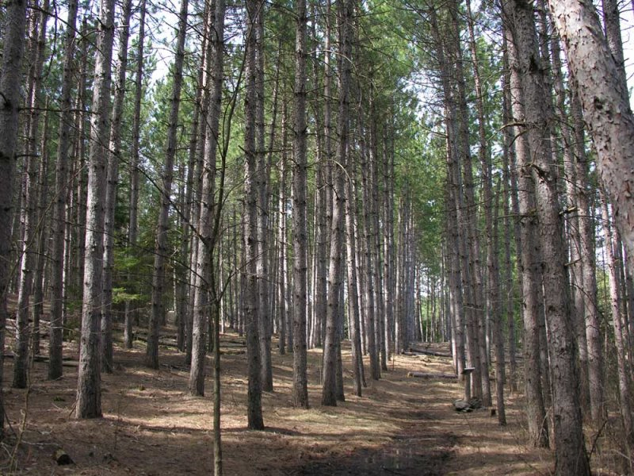
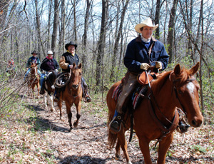

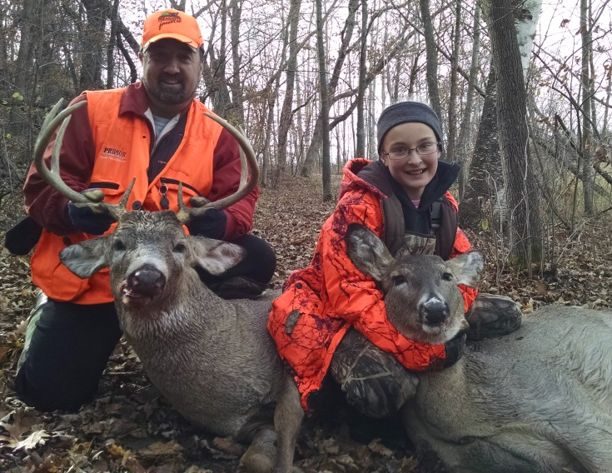
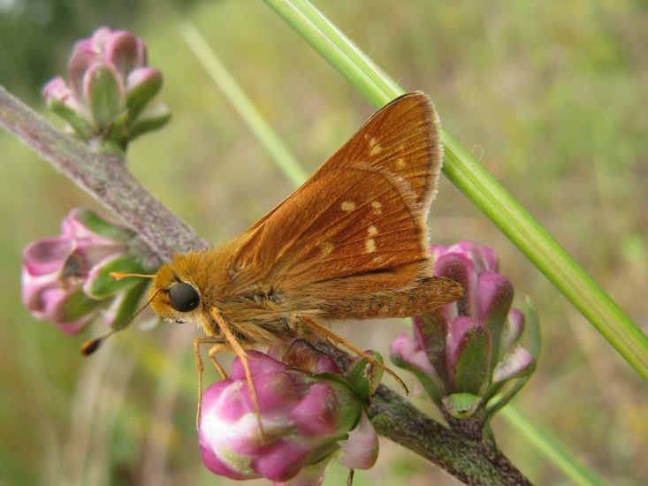
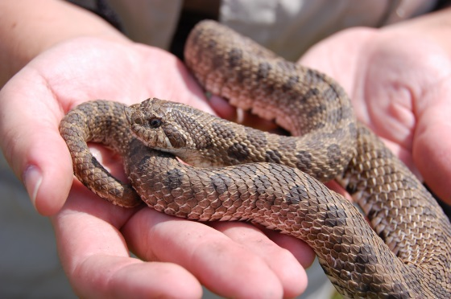
Sand Dunes State Forest
Managing for multiple values

Slide 2
Tree (Timber) Management in the
Sand Dunes State Forest
What we’ll cover:
Why cut trees?
Forest (Timber) Management
in the Sand Dunes
Recent and upcoming forest management

Slide 3
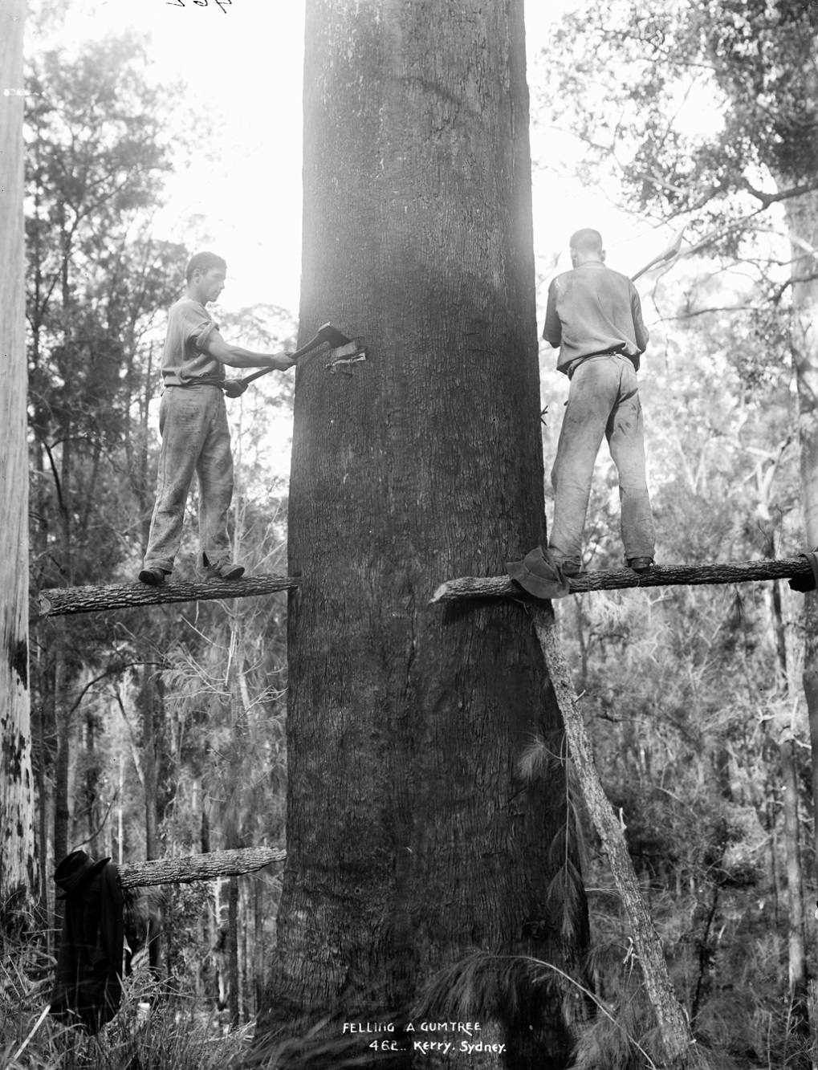
Why Cut Trees?

Slide 4
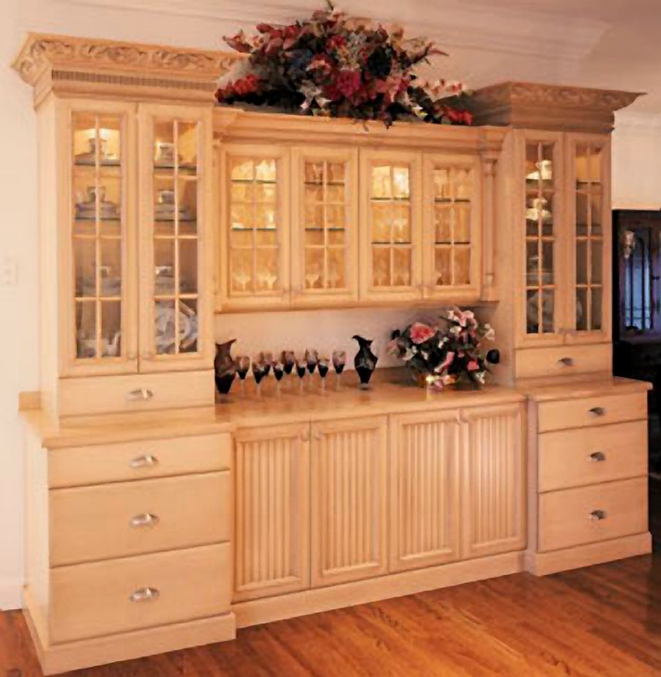
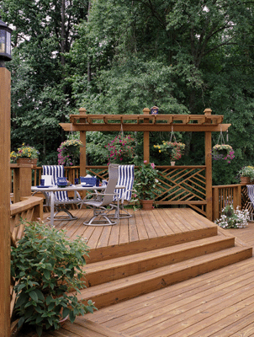
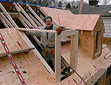
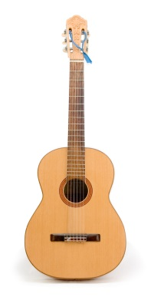

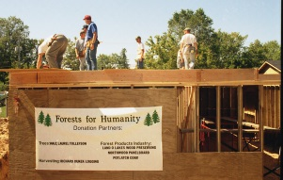

Slide 5
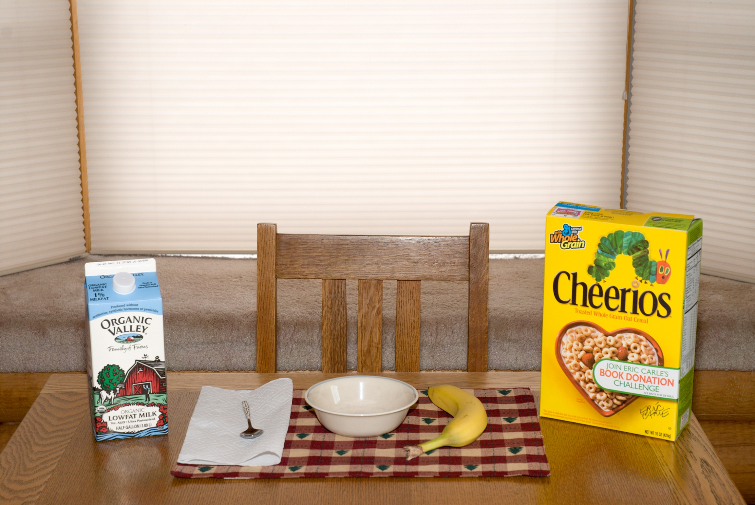

Slide 6
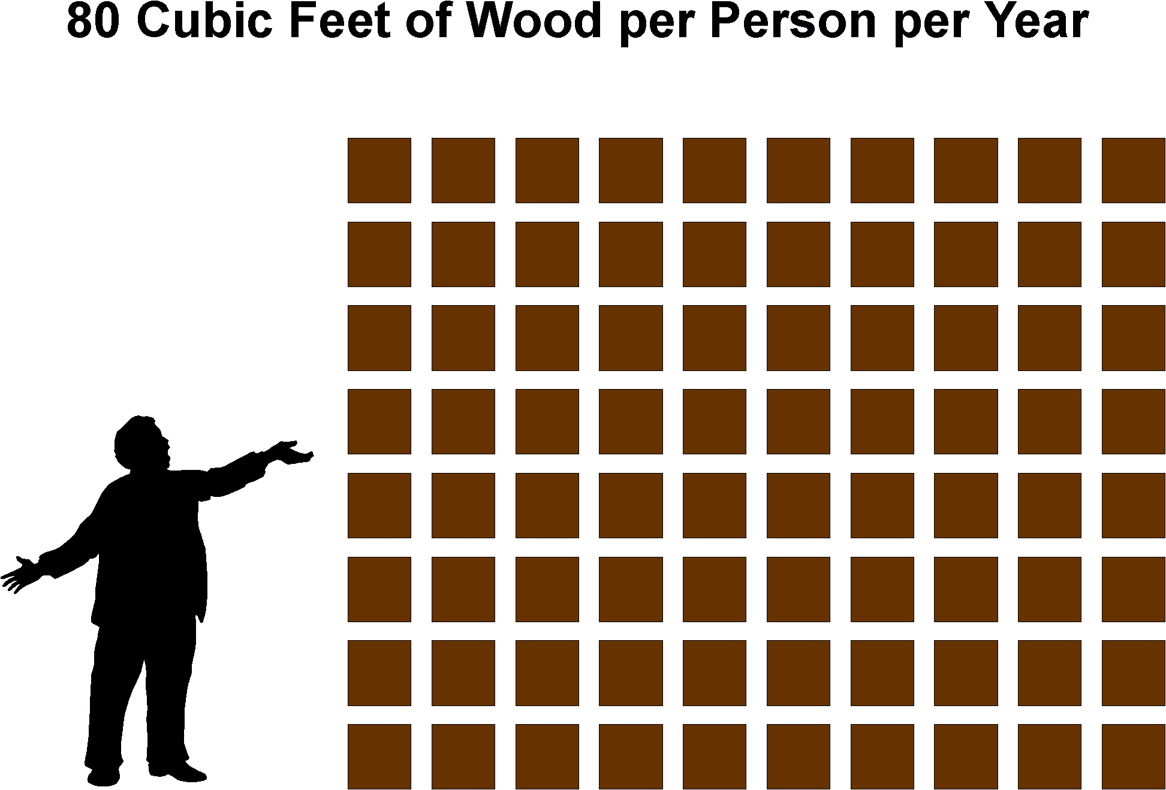
60 Cubic Feet of Wood per Person per Year

Slide 7
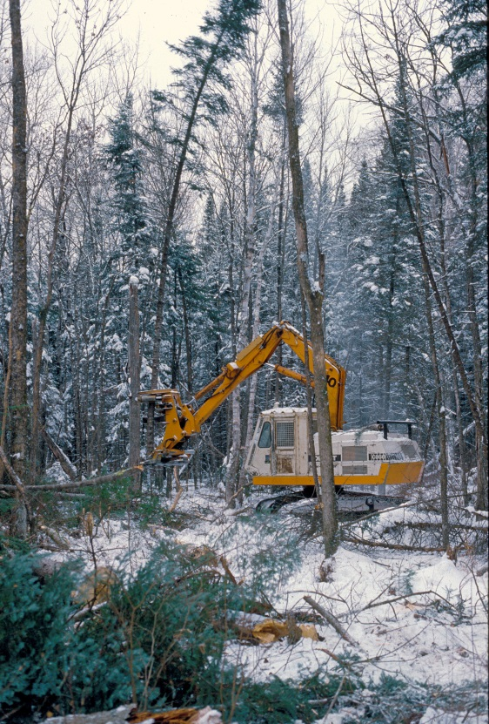
Sherburne County: about 90,000 residents (2013 census)
90,000 People x 60 cf/person (0.67 cord/person) =
60,000 cords of wood per year
About 2000 Acres of Forest per Year

Slide 8
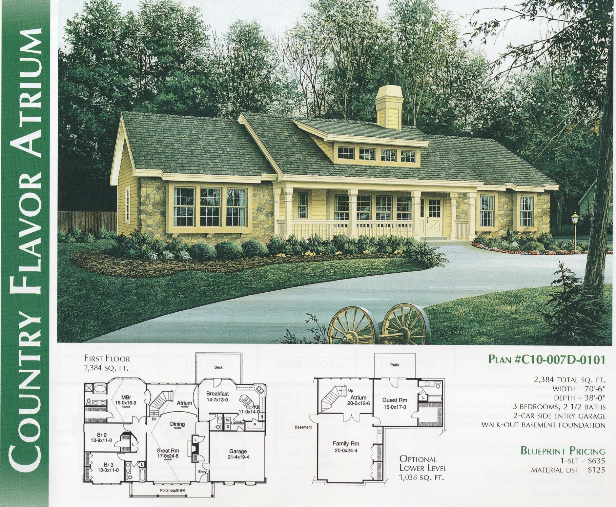

Slide 9
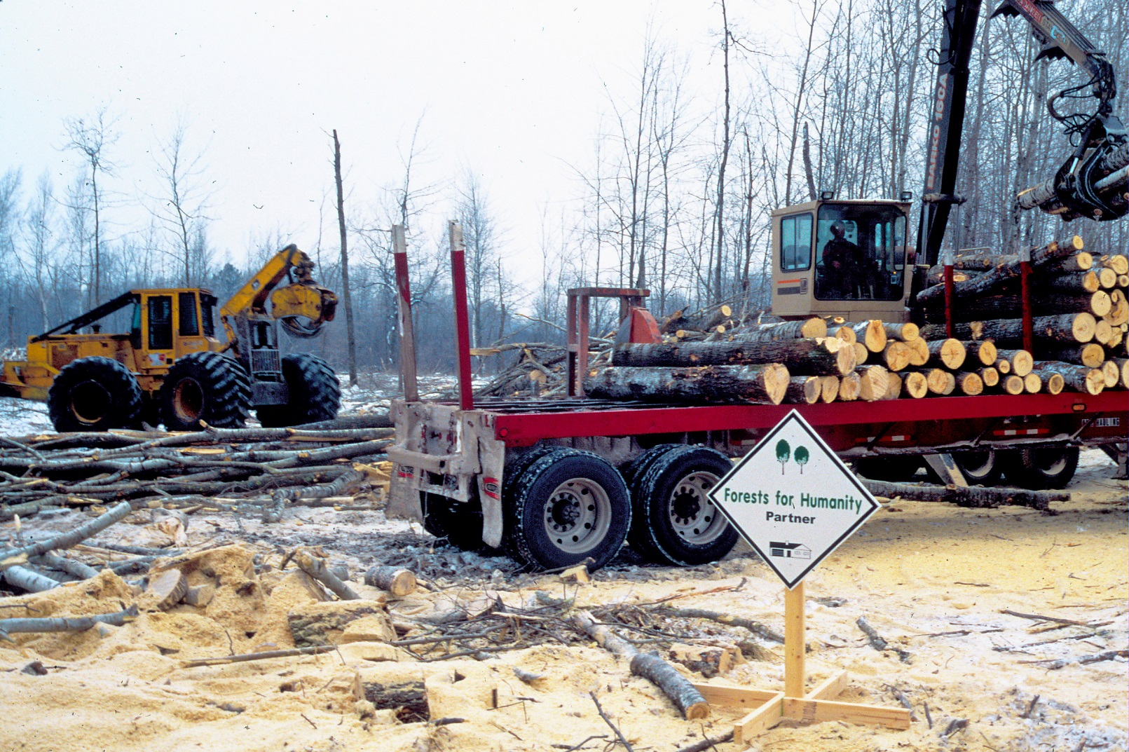
22,000 Homes x 15mbf/Home =
22,000 Acres of Forest

Slide 10
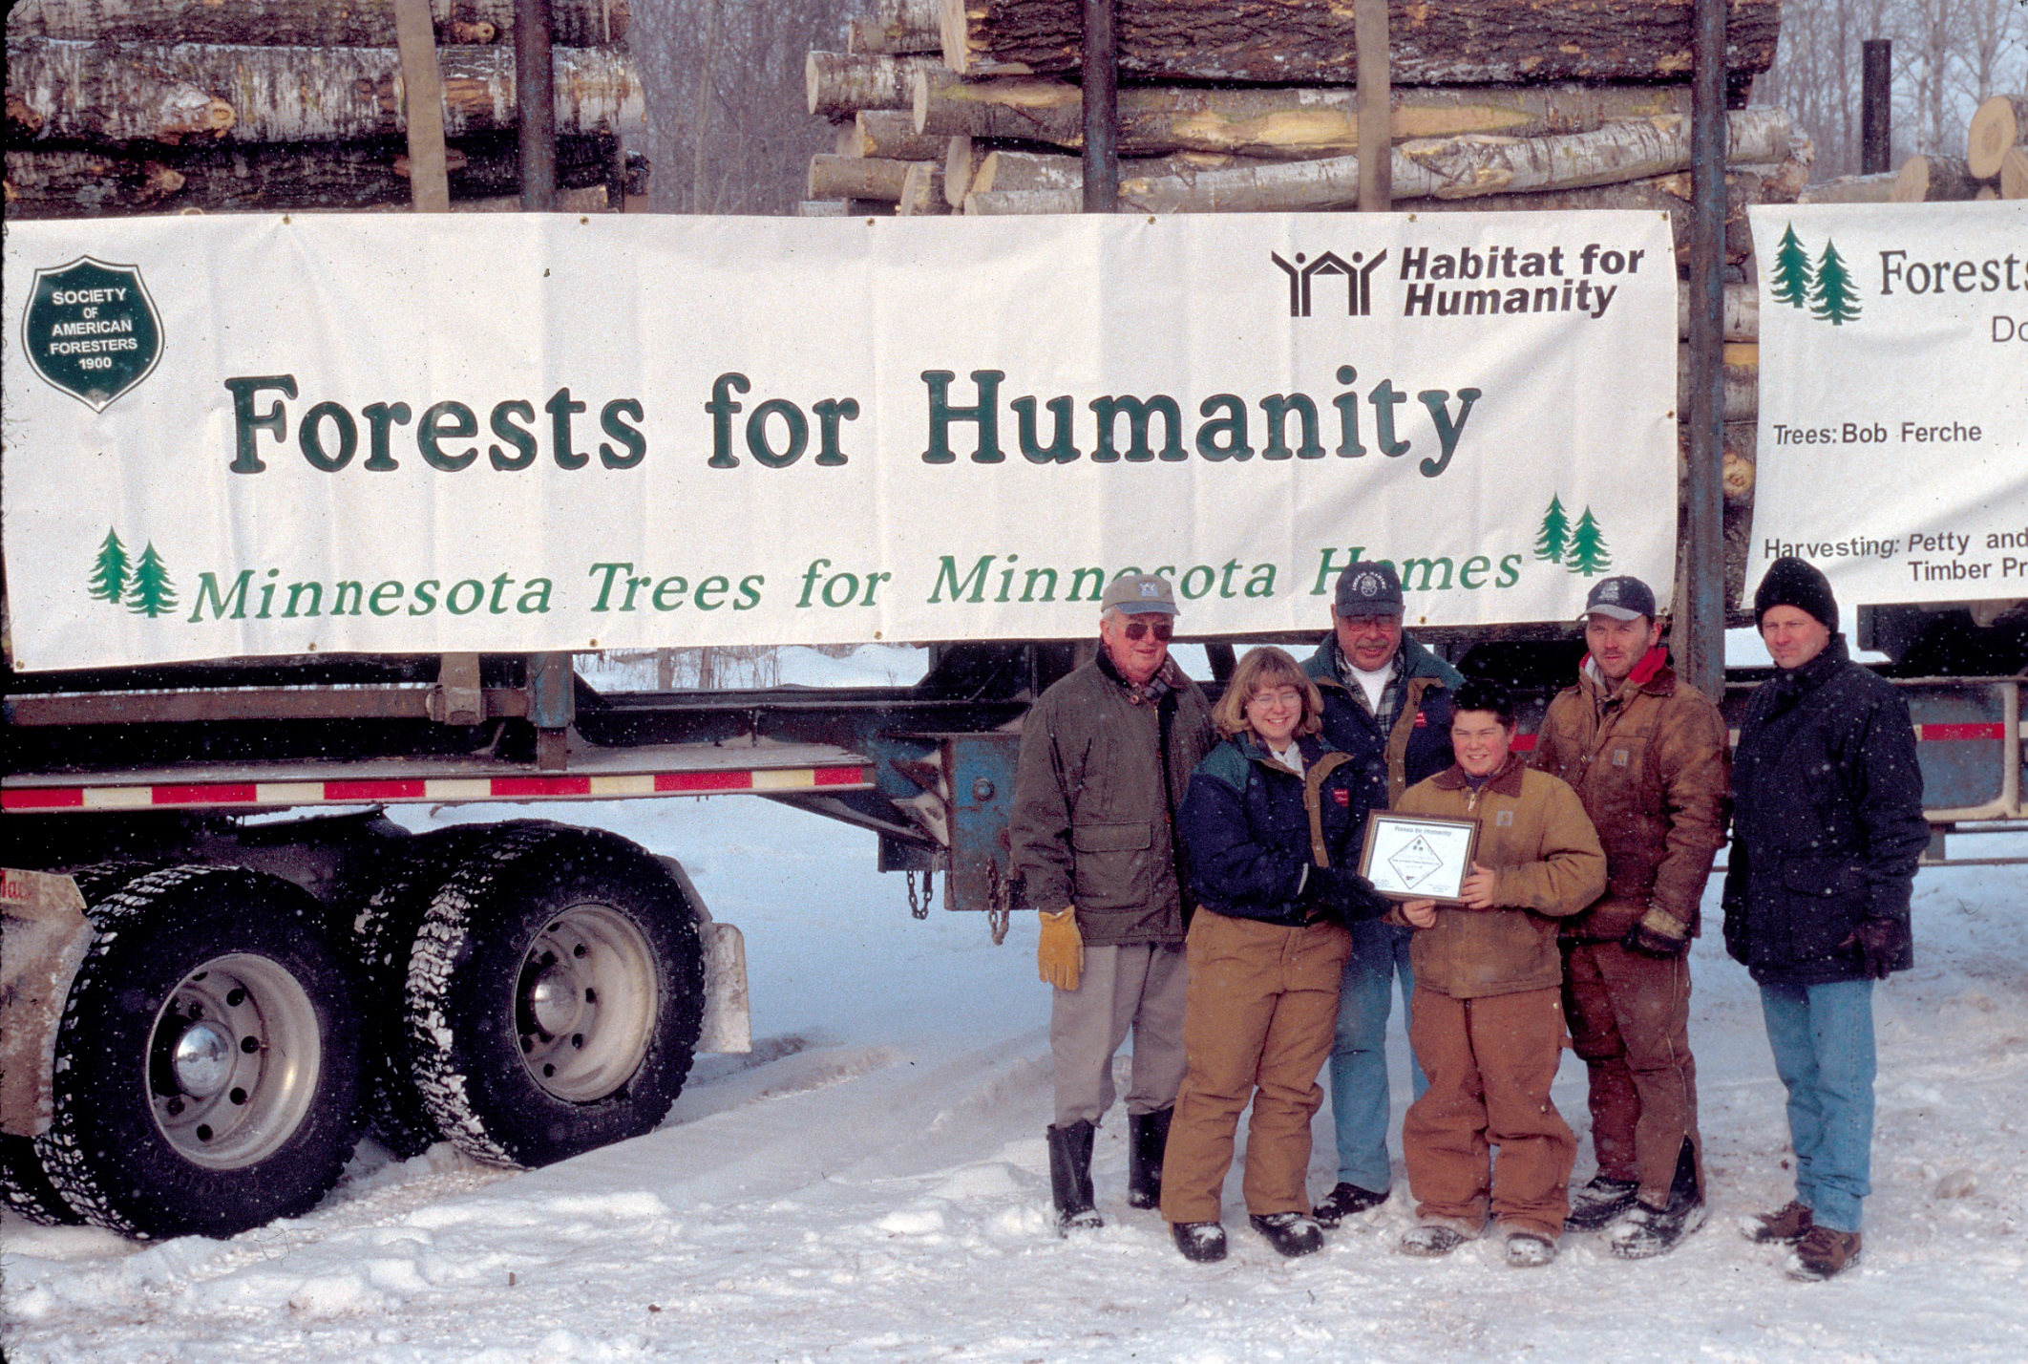

Slide 11
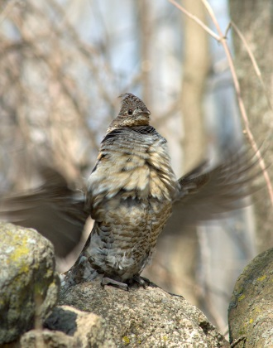
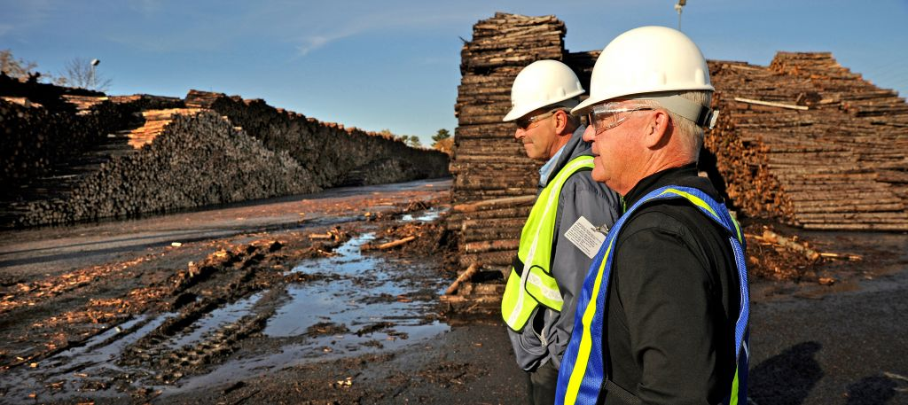
Forestry and Forest Products Matter In Minnesota
Good forest management is important to Minnesota:
Commercial harvesting is an important management tool used by foresters and wildlife managers.
Wood products manufacturing is a major contributor to the state’s wealth, and much of the raw material driving the industry is from Minnesota.

Slide 12




Wood Products Are an Economic Foundation for Many Communities
Notes:
Main street businesses in much of rural Minnesota depend on loggers and mill workers as customers. Much of the state’s rural infrastructure has been built or upgraded because of the forest products industry. This infrastructure benefits tourism and other important industries as well. It is also important to note that wood products industry tends to provide higher-wage jobs than many other nonmanufacturing occupations.

Slide 13
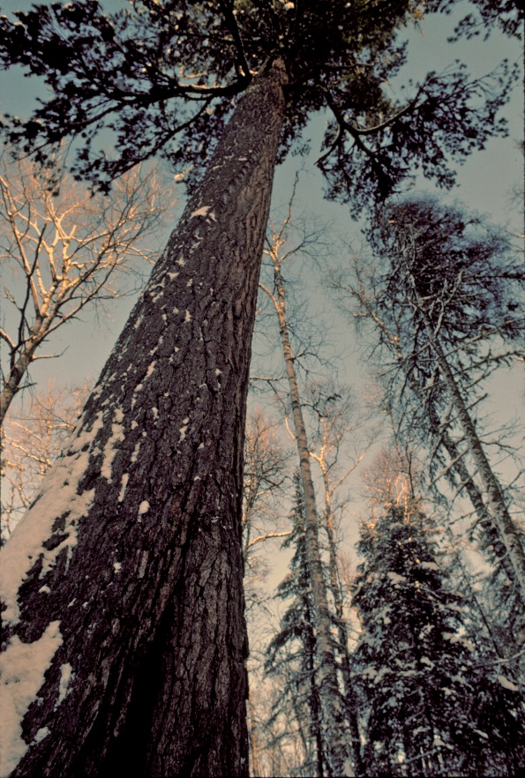
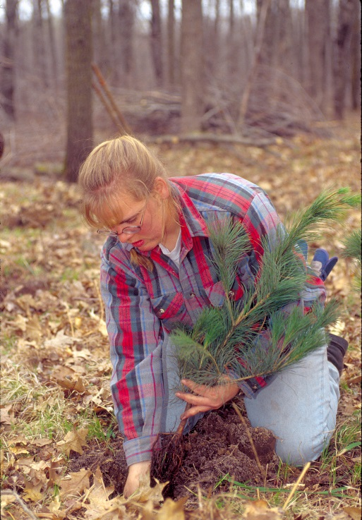
Forest Management
- Forests are dynamic – always changing
- Fire, wind, age, and humans are drivers of change
- Trees have a limited lifespan
- If you want a 50 year old tree 50 years from now, you need to start a tree today

Slide 14


Shade Tolerance of Trees
Jack Pine
Aspen
Red Pine
Paper Birch
Pin Oak
White Pine
Bur Oak
Basswood
Sugar Maple
Notes:
Folks often ask about our forest harvesting methods so I’d like to mention a few things about that. Just like house plants and garden plants, trees vary in their need for sunlight. The most common tree species in the Sand Dunes State Forest (red pine, white pine, Northern pin oak, and bur oak) become established and grow best with sunlight. In the past, forest disturbances like fire and wind created conditions favorable to establishing these species. Today, if we want to create conditions for establishing these species, we need to remove most of the shade from the site. The sandy soils in the area are droughty and relatively infertile which also tends to favor the sun-loving, pioneer species over the more shade tolerant, fertile soil species.

Slide 15
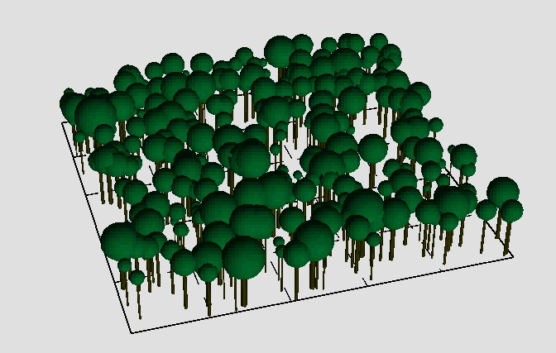

Slide 16
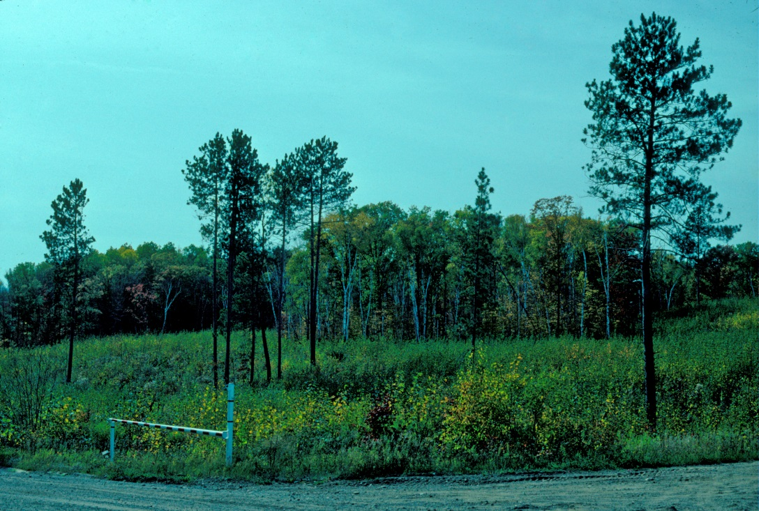
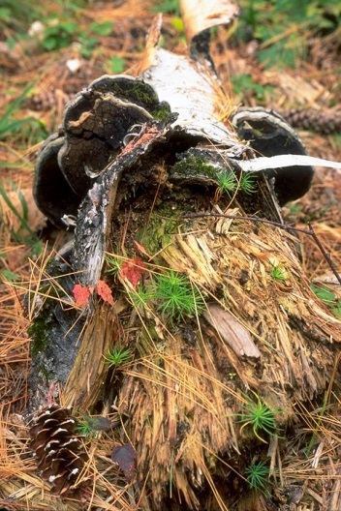
The harvest is really just the start of the
New Forest
Will next forest favor a shade-tolerant or sun-loving tree?
Sale regulations dictate how many trees are removed versus left behind (provide shade or sun?)

Slide 17
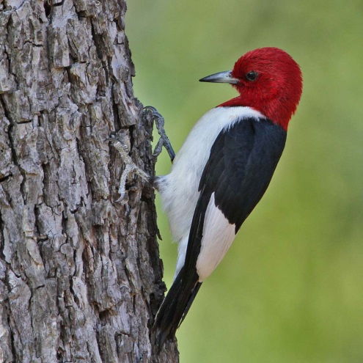
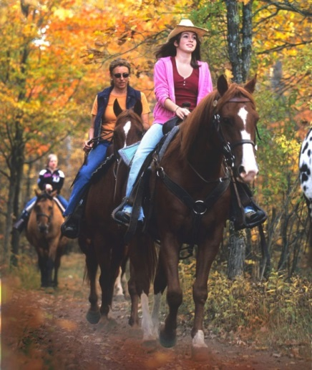
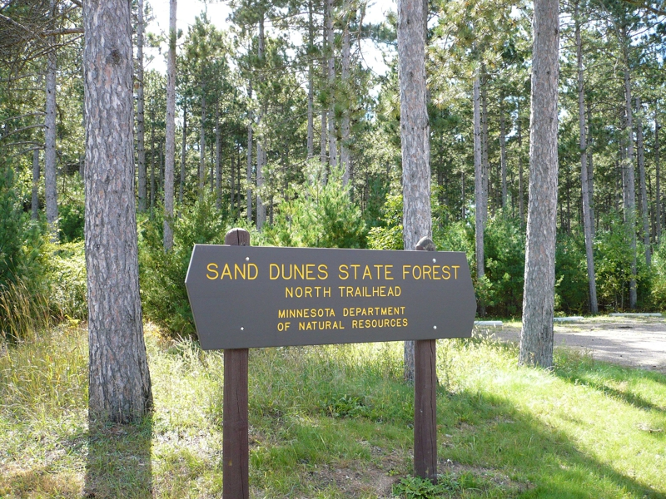
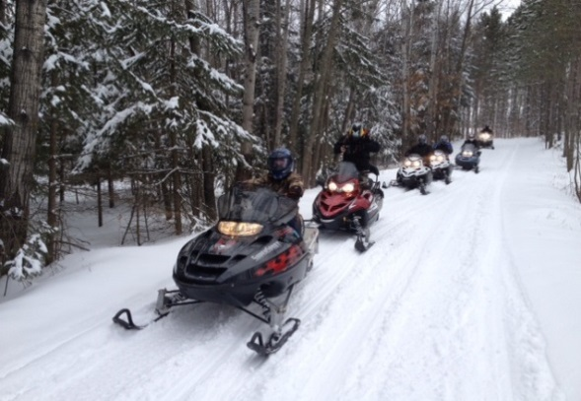
Recreation Considerations
Aesthetic Considerations
Rare Feature Considerations
Insect and Disease Considerations

Slide 18
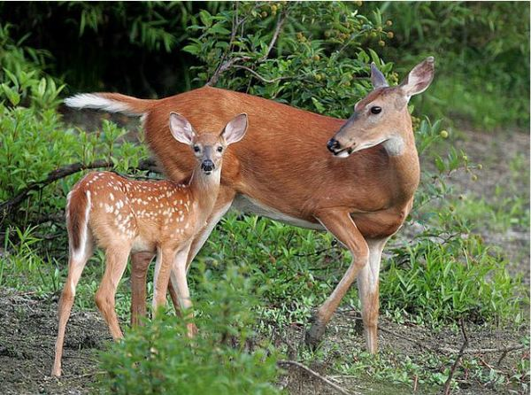
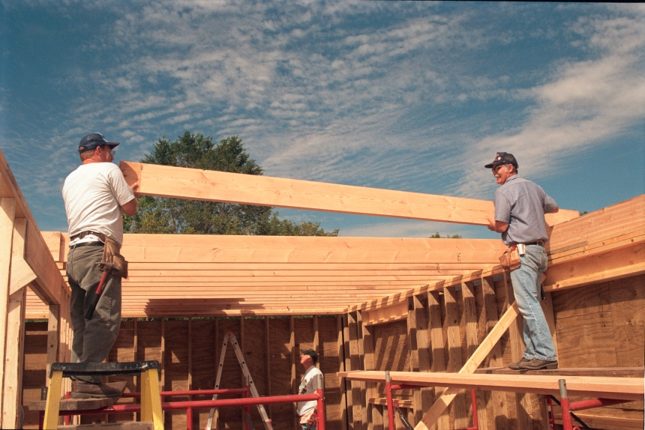
What is Sustainability?
“Not compromising future generations’ ability to derive desired goods and services from the forest with current activities.”
Involves more than timber.
Notes:
Many definitions, but this one seems like a good fit to me. Minnesota DNR’s forest management is 3rd party certified by the Forest Stewardship Council (FSC) and the Sustainable Forestry Initiative (SFI). Our forest management practices are audited by these folks regularly to ensure we are complying with their sustainability standards. We could “save our forests” and get our wood from somewhere else – rain forests, Brazil – but these places often have less environmental standards than we do, plus there’s the added energy cost to get the products to use, so the net impact to the environment is greater.

Slide 19
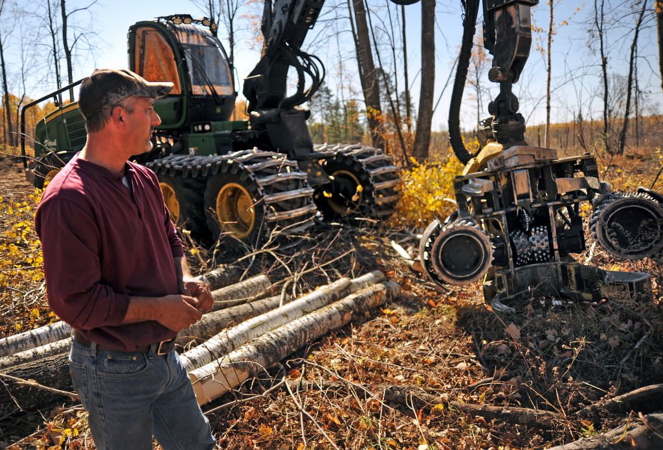
Tree Harvest in the Sand Dunes State Forest

Slide 20
89.021 STATE FORESTS ESTABLISHED (1943). For the purpose of vesting and revesting the state with title to lands in the areas hereafter described which are suitable primarily for state use and development as state forests, for growing, managing, and harvesting timber and other forest crops and for the establishment and development of recreational areas and for the protection of watershed areas, and the preservation and development of rare and distinctive species of flora native to such areas, there are hereby established as state forests all lands and waters now owned by the state or hereafter acquired by the state within the areas, in the townships and sections described as follows:

Slide 21
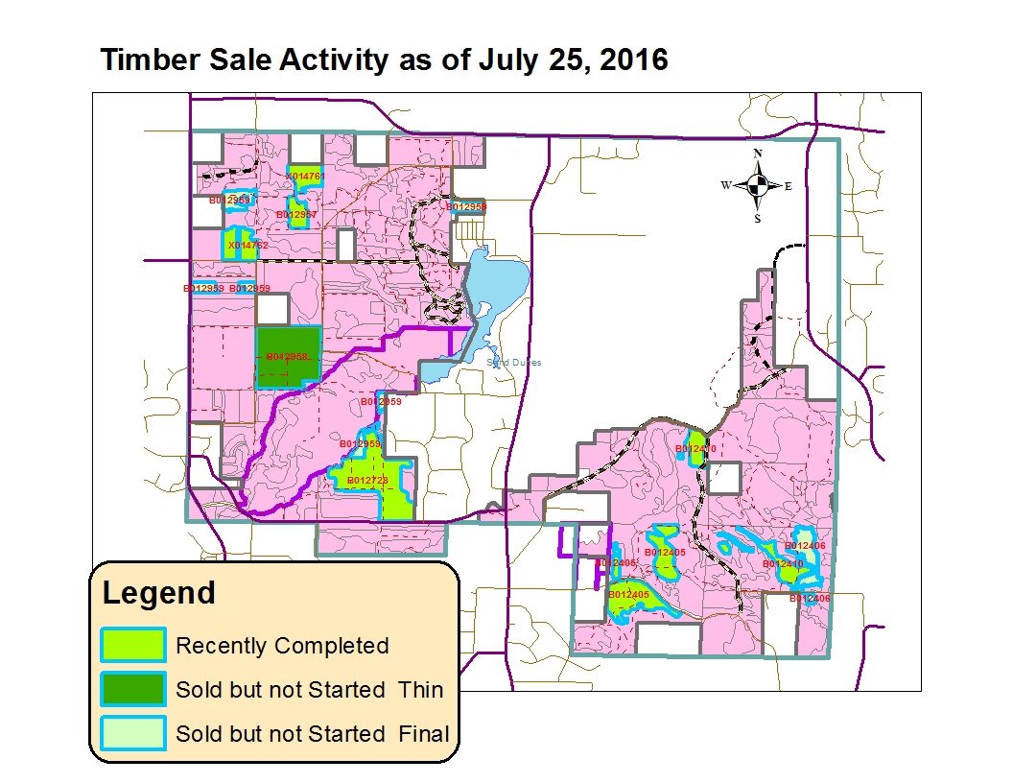

Slide 22
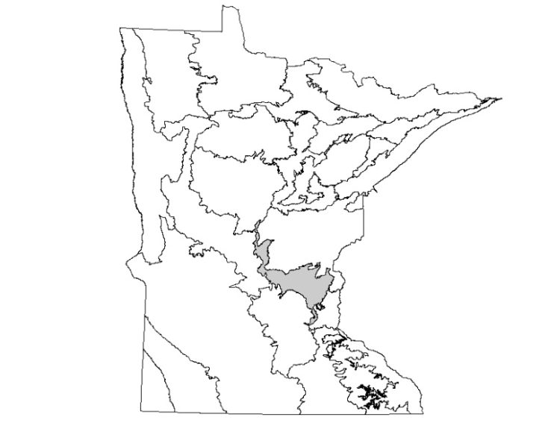

Every year, we have a new list of stands to field visit to assess for management needs
Stands come from the Anoka Sand Plains Subsection Plan
Subsection plan produced a 10 year list of stands to assess
Minnesota Department of Natural Resources
Division of Forestry
Anoka Sand Plain
Subsection Forest Resource Management Plan
April 2012
Notes:
How do we determine where to harvest?

Slide 23
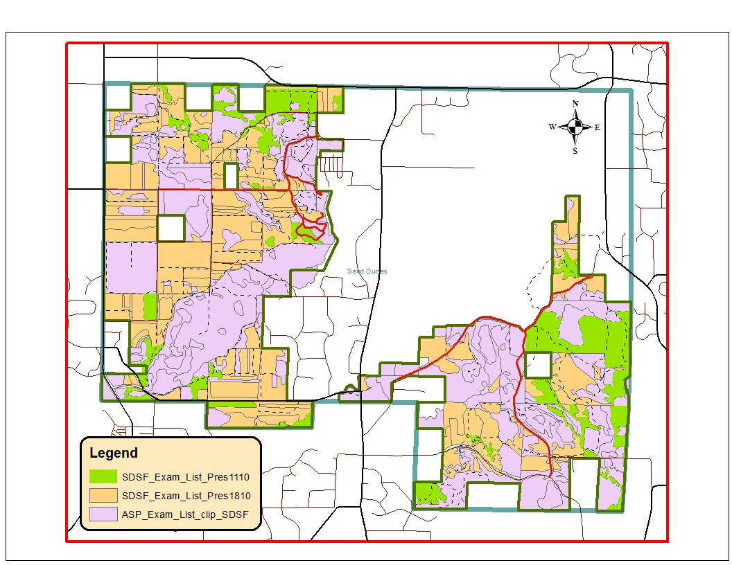
Notes:
Prescription Code 1110 means that the inventory for that stand suggests it is ready for or nearing a final harvest.
Prescription Code 1810 means that the inventory for that stand suggests it is ready for a thinning (removal of about 1/3 of the trees to increase the growing space for the remaining trees).
The remaining stands (in purple in the map) are not targeted for any treatment in the current Anoka Sand Plains Subsection Plan.

Slide 24
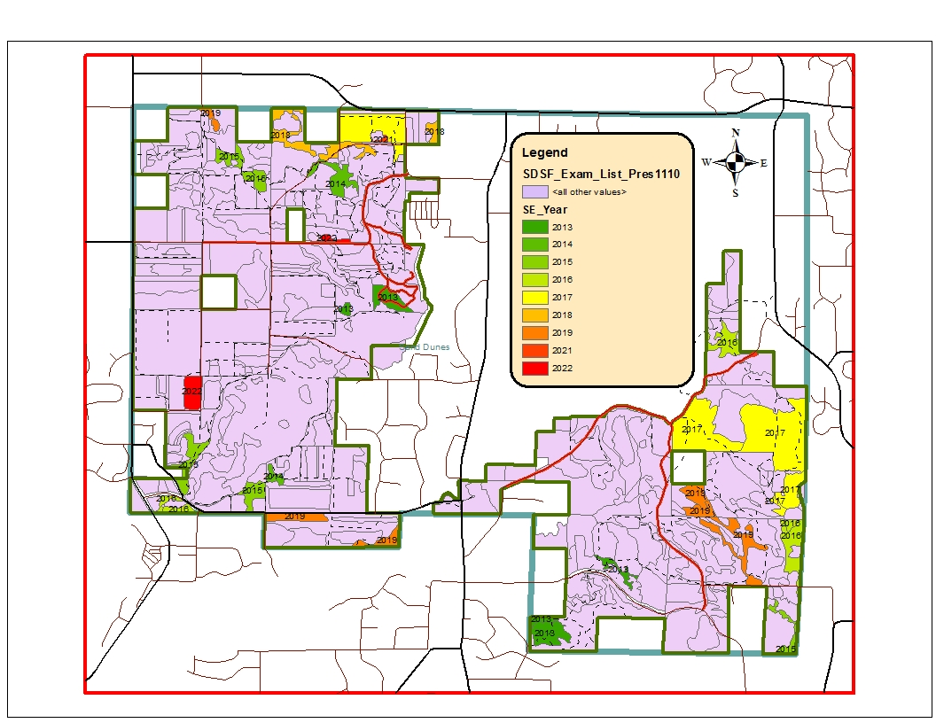
Notes:
Anoka Sand Plains Subsection Plan rotation ages: Aspen 40 years; Birch 40 years; Red and Pin Oak 80 years; Bur/white Oak 120 years; Red Pine 80 years; Jack Pine 30 years; Tamarack 100 years; Northern Hardwoods 80 years; White Pine 100 years.

Slide 25
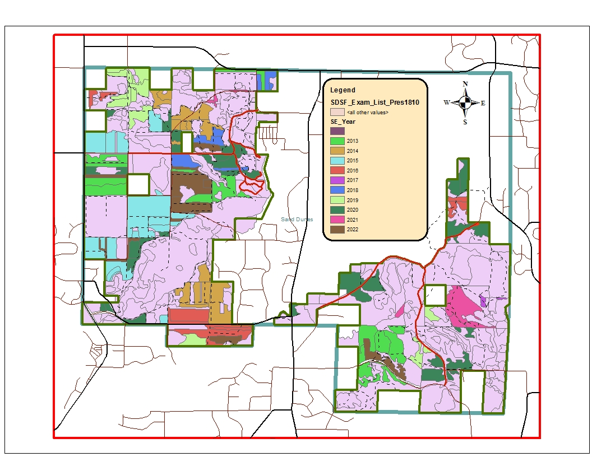
Notes:
Thin a stand when the basal area is at or above 120 square feet per acre.

Slide 26
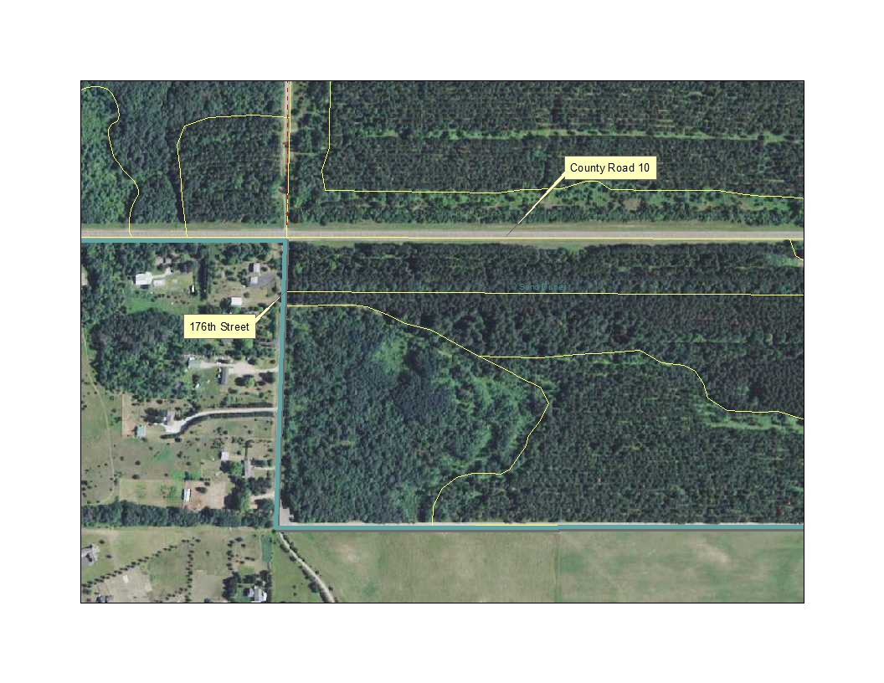

Slide 27
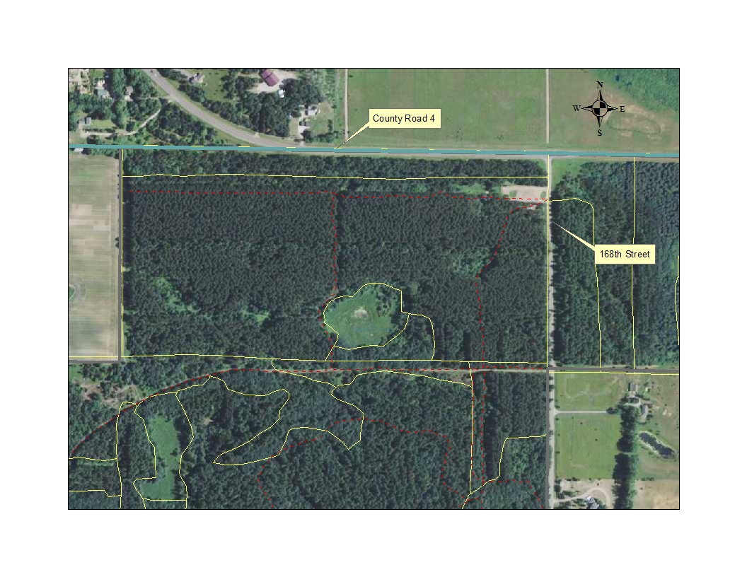

Slide 28
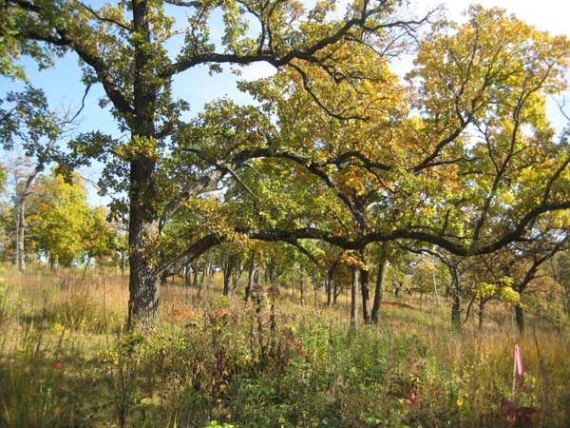
Notes:
This talk was primarily focused on how we manage trees and forests for timber products that are used by society. There are many other values in our forests. Those items will be covered in future meetings.

Slide 29
