Slide 1
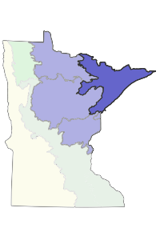
Northern Superior Uplands
Section Forest Resource Management Plan
Harvest Scenario Webinar
September 2015
Notes:
Welcome to the second in a series of three webinars connected with the development of the DNR Northern Superior Uplands Section Forest Resource Management Plan OR SFRMP. My name Jon Nelson. I’m a Forest Policy and Planning Supervisor with the DNR Division of Forestry and I’ll be your presenter for this webinar.

Slide 2
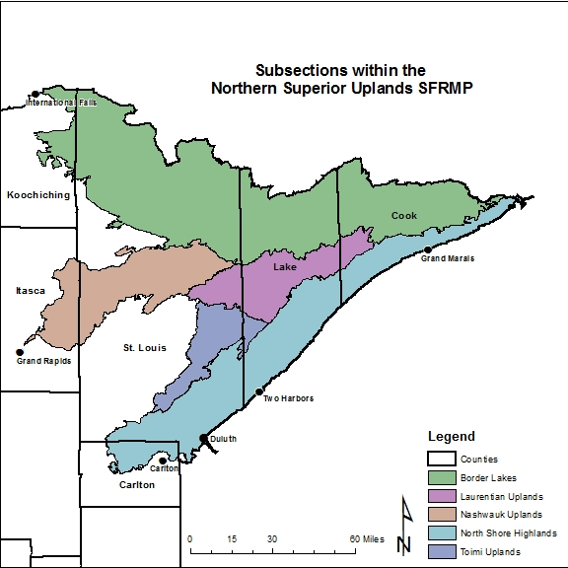
Northern Superior Uplands (NSU)
5 ECS Subsections
  North Shore Highlands
  Toimi Uplands
  Laurentian Uplands
  Nashwauk Uplands
  Border Lakes
4 Forestry Admin Areas
4 Wildlife Admin Areas
5 Fisheries Admin Areas
1 DNR Region (Northeast)
Notes:
As a refresher or brief introduction, the NSU SFRMP addresses vegetation management of certain DNR forest lands across the majority of MN Arrowhead region.
Approximately 600,000 acres or about 10-12% of the area of the entire Section.
It includes 5 ECS subsections (the next lower level in the DNR Ecological Classification System)
It also includes, in part or in whole, 4 DNR Forestry Areas, 4 DNR Wildlife area, and 5 DNR Fisheries Areas.

Slide 3
Balancing Multiple Values and Objectives
Stakeholder interests, statutes, and policies direct DNR to manage forestlands for multiple values, including:
    Habitat values
    Ecological /environmental values
    Economic values of forest products
    Sustainability of forest resources to support all values
DNR balances these multiple interests by:
    Developing forest management plans (SFRMP) that incorporate DNR policies and balance multiple objectives
    Applying department policies and SFRMP direction in day-to-day operations (e.g., stand level management prescriptions)
Notes:
Also as a refresher, it is important to understand SFRMPs in the context of DNR’s higher-level, overall direction and interest in : Balancing Multiple Values and Objectives its approach to forest management. This includes:

Slide 4
Goals of SFRMP Process
Consideration of broad resource management issues affecting vegetation management.
Resulting in a sustainable forest management plan that provides:
  Strategic forest management direction, and,
  A 10-year list of stands that will be examined for possible timber harvest or other management
Consider forest certification standards:
  Forest Stewardship Council (FSC) and
  Sustainable Forestry Initiative (SFI)
Notes:
Within the SFRMP process, these broad, higher level objectives are reflected in the:

Slide 5
Primary SFRMP Products
SFRMPs identify both:
1. Strategic forest management directions such as:
  General Direction Statements (GDS)
    Strategies,
    Desired Future Conditions (DFC), and
  A 10-year list of stands that:
    Will be field visited during plan implementation
    Provides the best opportunity to implement the plan’s strategic direction through timber harvest or other management.
Notes:
Input on the DFCs, GDSs and strategies, and results of the 10-year stand selection will occur with review of the Draft SFRMPs (which will be available late this year/early next year)

Slide 6
SFRMP Stakeholder Involvement
Stakeholders, and the public, are invited to become involved in the SFRMP process through 3 webinars:
Webinar 1: Background and Introduction to SFRMPs;
    Can be viewed on line at:
    http://www.dnr.state.mn.us/forestry/subsection/active.html
Webinar 2: Alternative Harvest Scenarios
Webinar 3: Review of the Draft SFRMP
Notes:
With this new round of SFRMPs (revisions), DNR is introducing the use of Webinars to facilitate stakeholder and public input in the development and review of these plans.
This webinar is the second in the series of three.
The first Introductory webinar recording can still be viewed on the DNR web site via the link address provided here.

Slide 7
Webinar 2
Review of Alternative Harvest Scenarios
The DNR developed 4 harvest scenarios to explore the implications and trade-offs associated with different planning decisions
This webinar describes these scenarios and their projected associated outcomes
DNR is asking for stakeholder feedback on these scenarios via a series of survey questions at the end of this webinar
Surveys, comments and questions will be accepted through October 17, 2015.
Notes:
For this 2nd webinar/public input opportunity, DNR used a harvest scheduling model called RemSoft to incorporate and assess a mix of planning decisions into 4 harvest scenarios.
These four scenarios are presented as a reasonable mix of possible planning decisions.
They are not the only potential combinations of planning decisions that DNR will consider.

Slide 8
Role of Harvest Schedule Modeling in SFRMP
Informs planning decisions by providing a way to examine:
  The implications of different planning decisions through the use of timber harvest scenarios
  The relative sensitivity of projected outcomes to different planning decisions
Optimizes the selection of the 10-year stand exam list by incorporating goals and criteria identified in the plan.
Notes:
RemSoft and harvest schedule modeling in general may be new to some of you. So it is important to understand what role it plays in DNR’s SFRMP process.

Slide 9
Modeling Parameters Varied in the Harvest Scenarios
The modeling parameters that we are varying across the 4 scenarios are:
  Even-flow
  Lowland Conifer Old Growth (LCOG)
  Cover type conversion
  Additional older forest
These are the modeling parameters with the greatest potential effect on model outcomes and for which DNR will make decisions prior to the final stand selection model run
DNR is not seeking input on other model parameters that are constant across the scenarios.
Notes:
These planning decisions are incorporated into the model as goals or targets for various modeling “parameters” that reflect these planning decisions
This webinar presents four timber harvest scenarios that represent a possible mix of planning decisions, represented by variations of four different modeling parameters, that DNR might use in the final stand selection model run for the draft SFRMP plan

Slide 10
Modeling Parameters Held Constant in All Scenarios
DNR is not seeking input on established “constant” modeling parameters, such as:
  Established normal rotation ages
  Thinning regimes for forest types that are typically thinned or managed as uneven-aged types (e.g., red pine, northern hardwoods)
  Applying a standard “3% discount rate” to estimate the current value of projected future timber revenues.
Notes:
DNR is not seeking input on “constant” modeling parameters (i.e., they are not changed across the various harvest scenarios) including:
Established normal rotation ages (established primarily in the original SFRMPs, calculated from forest inventory data, they generally don’t change much over time, don’t change across the scenarios)
Thinning regimes for forest types that are typically thinned or managed as uneven-aged types (e.g., red pine, white pine, northern hardwoods) (These thinning regimes represent or best reflect the most common application of forest management/harvest practices in these types; used by the model to estimate/project timber volumes and to best project these stands forward in time; these modeled thinning regimes don’t vary greatly across the state or over time).
Applying a standard “3% discount rate” value of money over time to estimate the present value of projected future timber revenues (3% falls range of commonly accepted/applied discount rates for forest/timber products)

Slide 11
Even Flow
Even Flow describes the variability in estimated timber harvest over time compared to a long-term average.
Range of Even Flow values explored in the 4 scenarios:
  Tight - 5% variation in harvest volume over time (overall and for each forest type). Produces more consistent harvest volumes decade to decade.
  Moderate - 20% variation in harvest volume over time (overall and for each forest type)
  Relaxed – 40% variation in harvest volume over time (overall and for each forest type). Produces more variable harvest volumes decade to decade.
See next slide for an example.
Notes:
Back to the modeling parameters that are varied across the four harvest scenarios. The first is Even Flow.

Slide 12
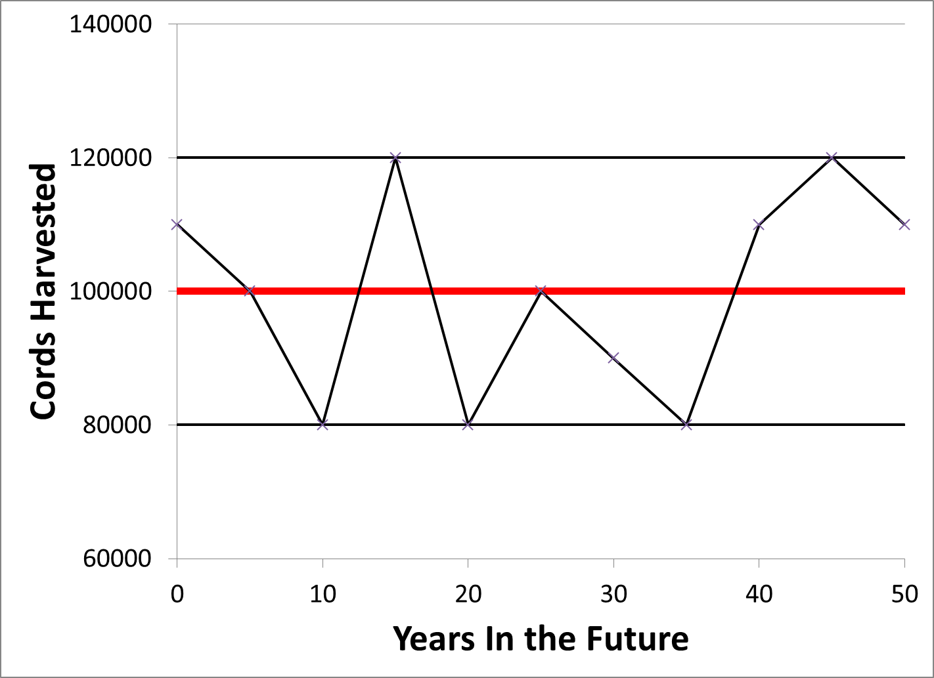
    Even Flow Example
    Moderate Level (20%)
    model allows variation up 20%
    projected long-term running average
    model allows variation down 20%
Notes:
The even-flow parameter has by far the greatest overall effect on the outcomes produced across the 4 scenarios.

Slide 13
Lowland Conifer Old Growth (LCOG)
LCOG describes the amount of productive (non-stagnant) black spruce lowland and tamarack forest types “reserved” from being selected by the model
Intended to represent possible levels of LCOG designation
Range of values explored in the scenarios:
  1.5% reserved, equivalent to the approximate amount of old growth forest designated on upland forest types.
  5% reserved, a rough mid-point between the lower and higher amounts
  10% reserved, the statewide average of productive lowland conifer forest types that have been temporarily reserved as Ecologically Important Lowland Conifer pending completion of LCOG designations.
Notes:
Lowland conifers were not included in the DNRs original OG designation process (early 2000’s) for a number of reasons.
Ecologically Important Lowland Conifers were identified and reserved from harvest in the original SFRMPs as a pool of stands from which LCOG might be identified in the future.
DNR LCOG designation is occurring in conjunction with the revision of each SFRMP.
A full description of DNR’s LCOG evaluation/designation process can be found on the DNR web site at: http://www.dnr.state.mn.us/publications/forestry/index.html

Slide 14
Cover Type Conversions
Cover type conversions describe the amount of assumed or desired change from one forest type to another
Range of values explored in the 4 scenarios:
  No Change - assumes no change from current mix of forest types on DNR lands in the landscape.
  Original SFRMP - continues conversion goals established in previous SFRMPs
    For the NSU, the model reduces the aspen and birch types by 5% each decade, with corresponding increases in jack pine, white pine, red pine, balsam fir, white spruce, and upland white cedar.
  Climate Change Response - conversion goals that represent a possible response to climate change effects over the 50-year projection period
    For NSU, the model assumes decreases in jack pine, black spruce, balsam fir, and white spruce, with corresponding gains in aspen, birch and red/white pine (in the first decade) and gains in northern hardwoods, red pine, white pine and oak in subsequent decades.
Notes:
An important part of DNR’s SFRMP process is identifying a goal for the composition of DNR forest lands in the future.
This future composition goal is expressed as cover type conversion goals (i.e., which forest types do we want less or more of in the future compared to current amounts).
These goals are incorporated into the model (i.e., assumed to take place) to see what effect the change in forest composition might have on the modeling outcomes.

Slide 15
Additional Older Forest
Describes the amount of forest over normal rotation age that the model maintains on DNR lands, based on an all-ownership assessment of current forest age-class distributions.
Applies to forest types managed primarily with even-aged management (aspen, birch, red pine, jack pine, black spruce, tamarack).
Range of values explored in the 4 scenarios:
  No additional – the model does not try to maintain any older forest on DNR lands included in the plan
  Some – the model tries to maintain roughly 5%-7% older forest on DNR lands for certain forest types on certain subsections.
  More – the model tries to maintain roughly 10-15% older forest on DNR lands for certain forest types on certain subsections.
Notes:
The “all-ownership” assessment of current/future forest age-class distributions is a requirement of SFRMP teams following the recent (late 2012) rescission of DNR’s 20-year old Extended Rotation Forest policy (i.e., due to substantial declines in statewide timber harvesting and the resulting overall continued aging of MN forests). More information on this is available in a 2012 Extended Rotation Forest policy review report again available on the DNR web site under Division of Forestry publications).
SFRMP teams assess all-ownership forest age-class data to determine if there are adequate amounts of “older forest” on the landscape now and looking forward (adequate meaning approximately 10-15% depending on the forest type).
If there are concerns, SFRMP plans may propose that additional older forest be maintained on DNR lands.
Applies to forest types managed primarily with “even-aged” management. I’ll talk more about this in a moment.
Can be applied across the planning area (i.e., ECS section) or in certain locations (i.e., ECS subsection).
If the team is considering a recommendation to maintain additional older forest on DNR lands, the 4 modeling scenarios will vary the amount of older forest to maintain (for specific forest types, in specific subsections).
I want to come back to explain the phrase “forest types management primarily with even-aged management.” Even-aged management means that you are managing a stand in a way that results in most trees being of the same or similar age. It is generally applied to the noted forest types because that is generally how they occur naturally because the dominant tree species require lots of sunlight and disturbance to regenerate, or have certain forest health concerns if managed as multi- or uneven-aged stands. It is achieved primarily with timber harvesting methods that produce sufficient disturbance and sunlight for regeneration of these tree species to be successful (either naturally or via planting/seeding). These methods include clear-cuttin (usually with reserve trees), seed tree and shelterwood harvesting.
Managing or assessing forest types based on stand age-class conditions or distributions (such as the amount of older forest) is only really applicable to these “even-aged” forest types (i.e., forest types/stands managed as multi- or uneven-aged stands/types don’t really have a single age, and are managed more based on tree densities and individual tree diameters, rather than stand age; they are also dominated by tree species that can regenerate/grow with less sunlight/disturbance).

Slide 16
The Mix of Parameters in the 4 Harvest Scenarios
Parameter | Scenario A | Scenario B | Scenario C | Scenario D
Even Flow | Tight 5% | Moderate 20% | Relaxed 40% | Relaxed 40%
LCOG | 10% | 5% | 10% | 1.5%
Cover type change | Climate Change Response | Original SFRMP | Original SFRMP | No Change
Add’l Older Forest (if needed for certain forest types) | More | Some | More | No Additional
Notes:
The four scenarios vary these four parameters to present a reasonable mix of possible planning decisions (and how each scenario affects projected outcomes):
Scenario A includes values for the four parameters that would generally be expected to be more restrictive to the amount of timber harvesting that might occur over time.
Scenario D includes values that are generally expected to favor higher levels of timber harvest, at least for certain periods of time.
Scenario B included values for the four parameters that are in between those for Scenarios A and D.
Scenario C is provided as a example that mixes values for the parameters to include some that are generally expected to be more and some that are expected to be less restrictive to timber harvesting.
These are not the only potential combinations of these parameters/planning decisions that DNR will consider!

Slide 17
Projected Outcomes
    Each scenario is evaluated against four projected outcomes:
    Projected harvested volume in cords
    The estimated amount of timber available to harvest.
      Timber volume is a measurable target specified in DNR’s 2015-2025 Strategic Conservation Agenda.
    Projected stumpage revenue from harvested cords
    Stumpage revenue (timber sales revenue) means gross revenue from timber.
      DNR contributes net revenue as part of its responsibility to the Permanent School Trust Fund (Trust).
      Timber sales revenue provides funding to the DNR.
      Timber sales revenue supports local and state economies.
Notes:
Following are the main Outcomes that will be used to convey the effects of the four harvest scenarios along with a brief note about why the outcome is relevant/important:
Modeling time frame: 10-50 years (same as with SFRMPs)

Slide 18
Projected Outcomes (cont.)
    Projected acreage of older forest
    Older forest refers to forest over normal rotation age.
    Only forest types managed primarily as “even-aged.”
    Older forests provide larger diameter products, habitat and aesthetic values.
    Projected acreage of younger forest
    Younger forest age varies by forest type but generally refers to forest 0 to 30 years of age.
    Only forest types managed primarily as “even-aged.”
    Younger forest offers habitat values and provides for future industry needs.
Notes:
Older/young forest outcomes are applied only to forest types managed primarily with even-aged silviculture.

Slide 19
Projected Outcomes are for Relative Comparison
Numerous factors potentially affect actual outcomes
  Data accuracy (e.g., inventory, yield tables)
  Generalized modeling assumptions
  Actual 10-year stand selection and adjustments (e.g., for specific spatial considerations)
  How spatial components of the model are applied
  Site-level considerations
Outcomes assume all stands selected by the model will be harvested
  Historical evidence shows that roughly 25-30% of selected stands do not result in a timber harvest.
Notes:
Since this in an evaluation of a modeling exercise, there are a number of important caveats and limitations to keep in mind as you review the outcomes:
Model assumes the inventory data it is using is 100% accurate. Which, of course, is not the case.
Models include generalized assumptions that are our best attempt at reflecting reality. Not possible to build all of the real world complexities into the model.
The outcomes at this stage of modeling (gauging the effects of certain “planning” decisions) are not spatial. Later, when the model produces a 10-year list of stands, it will try to match the broad outcomes identified during this non-spatial goal setting stage with the spatial selection of 10-years worth of stands to “best” match those broader landscape goals. The spatial section of stands is not always able to match the landscape non-spatial goals.
Actual management of the stands selected by model will be based on the conditions found during field visits.

Slide 20
Projected Outcomes Are for DNR SFRMP Lands
Outcomes do not reflect other forests on the landscape, including:
  Forests on non-DNR lands (i.e., federal, county, private)
  DNR forests within State Parks, Scientific and Natural Areas, and the Boundary Waters Canoe Area Wilderness.
  Formally designated DNR Old Growth
  Other forest types managed primarily by selective harvesting (e.g., northern hardwoods, white pine, lowland hardwoods).
Notes:
This is of particular importance in looking at the projected outcomes related to % older and % younger forests under the four scenarios.

Slide 21
Outcomes are Projected Out 50 Years
The modeling scenarios project outcomes 50 years into the future.
Scenario parameters are held constant over the 50-year projection period.
Allows evaluation of the potential long-term implications of current planning decisions.
SFRMPs are revisited every 10-years to reassess actual conditions and reconsider plan direction.
Notes:
50-year projections are used to see the effects of modeling parameters and trade-offs/variations in outcomes over time.

Slide 22
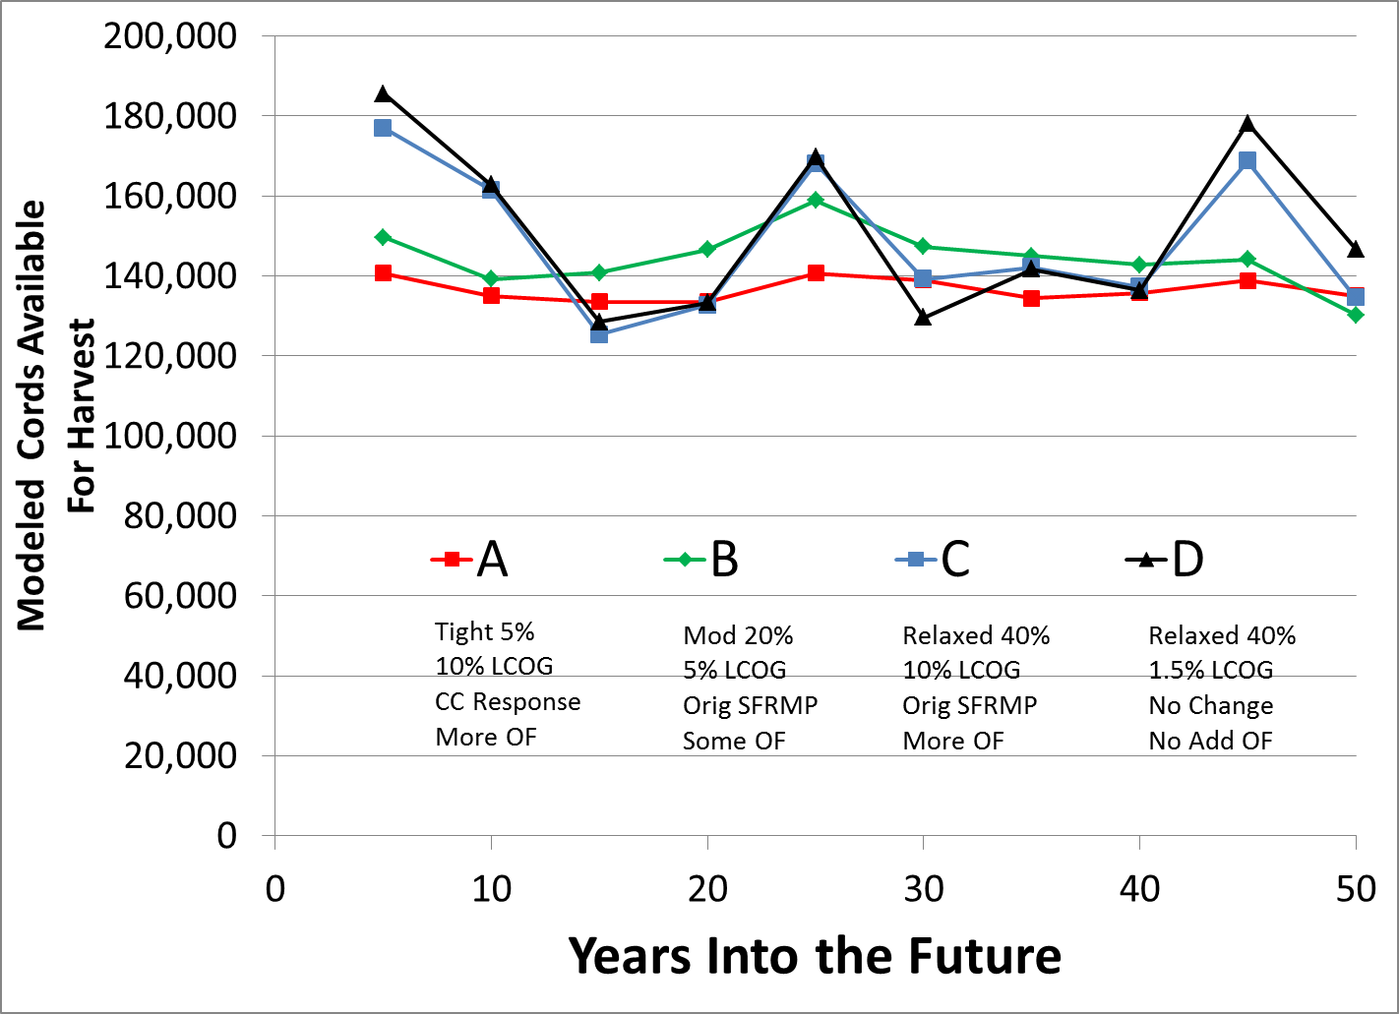
Scenario Modeling Outcomes for NSU:
Modeled Volume Available - All Species
Notes:
This projects “Potential” harvest volume, again assuming that all data is accurate and that all stands selected would result in a harvest.
The overall projected potential harvest volume illustrates the over-riding influence of the “even-flow” parameter compared to other parameters, with the two scenarios with the most relaxed even flow (C and D) tracking closely throughout the modeling timeframe, clearly with more variability over time compared to the Scenarios A and B that had lower even-flow levels

Slide 23
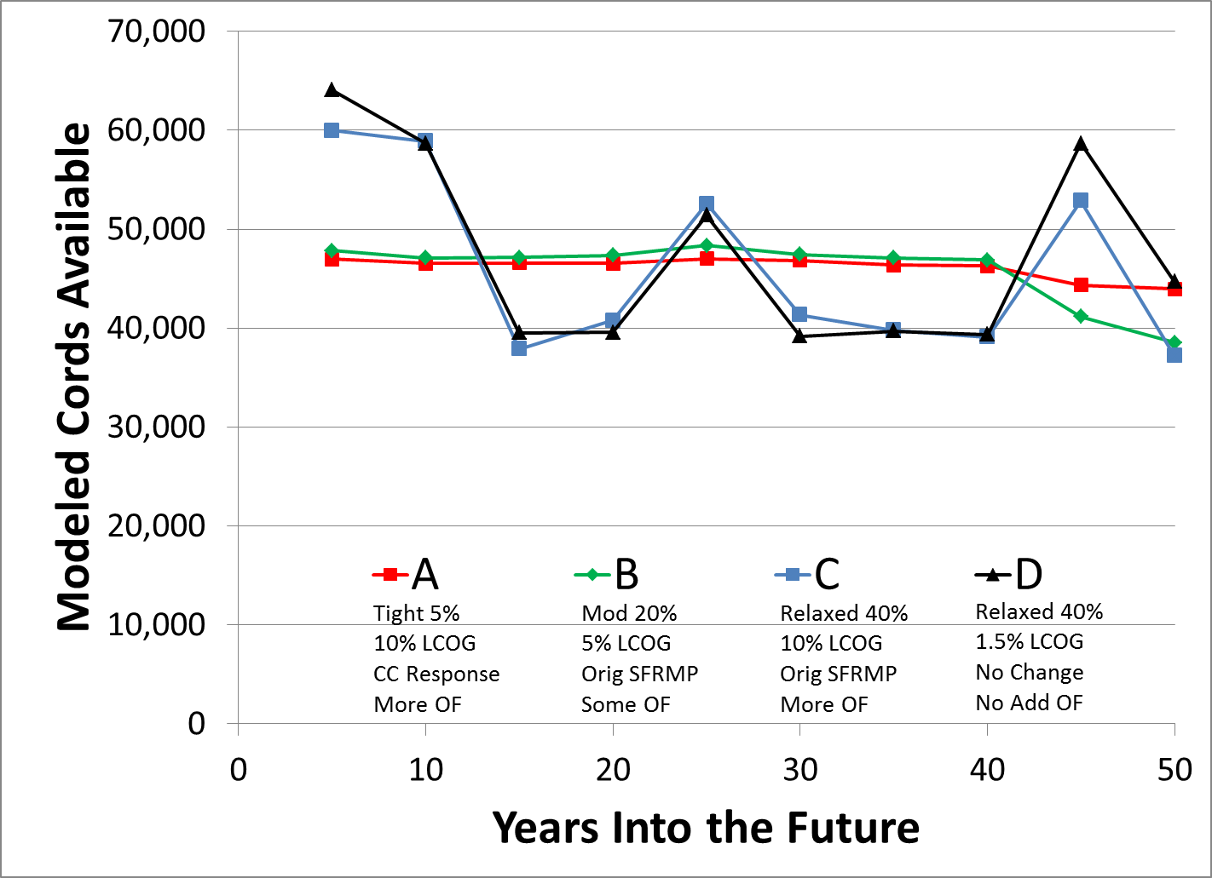
Example of Specific Tree Species:
Modeled Volume of Aspen
Notes:
This slide shows projected potential harvest volumes for just the Aspen species. Note again the influences of the even-flow parameter with lesser influences of the cover type change and older forest parameters. The LCOG parameter has little or no influence on Aspen harvest volumes (since there is little Aspen volume found in the lowland conifer cover types).
Relative declines seen in the last decade of the modeling period for scenarios B and C are likely due to the original SFRMP cover type change goals that have reduced the acres being regenerated to the Aspen cover type starting 40-50 years earlier.

Slide 24
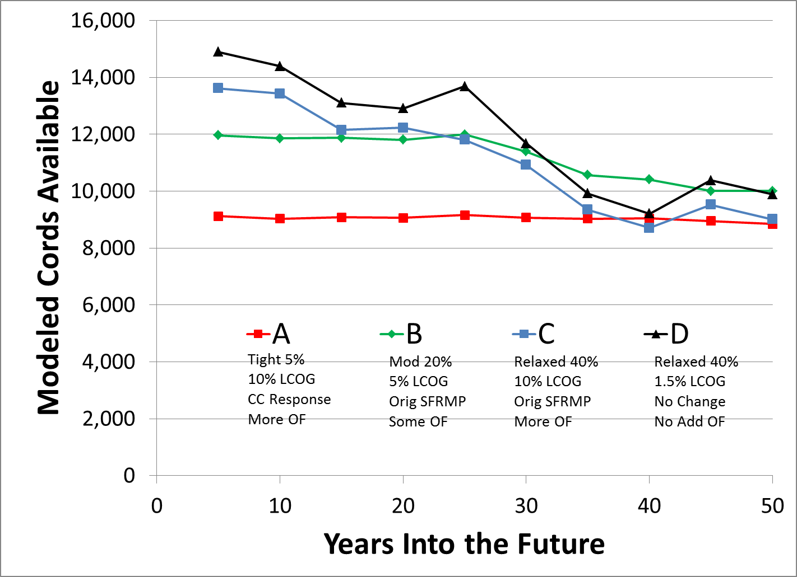
Example of Specific Tree Species:
Modeled Volume of Lowland Black Spruce
Notes:
This slide shows a couple of things.
Most obvious is the effect of the even-flow parameter has in combination with the current substantial amount of lowland black spruce that is beyond normal rotation age. With more relaxed even-flow (i.e., 40% and 20% in scenarios B, C and D) allow the model to select higher amounts of the BSL acres beyond rotation age across the first three to four decades, where as with “tight” even-flow (5% in scenario A), the model is limited on its ability to increase harvest of older BSL across the modeling period.
Secondary observation is the effect of higher LCOG (and to a much lesser extend older forest) in the difference between Scenarios C and D (both of which have even-flow at 40%).
There are additional modeled volumes for other tree species in the modeling report that I will mention later in the presentation.

Slide 25
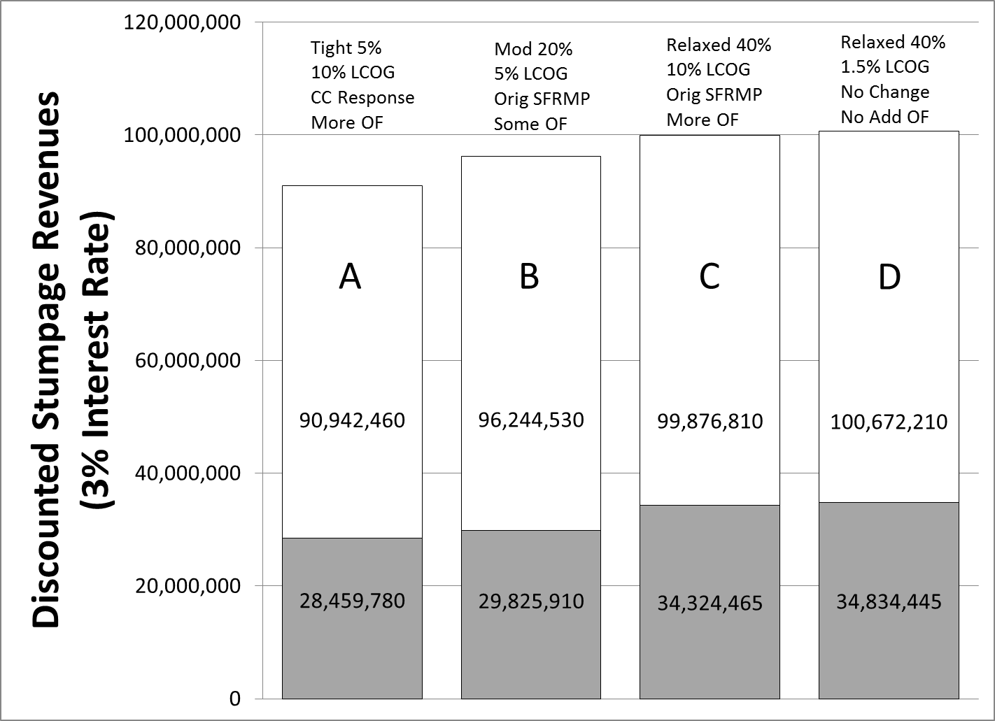
Scenario Model Outcomes for NSU:
Projected Stumpage Revenue in 10 & 50 Years
Notes:
This slide shows the estimated current (i.e., discounted) value of projected future timber stumpage revenues for each of the four scenarios
The results are shown (in current dollars) for both the first 10-year period and for the full 50-year modeling period.
The ten-year discounted revenues are the grey bars at the bottom..
These are projected timber stumpage revenues from all cover types/tree species included in the SFRMP modeling (i.e., all commercial forest types).
They do not represent various estimated economic multipliers associated with each cord of wood harvested or $ of stumpage value (output and value added, direct and indirect employment, state and local tax receipts) which show a much greater scale of economic impact (higher $$ amounts), but similar relative differences among the scenarios.
The relative progression in projected stumpage values among the four scenarios are similar in both the 10- and 50-year projections (but a different scales) with Scenario A producing the least revenue and D the most. However the % difference between the lowest (A) and highest (D) scenarios is greater in the first 10-years compared to the 50-year projections (22% between A and D in 10-year; vs 11% in 50-year)

Slide 26
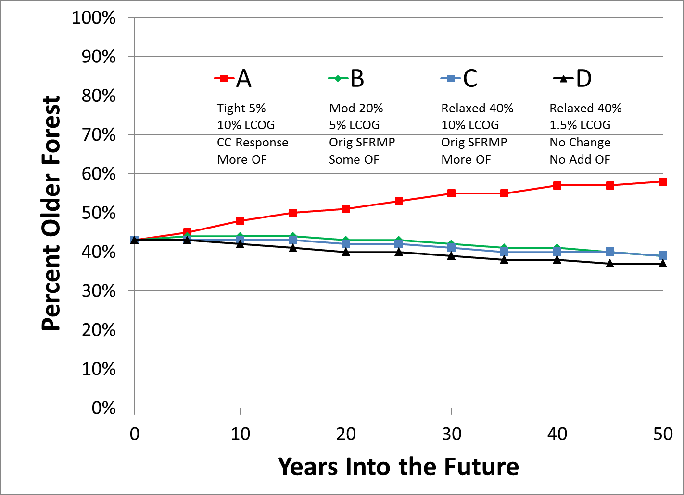
Scenario Model Outcomes for NSU:
Projected Older Forest % for Lowland Conifers
Notes:
The lowland conifer group presented in this slide includes productive (i.e., not stagnant) lowland black spruce, tamarack, and northern white cedar cover types.
Observations on this slide:
Even with the higher levels of lowland black spruce (BSL) harvests under scenarios B, C and D (shown in slide 24), the % of older lowland conifer forest decreases slightly (i.e., <5%) over the 50-year modeling period. This is likely due:
substantial acreages of the northern white cedar cover type from which little harvest is projected to occur (based on continuation of limited markets and difficulty in regenerating this type following harvest)
large amounts of BSL and tamarack that are currently beyond normal rotation age (NRA)
both of which offset or limit the effect of projected increased harvest levels in BSL on the amount of older lowland conifer forest.
Under Scenario A, the % of older lowland conifer forests increases by approximately 15% (again due to limited harvest in the NWC type, existing large amounts of BSL and Tamarack > NRA, lower projected harvest levels in BSL with the tight even-flow parameter, the higher level of LCOG, and assumed decreases in the lowland black spruce type in the response to climate change).

Slide 27
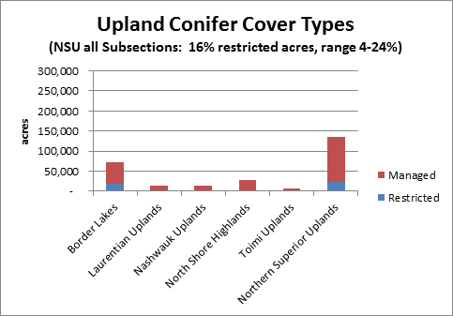
Managed Lands and Reserved Lands
Upland Conifer Types
Notes:
This slide illustrates a point made earlier that the projected outcomes don’t include all DNR forest lands. Specifically related to the upland conifer “older forest” outcome, there are many acres (approximately 16%) of upland conifer forests on DNR lands in the NSU section that are protected from harvest or have restricted harvest. These areas provide older forest on the landscape but are not included in the model.
Examples of these reserved or restricted harvest lands include: State Parks, SNAs, designated old growth.

Slide 28
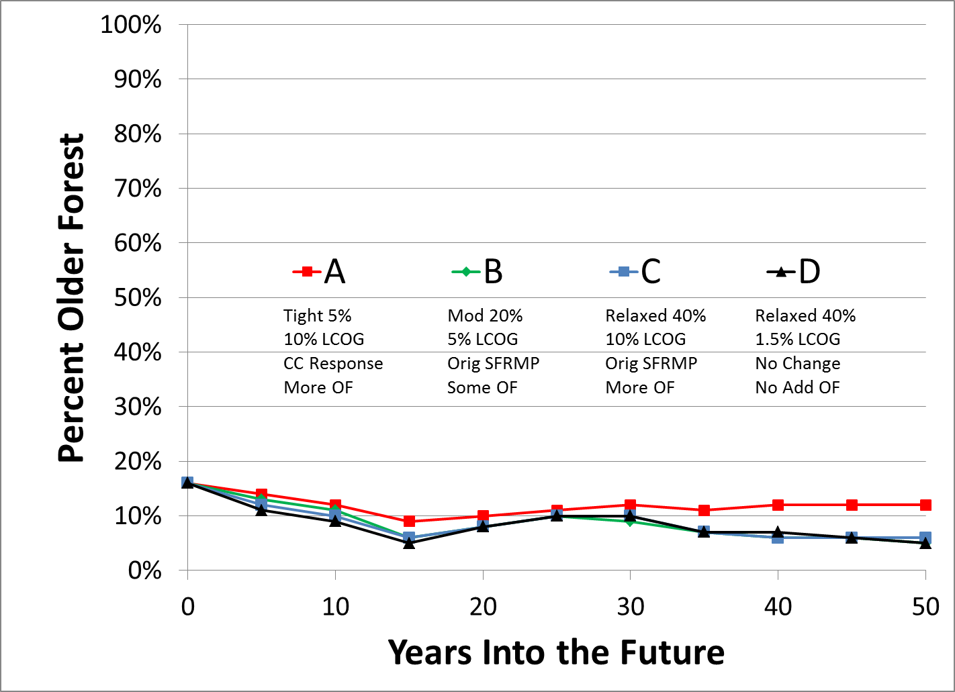
Scenario Model Outcomes for NSU:
Projected Older Forest % for Upland Conifers
Notes:
For the purposes of these outcomes, the Upland Conifer group includes upland conifer cover types that are managed primarily by even-aged silvicultural systems. These include:
Red pine (natural and planted combined)
Jack pine
Upland black spruce
Balsam fir, and
White spruce plantations.
It does not include white pine (which is managed primarily as a multi-aged cover type).
A couple observations:
Scenario A maintains a higher % of older upland conifer forest over the duration of the 50-year projection period (likely the result of the “tight” 5% even-flow, but also the “more” older forest parameter specifically for jack pine and white spruce plantations).
Some relatively small differences (<5%) among Scenarios B, C, and D in the first 15 years, but very little difference from then on out.

Slide 29
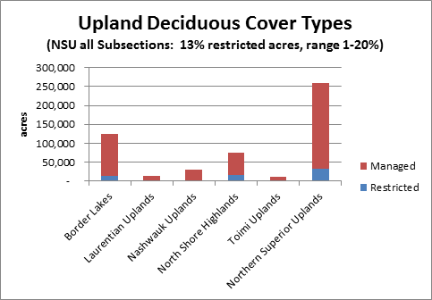
Managed Lands and Reserved Lands
Upland Hardwood Types
Notes:
This slide illustrates again a point made earlier that the projected outcomes don’t include all DNR forest lands. Specifically related to the upland hardwood “older forest” outcome, there are many acres (approximately 13%) of upland hardwood forests on DNR lands in the NSU section that are protected from harvest or have restricted harvest. These areas can provide older forest on the landscape but are not included in the model.
Examples of these reserved or restricted harvest lands include: State Parks, SNAs, designated old growth.

Slide 30
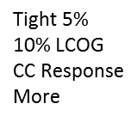
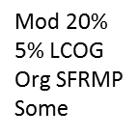
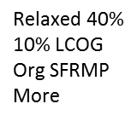
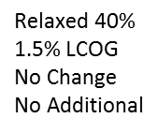
Scenario Model Outcomes for NSU:
Projected Older Forest % for Upland Hardwoods
Notes:
In reviewing this outcome, it is important to remember that it only reflects modeled outcomes for the aspen and birch cover types on DNR lands included in the SFRMP. There are other upland hardwood forests on DNR lands and other ownerships (see previous slide and caveats on slide 20).
Observations:
There is roughly a 5% or less spread among the four scenarios in the first 30 years. Tighter after that.
Early differences likely due primarily to variations in even-flow.
Later convergence towards very low older forest % likely due to little additional older forest being proposed for Aspen and Birch in any of the scenarios (i.e., review of all ownership age-class data showed adequate amounts of older aspen/birch across all ownerships).

Slide 31
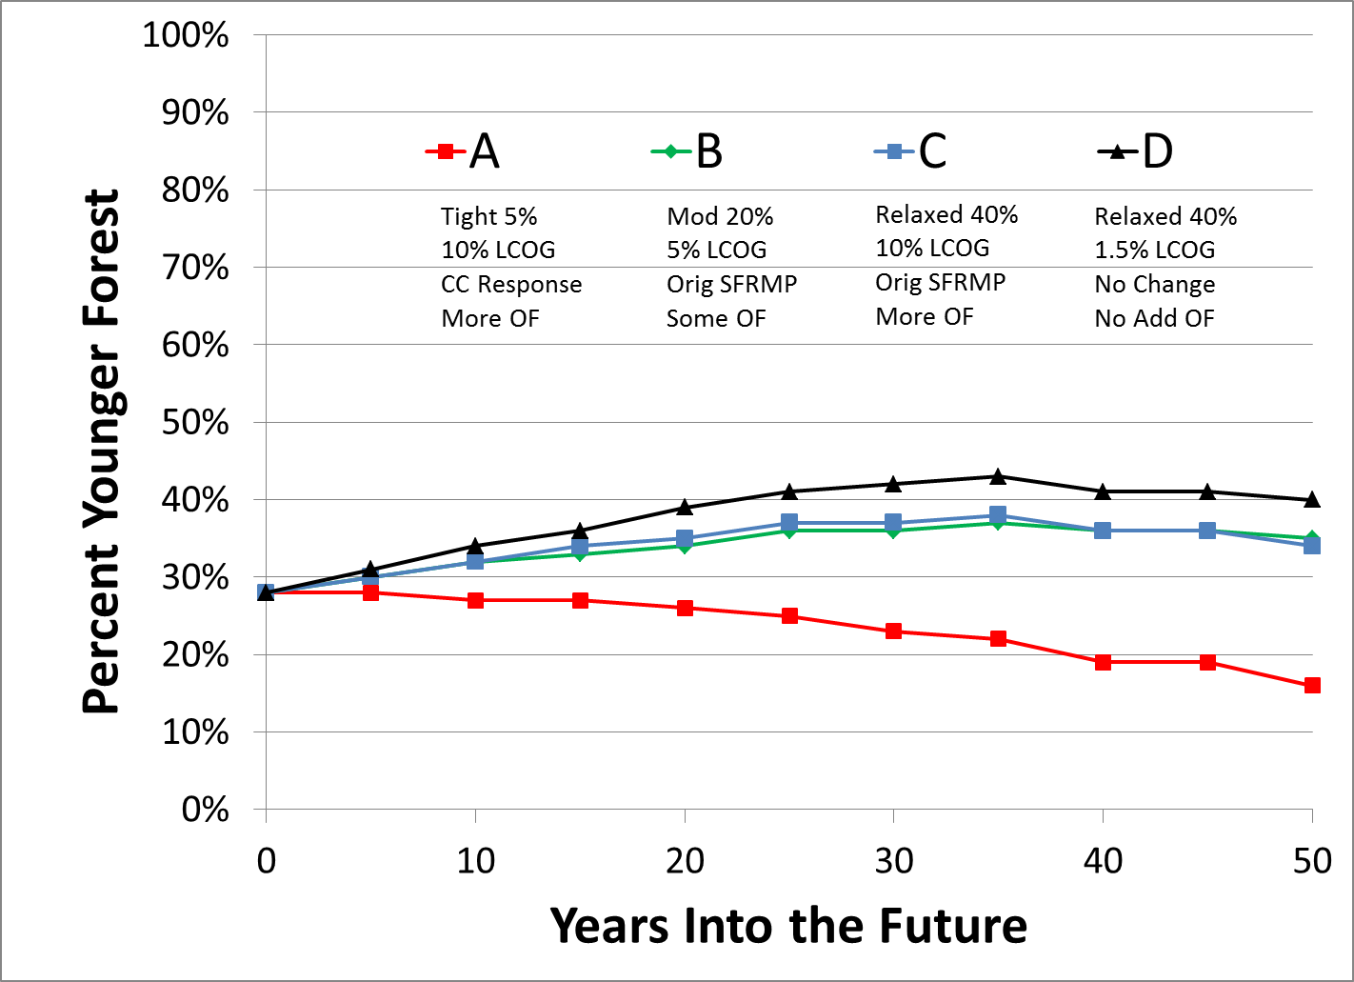
Scenario Modeling Outcomes for NSU:
Projected Young Forest % for Lowland Conifers
Notes:
This slide shows essentially the reverse of what was shown for lowland conifer older forest in slide 26.
A gradual increase in the amount of young lowland conifer forests in Scenarios B, C and D likely due to the projected higher harvest levels for lowland black spruce (BSL) with 20% or 40% even-flow (tempered by the acreage of N. White Cedar for which there is very limited projected harvesting, and higher LCOG amounts in Scenarios B and C).
A decline in young forest in Scenario A, likely due primarily to a combination of the lower levels of harvesting of BSL beyond normal rotation age due to a “tight” level (5%) of even-flow, the limited amount of harvesting in N. White Cedar, the higher LCOG amount, and assumed decreases in lowland black spruce in the response to climate change.

Slide 32
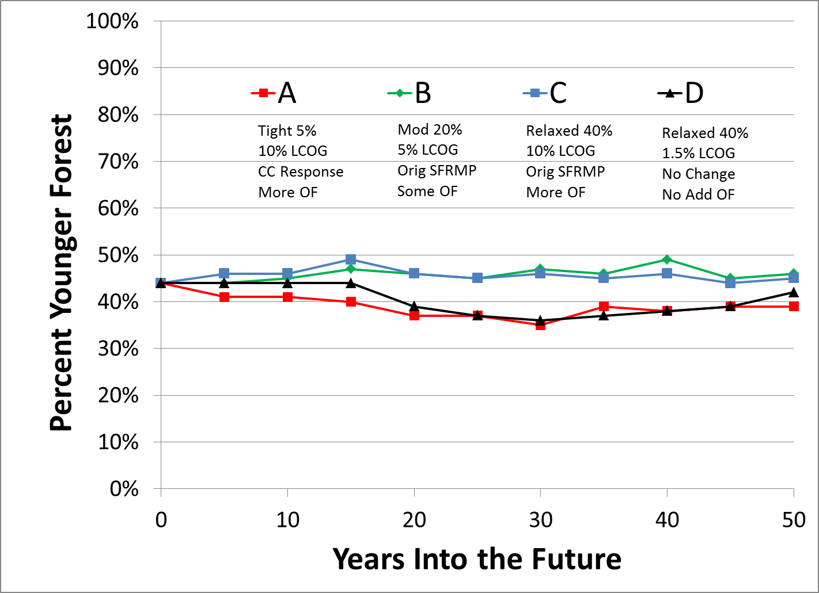
Scenario Model Outcomes for NSU:
Projected Young Forest % for Upland Conifers
Notes:
As noted previously, for the purposes of these outcomes, the Upland Conifer group includes upland conifer cover types that are managed primarily by even-aged silvicultural systems. These include:
Red pine (natural and planted combined)
Jack pine
Upland black spruce
Balsam fir, and
White spruce plantations.
It does not include white pine (which is managed primarily as a multi-aged cover type).
Observations:
Scenarios B and C show higher % of young upland conifers most likely due to higher levels of conversions to upland conifers in the Original SFRMPs (as opposed to No change in Scenario D, and an increase in some upland conifer types and a decrease in others under the climate change response of Scenario A).
In Scenarios A and D, the young forest % shows a gradual increase about 30 years out due to projected increases in the harvest of red pine and (to a lesser extent) jack pine (as older acres of these types are regenerated as young forest).

Slide 33
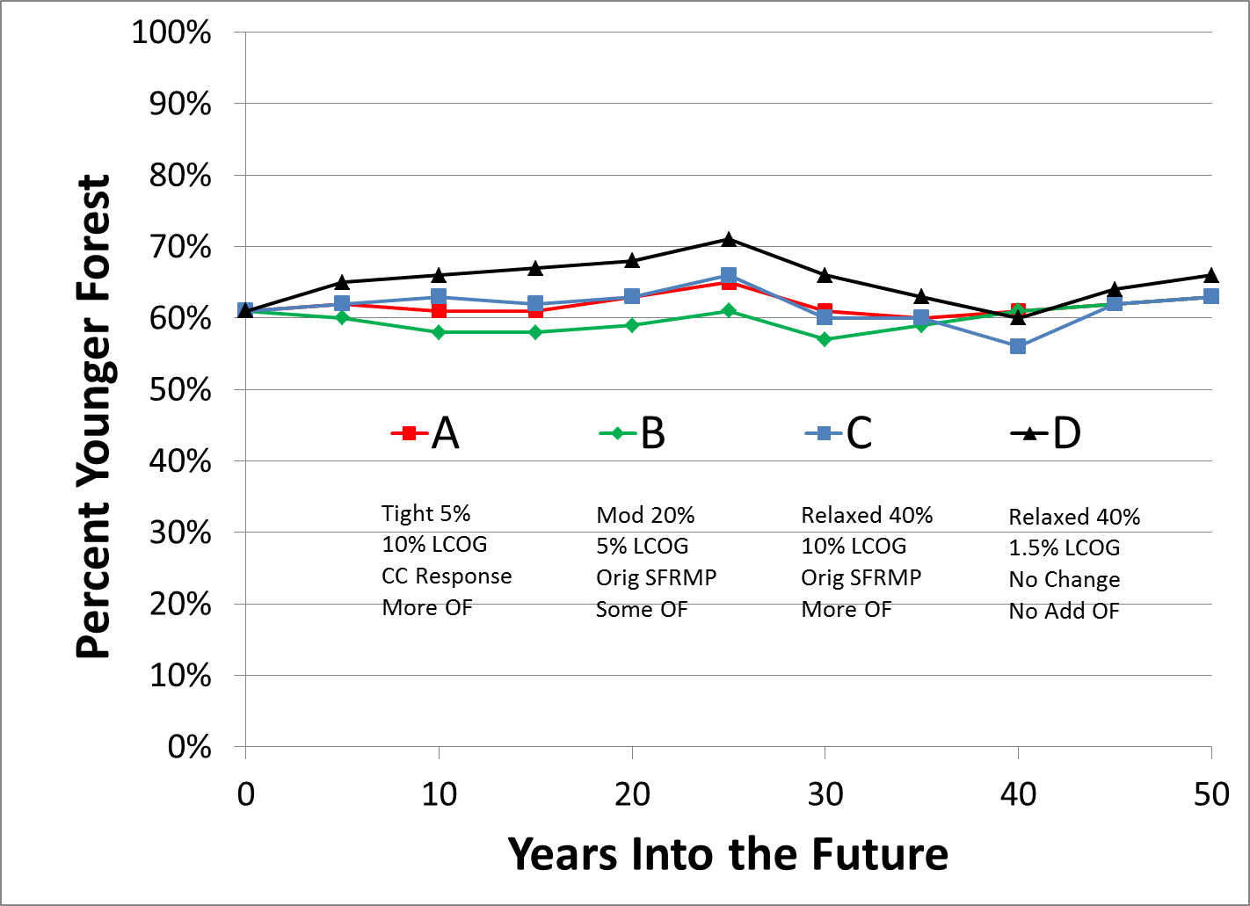
Scenario Model Outcomes for NSU:
Projected Young Forest % for Upland Hardwoods
Notes:
Again, it is important to remember that this chart only reflects modeled outcomes for the aspen and birch cover types on DNR lands included in the SFRMP.
Scenario D higher throughout likely due to no cover type change parameter.
Scenario A is relatively higher or the similar compared to Scenarios B and C likely due to little change (and even a slight increase) in Aspen/Birch under the response to climate change.
The Original SFRMP cover type change parameter included in Scenarios B and C projected substantial decreases in the Aspen/Birch cover types over the projection period.
With the young forest age being 30 and 35, and the normal rotation age being 45 and 60 for aspen and birch respectively, it is not surprising that the % young forests is hovering around the 60-65% range (30/45 = 67%; 35\60 = 58%).

Slide 34
Modeling Scenarios Report
This presentation summarizes analysis included in the report entitled “Description of the Northern Superior Uplands SFRMP Modeling”
The Modeling Scenarios Report was prepared by DNR’s Forest Modeler and is available as a technical background document (pdf file) at:
http://files.dnr.state.mn.us/forestry/subsection/nsu/sfrmp-nsu-modeling.pdf
Notes:
This report provides a greater level of detail than we are able to provide in the webinar format. Please use it to access species-specific data and charts and gain a deeper understanding of the future effects of the potential harvest scenarios.

Slide 35
Your Input
Comprehensive forest management results from balancing many interests, including yours.
Please complete the survey that follows, and comment on these parameters, scenarios and outcomes, so that your interests are considered.
All comments will be evaluated and considered as the NSU planning team prepares the draft NSU SFRMP

Slide 36
How to provide Your input
Complete the survey no later than October 17, 2015
See survey at:
    https://www.surveymonkey.com/r/TK3LSK2
    In addition to the survey, written comments may also be directed to: Lynn Sue Mizner, Minnesota DNR Forestry, 1200 Minnesota Avenue S., Aitkin MN 56431;
    or email to Lynn.Mizner@state.mn.us

Slide 37
SFRMP Contact
Minnesota DNR thanks you for your time and interest in the SFRMP process!
For questions on the NSU SFRMP and modeling scenarios contact:
Lynn Mizner
1200 Minnesota Ave., S.
Aitkin, MN 56431
Phone 218-429-3022
Email to lynn.mizner@state.mn.us

